Slide 1

State
of the
Charter Schools
Update SY 2024/2025
Moving Forward SY 2025/2026

Slide 2
OUR VISION
OUR MISSION
Oasis Charter Schools believes that everyone can succeed in a nurturing and secure learning environment with support from diverse and meaningful community partnerships.
Our mission is to create a K-12 system that educates students to be responsible, critical thinkers who are prepared to successfully compete in a dynamic global workforce.

Slide 3
STATE OF THE SCHOOLS STRATEGIC GOALS FY25
01
02
03
STUDENT ACHIEVEMENT
COMMUNITY ENGAGEMENT
CONTINUOUS IMPROVEMENT

Slide 4
STRATEGIC GOAL #1
STUDENT ACHIEVEMENT
Oasis Charter Schools will cultivate academic achievement using a rigorous and aligned curriculum that will provide all students the opportunity to master knowledge and
expand their learning

Slide 5
STRATEGIC GOAL #1
STUDENT TEST DATA: Proficiency and Gains

Slide 6

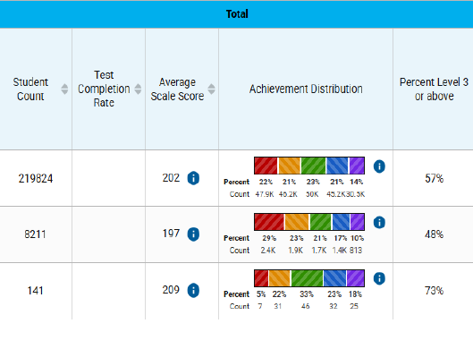
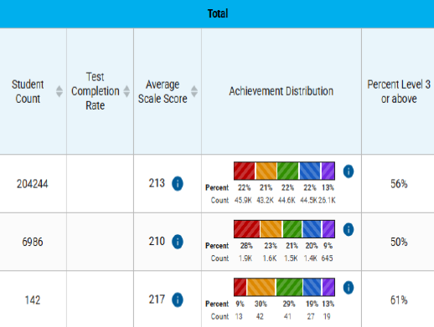
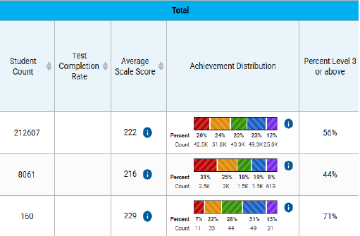
ELA Scores 2024 - 2025
Grade 3
Grade 4
Grade 5
STATE
DISTRICT
SCHOOL
Notes:
Changed teachers, added phonics program for low performers

Slide 7
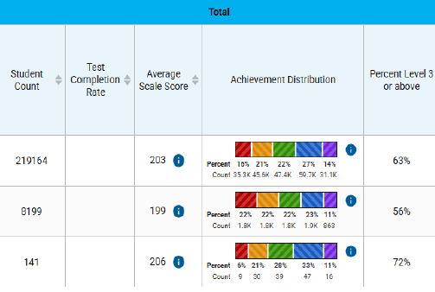
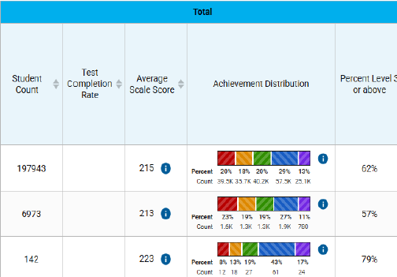
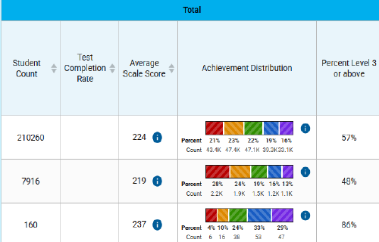
MATH Scores 2024 - 2025
Grade 3
Grade 4
Grade 5
DISTRICT
STATE
SCHOOL

Slide 8
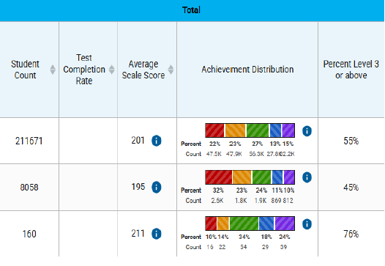
Science Scores 2024 - 2025
Grade 5
DISTRICT
STATE
SCHOOL

Slide 9

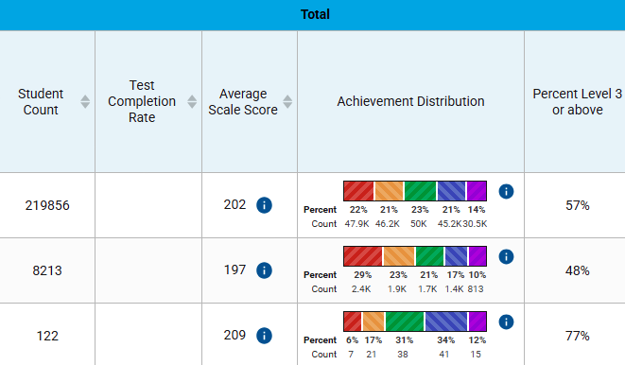

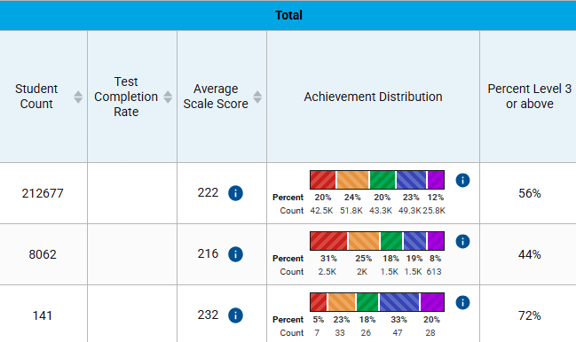
ELA Scores 2024 - 2025
Grade 3
Grade 4
Grade 5
DISTRICT
STATE
SCHOOL

Slide 10
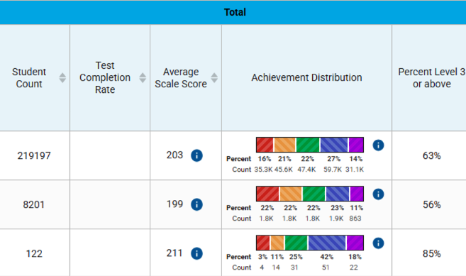
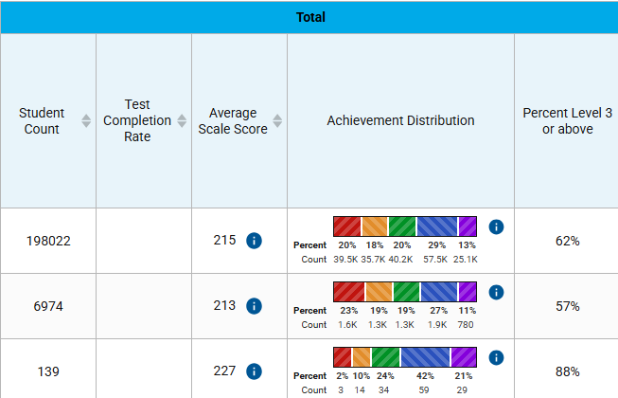
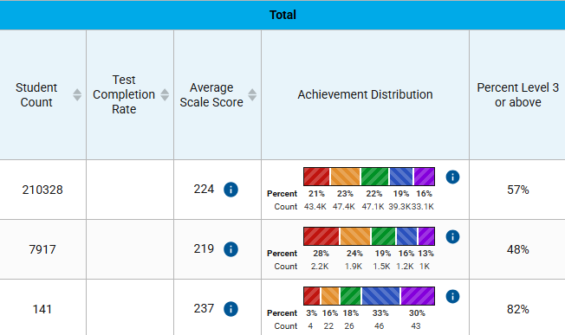
MATH Scores 2024 - 2025
Grade 3
Grade 4
Grade 5
DISTRICT
STATE
SCHOOL

Slide 11
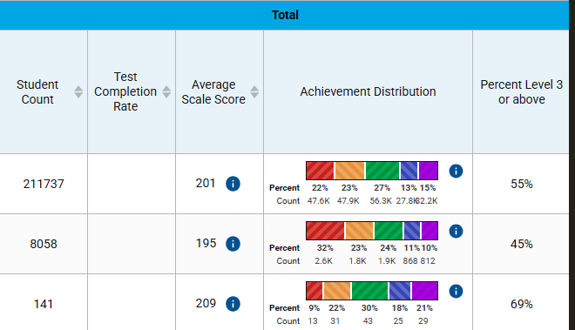
SCIENCE Scores 2024 - 2025
Grade 5
DISTRICT
STATE
SCHOOL
Notes:
UP 5% from last year – for 2nd year in a row has science special in addition to STEM special to reinforce science concepts

Slide 12

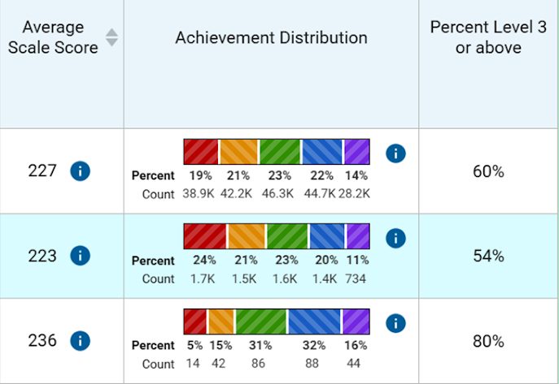
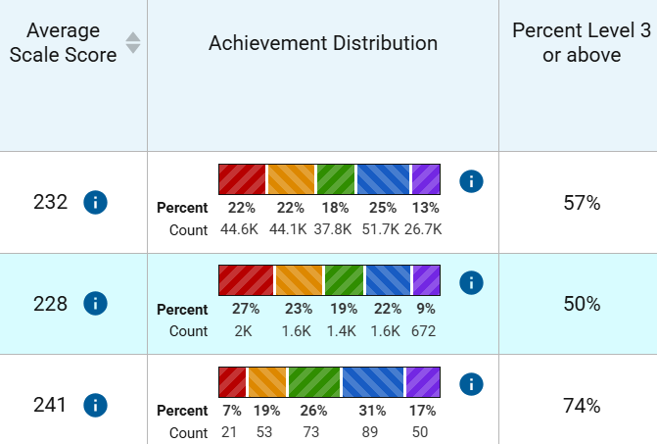
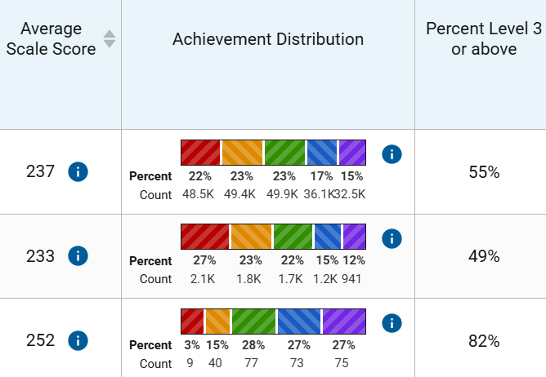
ELA Scores 2024 - 2025
Grade 6
Grade 7
Grade 8
DISTRICT
STATE
SCHOOL

Slide 13
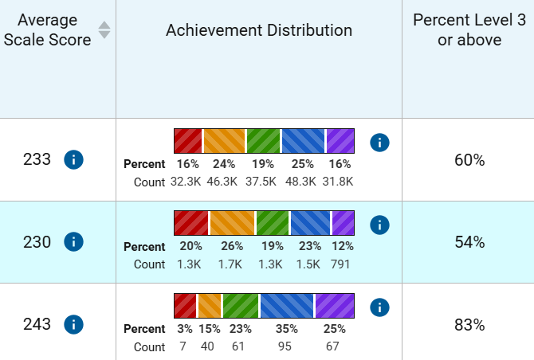
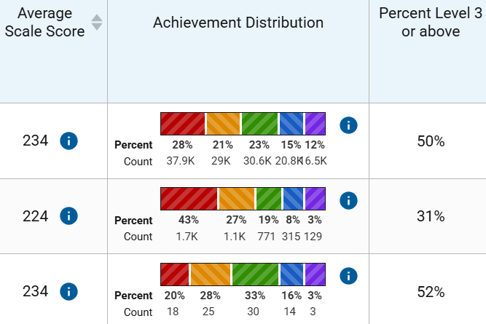
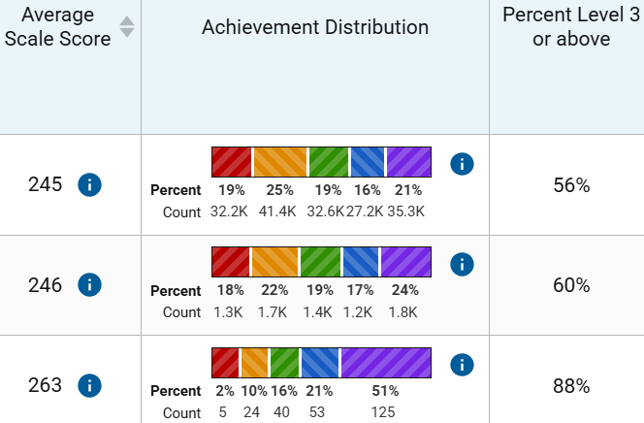
MATH Scores 2024 - 2025
Grade 6
Grade 7
Grade 8
DISTRICT
STATE
SCHOOL
Notes:
Grade 7 math igenerally consists of lower performing students. Grade 6 students that excel go to Grade 8 math grade 8 math go to pre algebra. Have 2 teachers teaching smaller groups in grade 7 math

Slide 14
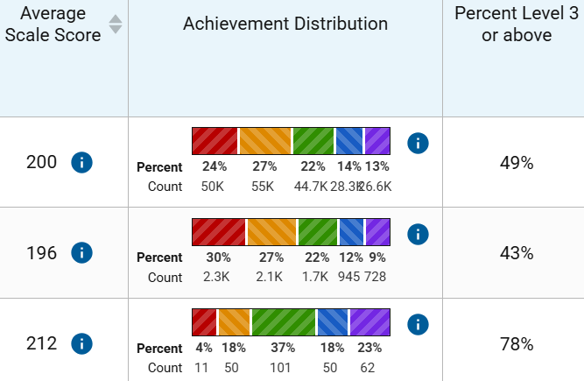
SCIENCE Scores 2024 - 2025
Grade 8
DISTRICT
STATE
SCHOOL

Slide 15
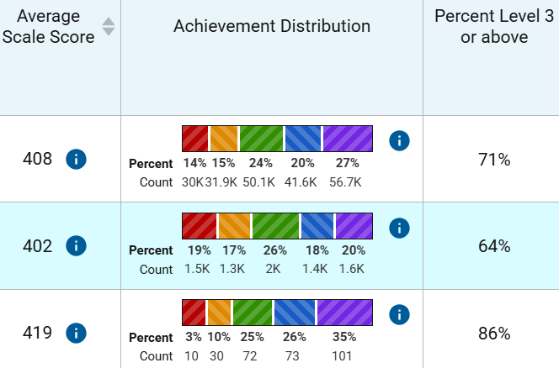
Civics Scores 2024 - 2025
Grade 7
DISTRICT
STATE
SCHOOL

Slide 16
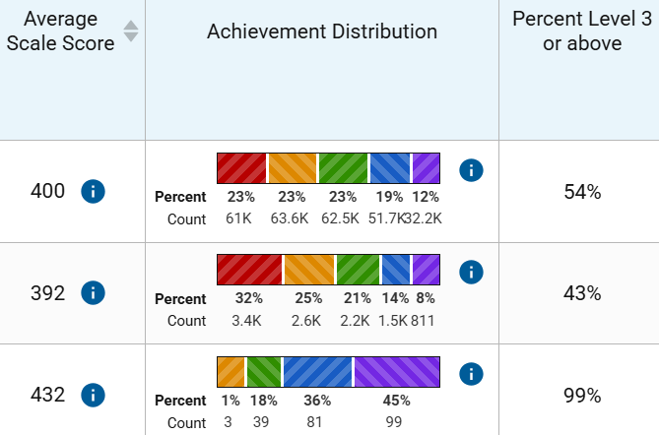
Algebra Scores 2024 - 2025
Grade 8
DISTRICT
STATE
SCHOOL

Slide 17

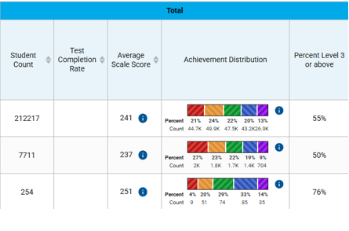
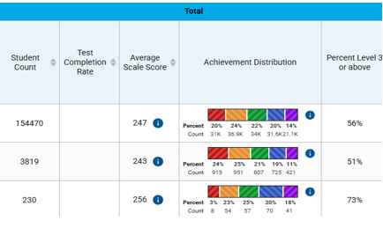
ELA Scores 2024 - 2025
Grade 9
Grade 10
DISTRICT
STATE
SCHOOL

Slide 18
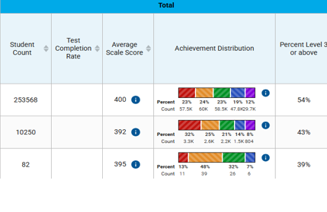
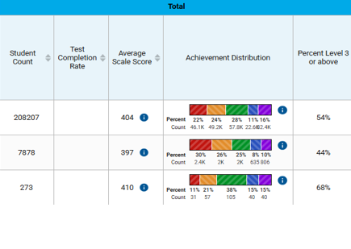
MATH Scores 2024 - 2025
Algebra
Geometry
DISTRICT
STATE
SCHOOL
Notes:
Those that did not take pre algebra take algebra. Those that took Pre algebra take geometry. New teachers this year in both areas.

Slide 19
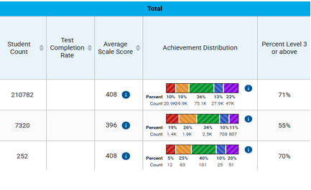
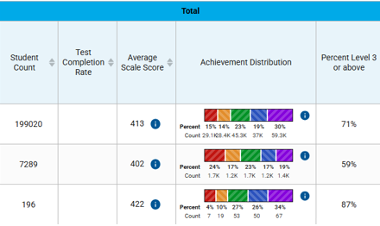
Scores 2024 - 2025
Biology
US History
DISTRICT
STATE
SCHOOL

Slide 20
OHS Gains/Cambridge Testing Highlights 2024 - 2025
School Grade Components
Cambridge Testing Highlights
Category | 23-24 Points | 24-25 Points | 24-25 District/State | Oasis Increase/ Decreases | 25-26 Points
ELA Achievement | 77 | 75 | 50/55 | -2
ELA Learning Gains | 61 | 60 |  | -1
ELA LG of Lowest 25% | 58 | 70 |  | +12
Math Achievement | 61 | 61 | 43/54 | =
Math Learning Gains | 36 | 35 |  | -1
Math LG of Lowest 25% | 38 | 23 |  | -15
US | 76 | 89 | 59/71 | +13
Biology | 75 | 71 | 55/71 | -4
Acceleration (1 year behind) AICE/Dual Enrollment/Industry Certification | 72 | 63 | 67/ | -9 | 94/+31
Grad Rate (1 year behind) | 99 | 99 | 86/89 | = | 100/+1
Total | 653 | 646 |  | -7
Diploma Requirements: One Test Required from Groups 1/2/3 Optional 2 Courses Five Categories/ 7 Exam Series = AICE Diploma | 2024 % Passed | 2025 % Passed | Number Tested
Group 1/ Math & Science Chemistry Environmental Management (Group 1 or 3) Mathematics Physics Psychology (Group 1 or 3) | 11 69 26 18 69 | N/A 72 23 20 62 | 0 103 81 26 51
Group 2/ Languages English Language Spanish Language | 78 89 | 76 86 | 114 7
Group 2/ Humanities International History Literature in English US History Music | 40 80 80 100 | 40 69 81 N/A | 114 186 86 0
Interdisciplinary and Skills based Subjects Thinking Skills English General Paper (Gen Ed 78%/ AICE 100%) Required: Global Perspectives Travel and Tourism | 82 80 100 N/A | 75 90 99 13 | 117 103 91 31
Total Tested Total Passes Cambridge Diplomas | 1152 801/70% 66 | 1207 836/69% 62
OASIS HIGH SCHOOL IS A SCHOOL OF EXCELLENCE

Slide 21


GOAL#1: Student Achievement
OASIS ELEMENTARY SOUTH IS A SCHOOL OF EXCELLENCE
OES | Points | Gains
Grade 3 ELA Achievement | 73 | -4
ELA Achievement | 69 | -6
ELA Learning Gains | 62 | -8
ELA LG of Lowest 25% | 51 | -3
Math Achievement | 80 | -2
Math Learning Gains | 73 | -6
Math LG of Lowest 25% | 64 | -1
Science | 76 | same
Total | 548 | -30
Notes:
492 points needed for an A grade

Slide 22

GOAL#1: Student Achievement
OASIS ELEMENTARY NORTH IS A SCHOOL OF EXCELLENCE
Oasis Elementary North | Points | Gains
ELA 3rd Grade Achievement | 78 | +1
ELA Achievement | 75 | +4
ELA Learning Gains | 67 | +11
ELA LG of the Lowest 25% | 63 | +9
Math Achievement | 85 | +1
Math Learning Gains | 74 | -3
Math LG of Lowest 25% | 63 | -9
Science | 69 | +5
Total | 574 | +38

Slide 23

GOAL#1: Student Achievement
OASIS MIDDLE IS A SCHOOL OF EXCELLENCE
Oasis Middle School | Points | Gains
ELA Achievement | 78 | +10
ELA Learning Gains | 69 | +10
ELA LG of the Lowest 25% | 66 | +13
Math Achievement | 86 | +4
Math Learning Gains | 77 | +5
Math LG of Lowest 25% | 74 | +10
Science Achievement | 78 | +16
Civics Achievement | 87 | 0
Acceleration | 91 | +13
Total | 706 | +81

Slide 24
STRATEGIC GOAL #1
1.1 Align K-12 Measurable Curriculum
1.2 Provide Innovative Curriculum to promote high academic performance
1.3 Integrate Resilience learning
1.4 Develop Professional Teaching Corps

Slide 25

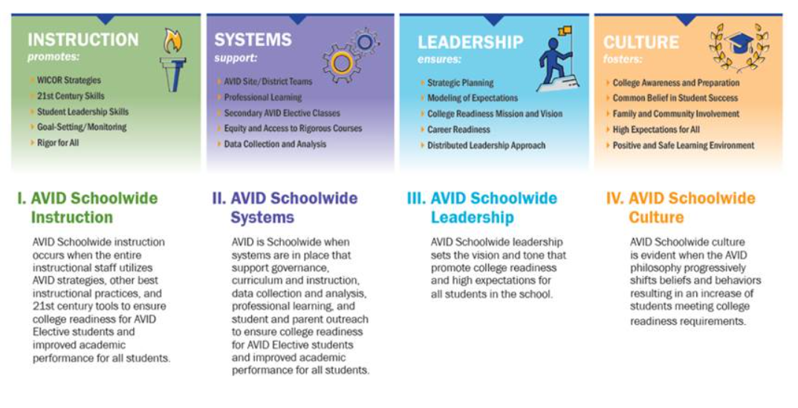
How do we go from “Great to Exceptional” academically?
  Universal approach to teaching and learning as a system​
  Strategic focus on professional development​
  Commitment of minimum 3-5 years in staff development & implementation​
  Laser Focus on Instruction, Systems, Leadership and Culture
Notes:
2nd year of implementation, system wide approach

Slide 26
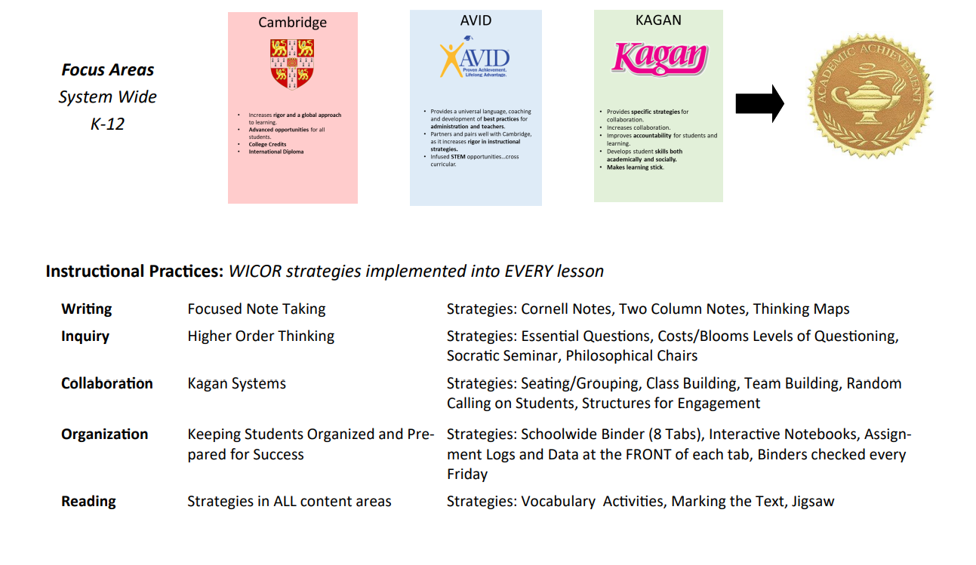

Slide 27
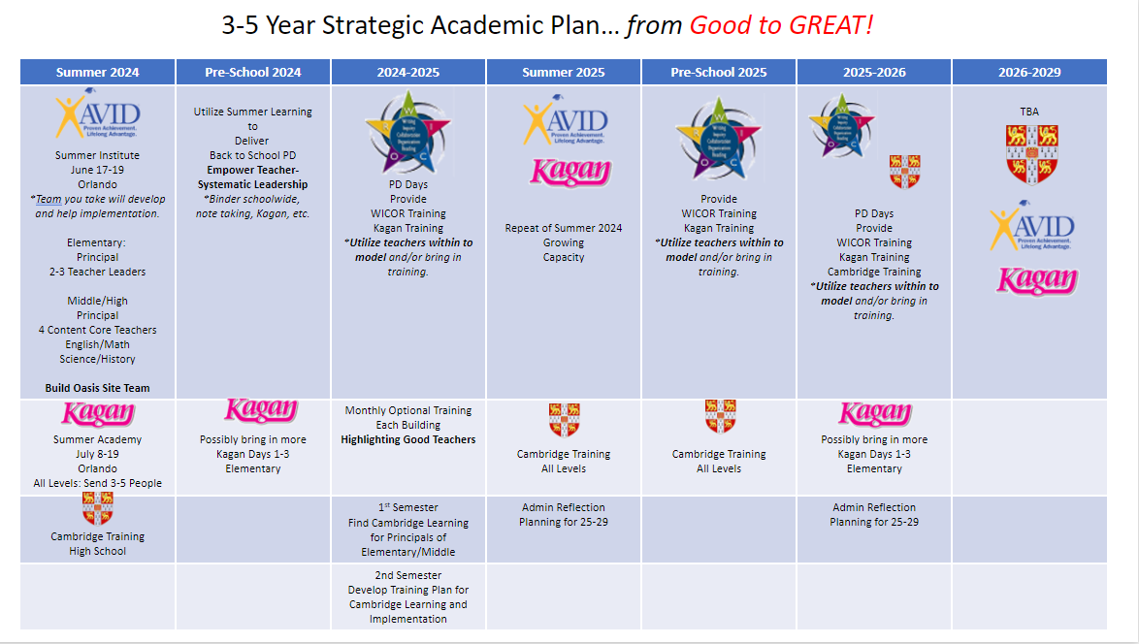

Slide 28
STRATEGIC GOAL #2
CONTINUOUS IMPROVEMENT
Oasis Charter Schools will identify, recruit and retain high caliber educators by offering a competitive salary, shared educator values and opportunities for professional development

Slide 29
STRATEGIC GOAL #2
2.1 Recruit and Retain Qualified Staff
2.2 Educator Development

Slide 30
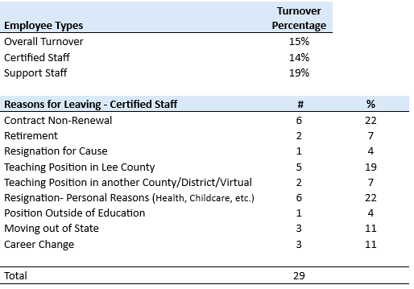
Charter Schools Workforce 24/25 - TEACHERS
FY24: 17.43% turnover rate
FY 25: 14% turnover rate
Notes:
110 teachers

Slide 31
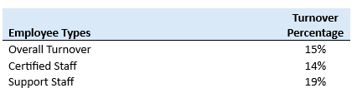
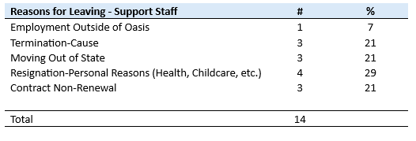
Charter Schools Workforce 24/25 - SUPPORT
FY24: 17%
turnover rate
FY 25: 19% turnover rate

Slide 32

Employee Compensation
Employee Compensation and Classification System Study FY 25:
Total cost to system for salary increases :$1,458,500
Bonus amounts FY 25: $725,450
  (Holiday bonus and Longevity Bonus from reserves)
School Recognition Bonuses: $462,526 (from state)

Slide 33
Professional Development for Teachers
AVID Training
Kagan Training
Learning and the Brain; Teaching Stronger Brains
UF Micro credential; AI in classrooms
UF Micro credential; Intro to Computer Science and Computational Thinking
ISTE+ASCD; Generation AI
Cambridge: (AICE)
ITEEA (STEM)
Makerpalooza STEM; SW Fla Library Network
STEM Institute for Teachers FGCU
55% of instructional staff attended professional development in FY 25
100% administrative staff attended professional development in FY 25
100% of staff received training on AVID/Kagan instructional strategies
Notes:
110 teachers/administrators attended trainings last year. Roughly 55% attended PD last year.

Slide 34
STRATEGIC GOAL #2
2.3 Refine Educator Evaluation Process
2.4 Develop Workforce Pathways

Slide 35
Evaluations
Transition to Danielson framework – Replaced Marzano model with Danielson to better align teacher evaluations with AVID instructional strategies and leadership abilities.
Support staff evaluations standardized – All evaluations now consistently include key components: job-related competencies, specific tasks from job descriptions, qualitative performance review, and an overall rating.
PowerSchool as evaluation hub – All evaluations will be housed and managed in our PowerSchool digital platform.

Slide 36
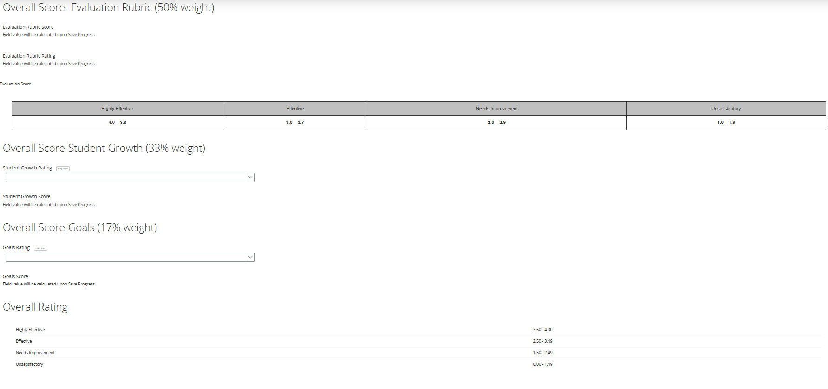
Notes:
Marzano was cumbersome to navigate, too lengthy for efficiency purposes. Evaluation patterns suggest that the Marzano model’s student engagement component may disproportionately contribute to higher performance ratings.” “The Danielson evaluation model addresses this issue by basing high performance ratings on teachers’ demonstrated leadership actions.”

Slide 37
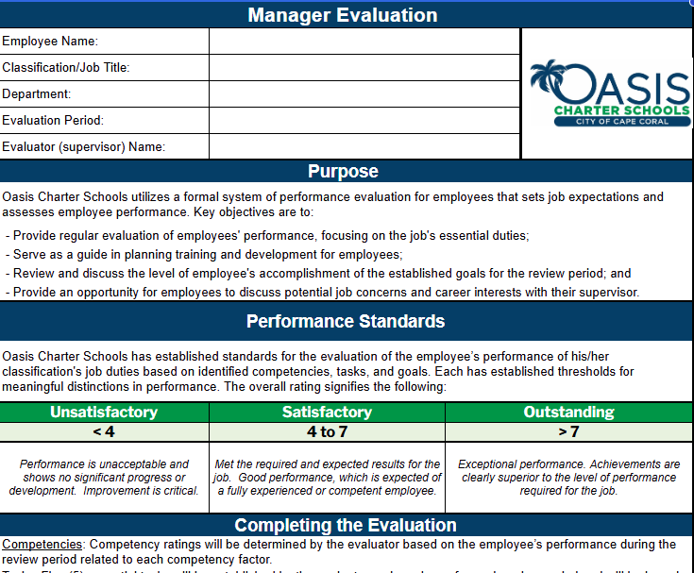
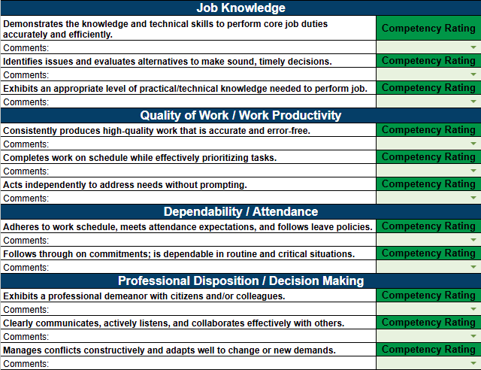
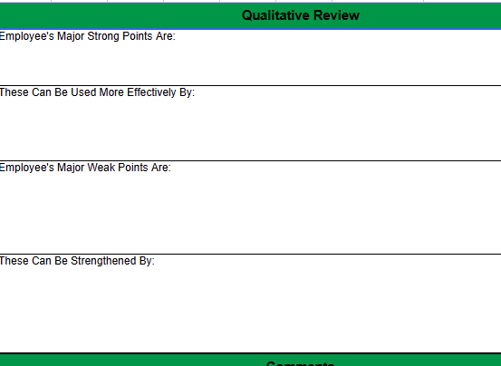
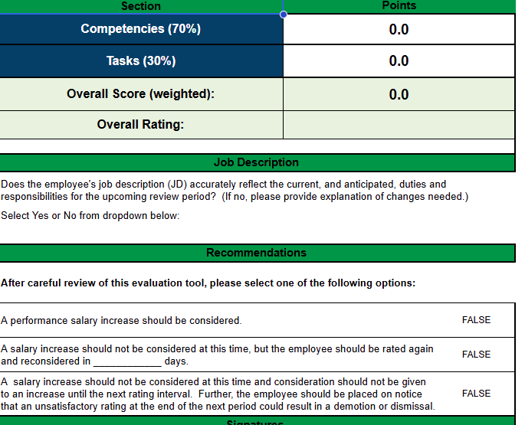
Support Staff Evaluation

Slide 38
Work force pathways
Annual Job Fairs
Annual College Fairs
Certifications that lead to work force readiness by area:
Illustrator – 17
Photoshop – 23
Entrepreneurship – 5
Adobe Certified Professional in Visual Design - 12
ServSafe (certified Food Protection Manager) - 13
Autodesk Certified User Fusion 360 - 8
Unity Certified User: Artist - 6
Career Day
Career’s Class

Slide 39
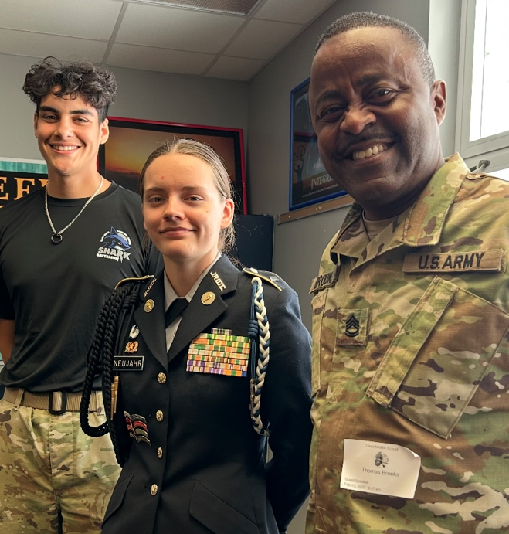
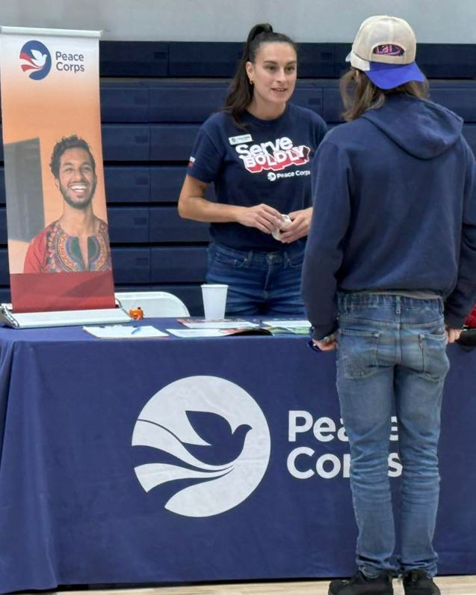
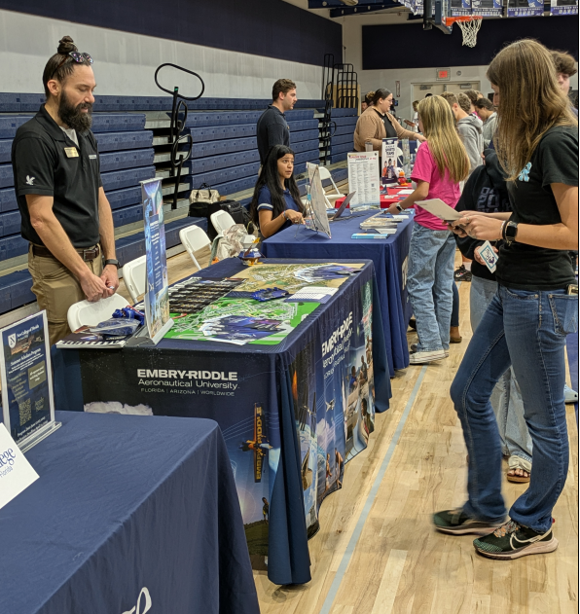
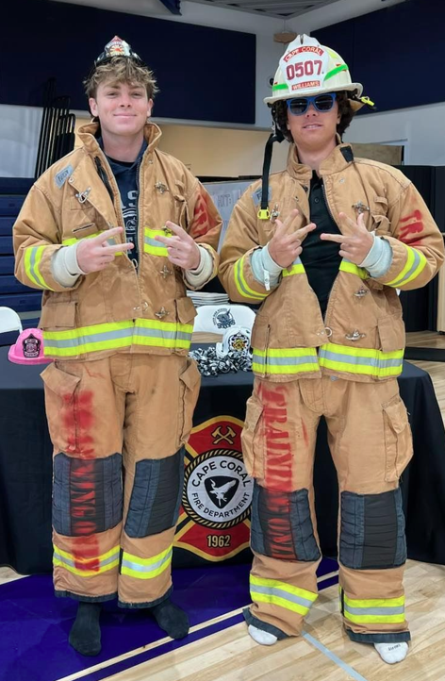
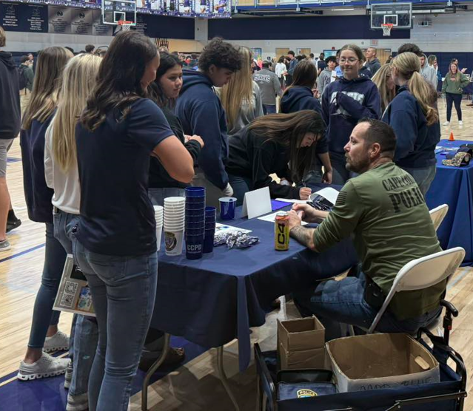
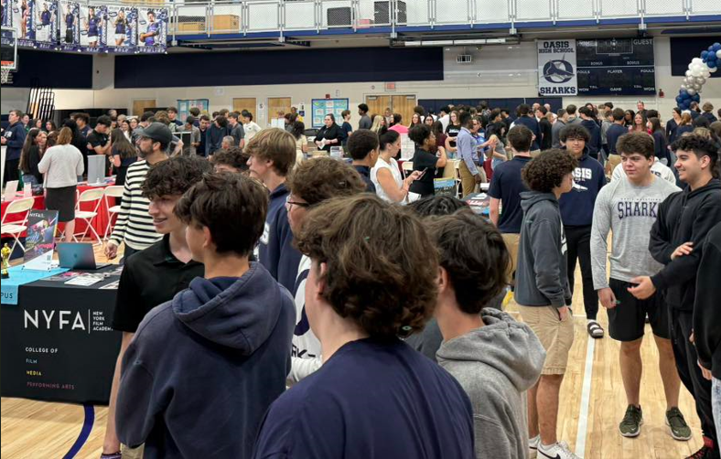
Work force pathways

Slide 40
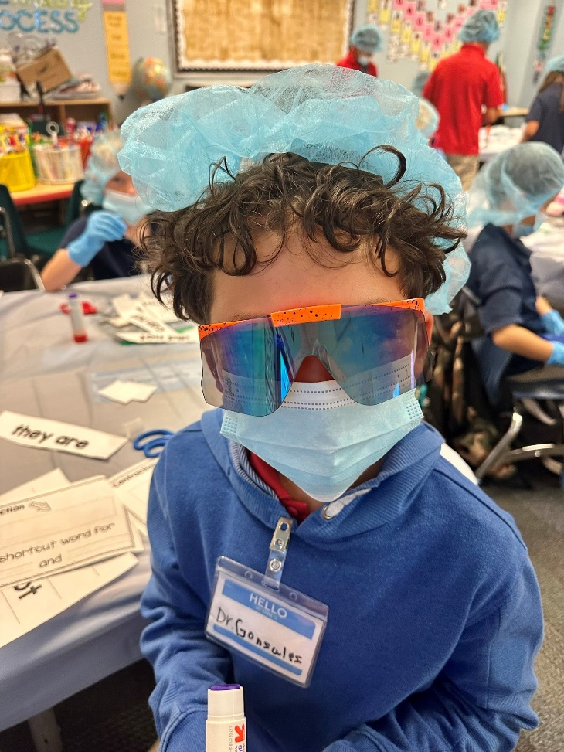
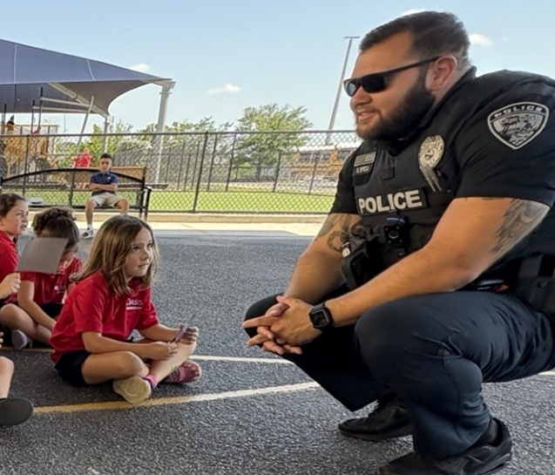
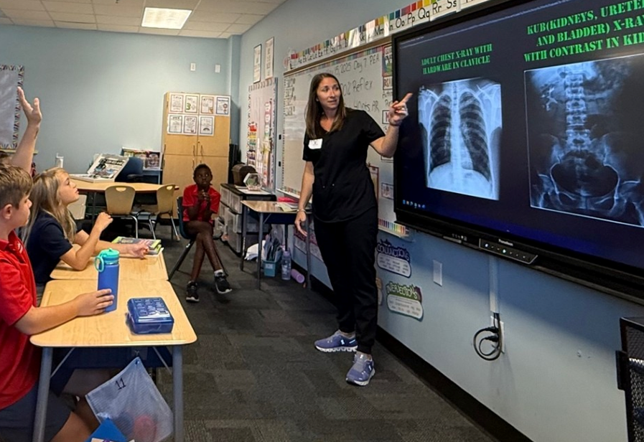
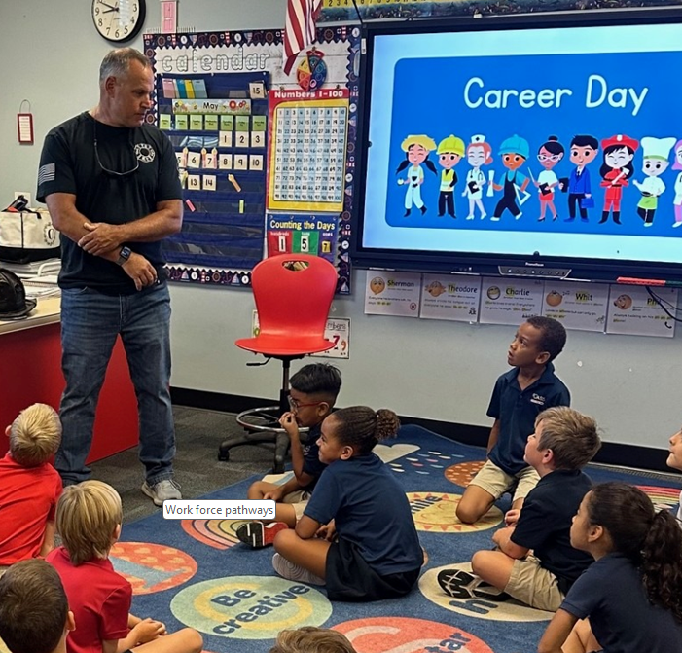
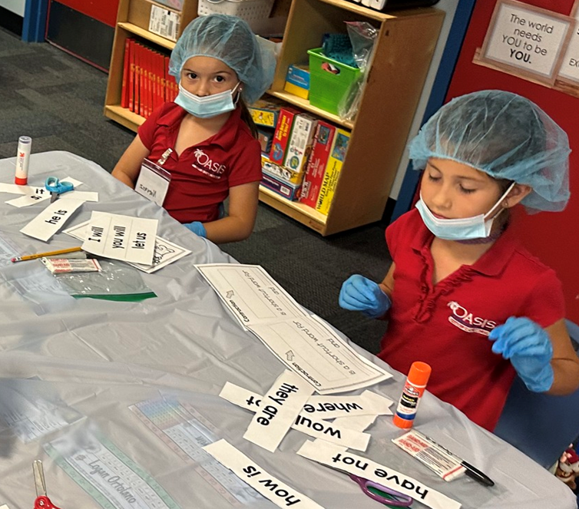

Work force pathways

Slide 41
STRATEGIC GOAL #3
COMMUNITY ENGAGEMENT
Oasis Charter Schools will nurture alliances with community partners who share the same vision, mission and commitment to the community at large.

Slide 42
STRATEGIC GOAL #3
3.1 Brand Expansion
3.2 Cultivate Economic Allies
3.3 Increase Parent Involvement Support
3.4 Develop Funding Support

Slide 43




Branding Action Plan
Protect and Promote Brand:
Service mark logo
Developing governing board logo
Use of tagline
Make the brand experience consistent:
Unified messaging (customer service response)
Unified electronic signature
Consistency in use of logos
Boost community presence
Community alliances with companies that have similar values.
Social Media Platforms posted by school admin/athletics/PTO’s
Branding is the art and science of shaping how people think and feel about you.
Notes:
Logo is unique to us (O and palm tree). We own it. Service marking will give us legal protection to our image and name. We can control how it is used, who is able to use it , etc.

Slide 44


Parent Volunteer Opportunities OES FY 25
Parent Volunteer Opportunities OEN FY 25
OES logged approximately 7446 Parent volunteer hours:
  Boosterthon
  Trunk o’ Treat
  Fall Fest
  PTO Events
  Classroom Parties
  WatchDogs
  Book Fairs
  Field Day
  Jingle Jog
  Turkey Trot
  Read Across America
  Career Day
  Classroom Activities
  Donuts with Santa
  Field Trips
  Curriculum Nights
OEN logged approximately 8050 Parent volunteer hours:
  Boosterthon
  Trunk o’ Treat
  Fall Fest
  PTO Events
  Halloween Parade
  Parent/teacher Conferences
  Book Fairs
  Candy Cane Lane
  Lunch Room Volunteering
  WatchDogs
  Mother/Son Dance
  Father/Daughter Dance
  Water Day
  Classroom Parties
  Field trips
  Curriculum Nights

Slide 45


Parent Volunteer Opportunities OMS FY 25
Parent Volunteer Opportunities OHS FY 25
OMS Parent volunteer opportunities:
  Athletic Games/Concessions
  Gator Jog
  Winter Dance
  8th Grade Dance
  Drama/Musical Production
  Lunch Duty
  PTO Events
  Fall Fest
  Open House
  Band/Choral Concerts
  Career Day
OHS Parent Volunteer Opportunities:
  Athletic Events: Ticket Takers/music DJ/Announcer/general attendance
  School Advisory Committee
  Theater Trips
  Drama Production Assistance
  Homecoming Dance
  Athletic Boosters: Concessions/tickets/fundraisers
  All sports: cook and provide pre-game meals, assist with travel
  Senior Night Organization/fundraising
  Open House

Slide 46

Funding Opportunities FY 25
Partnerships
Preparing for CPA grant – Culinary Remodel $59,000 (initial preparation)
FDA Grant Food Services $1.2M
(initial preparation)
Google Grant – STEM/AI $20,000
IncredibleBank sponsor of Elementary Robotics Competition $ 3,000
Gunterberg Foundation – STEM $70,000
Rist Foundation $30,000
Francis Dewing Foundation $ 5,000
Glenn W. Bailey $20,000
OHS Booster Club $45,736
The Rist Family Foundation
The Gunterberg Foundation and Culliton Family
IncredibleBank
Florida Gulf Coast University
Florida Southwestern State College
Keiser University
Full Sail University
The Cape Coral Municipal Charter School Foundation
Frances R. Dewing Foundation
Glenn W. Bailey Foundation
BirdBrain Technologies
The Scientists’ Society of Southwest Florida

Slide 47



OUR GOVERNING BOARD
Board Members are appointed by City Council and serve two-year terms.
They are certified by Florida Charter School Governance Training.
Kristifer Jackson, Chair
CA
Mykisha Atisele
CA
Jose Santos
CL
Joseph Kilrane, District 5
PR
Jen Hoagland
BC
Karen Michaels, Vice Chair
PR
Gregor Schade, PR/OMS
BC
PR
Jose Soto PR/OES
Guido Minaya
ED
Sara Katine
PR
Caroline Rouzeau, PR/OEN

Slide 48
Thank You!

