Slide 1
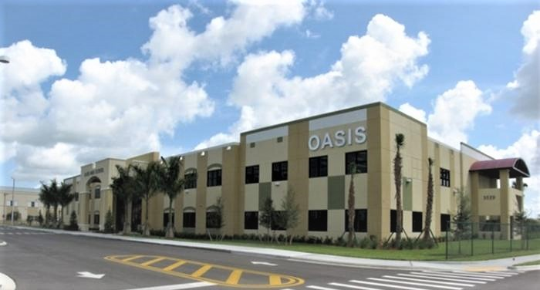

Tentative Operating Budget
FY 2022 – FY 2024
June 8, 2021

Slide 2

Budget Process
December
Budget Kick-Off
Budget Guidelines and Capital Asset Plans
Released to Schools
June
Tentative Budget Presented
For Governing Board Approval
July
Additional Adjustments
Are Made as Actual Results
Are Received
August
Adopted Budget Is
Presented for Governing Board
Approval and Incorporated Into the City of Cape Coral Budgets for Public Hearings and Final Adoption in September
January- February
Capital Asset Plans Due
Budget Projections are
Released to
Schools
March
Operating Projections Close
Submissions are Reviewed by Business Manager
Meetings are Held With
Superintendent
April
Budget Workshop No. 1 Held
With Governing Board
May
Adjustments Made
September/October
Annual Strategic Planning Session
Start
Notes:
As we move forward in Budget Process, this evening I will be presenting the Tentative Budget for your approval. While a 3-year budget is referenced, the GB will be asked to approve FY 2022 only.
Continue to adjust as we learn more and presented for Adoption in August where it will be incorporated into the City Budgets for Public Hearings & Final Adoption in Sept.

Slide 3
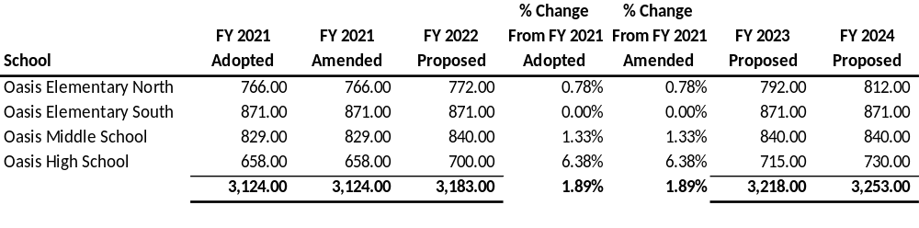
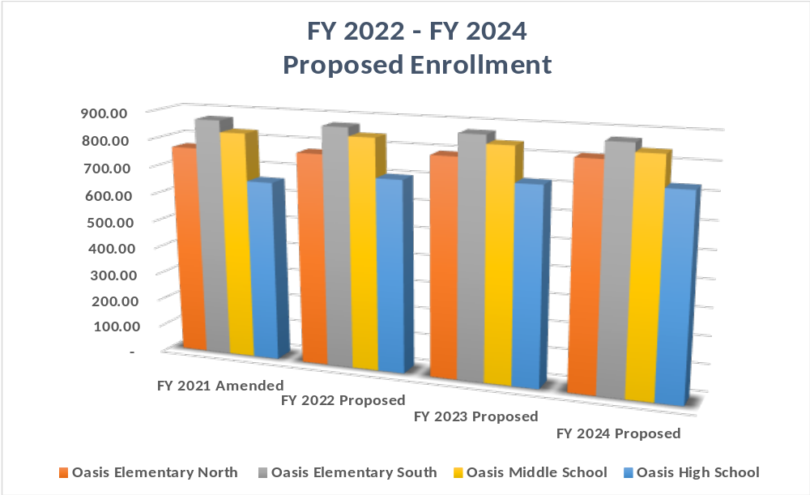
Enrollment Forecast
Notes:
Estimated to increase by 59 students. 6 OEN, 11 OMS, 42 OHS – for a total of 3,183 system-wide
FY 23 & 24 OEN will increase by 20 each year associated with portables. OHS 15 each year until full capacity is reached (750).

Slide 4
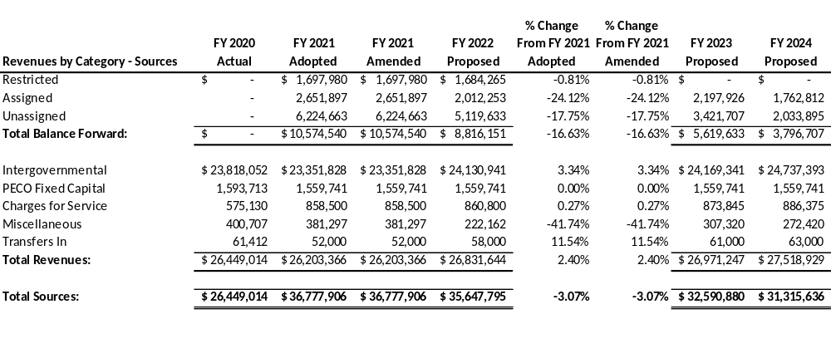
FY 2022—2024
Proposed Revenue Budget
Notes:
Fund balance is estimated at $8.8m and is adjusted when the annual financial statements are finalized by our external auditor/City Finance Department. We anticipate the use of $2.0m in fund balance. Overall, balance forward (cash) reflects a 16.63% decrease over last fy. Contributing factors include year-end payroll as well as $1.1 m in outstanding p.o.’s.
Revenues reflect a 2.4% increase and will be discussed on the following slides.
Overall, the FY 22 Tentative Revenue Budget of $35.6m reflects a $1.1m or 3.07% decrease over last fiscal year.

Slide 5
FY 2022-2024
Proposed Revenue Highlights
All State Shared Revenues are budgeted at 95% per policy
Florida Education Finance Program increases Base Student Allocation (BSA) by $53; Total Funds per Student from $7,756 to $7,795
Teacher Salary Allocation of $550 million ($50m greater than last FY) to support new teacher salaries to $47,500 and veteran teacher increases as previously allocated
Safe School Funds $180m ($145k allocation pays 4 School Resource Officers)
Mental Health Assistance $120m (funds youth mental health issues, i.e., social worker and psychologist)
Public Education Capital Outlay (PECO) $182.9m (budgeted at $1.5m)
Notes:
Misc. Revenue includes Contributions/Donations continue to decline and Short Term Investment Income has dropped significantly due to lower interest earnings in our Investment Funds to due the downturn in the economy and Covid. In FY21 we received a total of $16.5k through April compared to $147k in the previous year.

Slide 6
FY 2022-2024
Proposed Revenue Highlights
Restricted Fund Balance (OEN Portable Funds)
  Issued P.O. in FY 2021 to GradyMinor for Due Diligence
  Balance of $1,684,265 remains in Restricted; have requested City to initiate a Capital Project to capture costs
Other
  In FY 2021, E-Rate Award of $537,740 to be spent over the next 5 years; working with City IT to identify needs
  Grants – not budgeted (have potential to decrease expenditures by an estimated $600k)
    Include: Elementary & Secondary School Emergency Relief Fund (ESSER), Title IV, TAPS
  Recent Teacher/Principal Bonuses are not included as we await receipt of funds

Slide 7
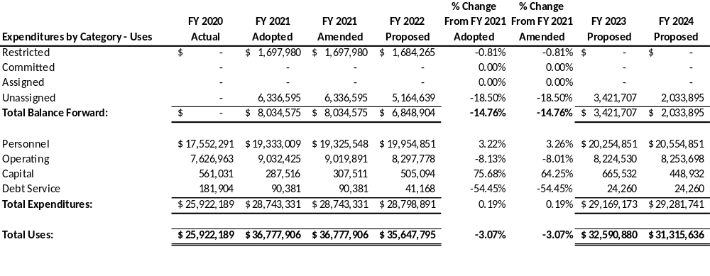
FY 2022-2024
Proposed Operating Budget
Notes:
Restricted FB has been set aside for the OEN Portables.
Balances forward reflects an overall decrease of $14.76%. Again, this is associated with the $1.1 million in outstanding P.O.’s and the large payroll payout at year-end.
Expense categories reflect an overall increase of $55,560 or .19%. The largest increase is reflected in Capital Outlay. Items of importance will be discussed on the following slides.
Overall, the FY 22 Prop Operating Budget reflects a $1.1m reduction or 3.07% decrease over FY 2021.

Slide 8
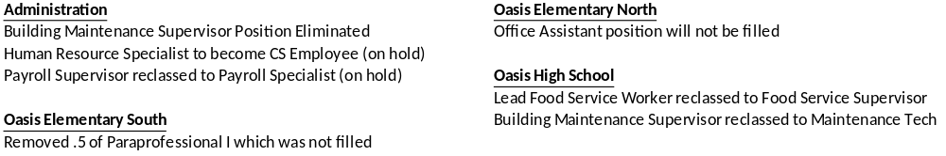
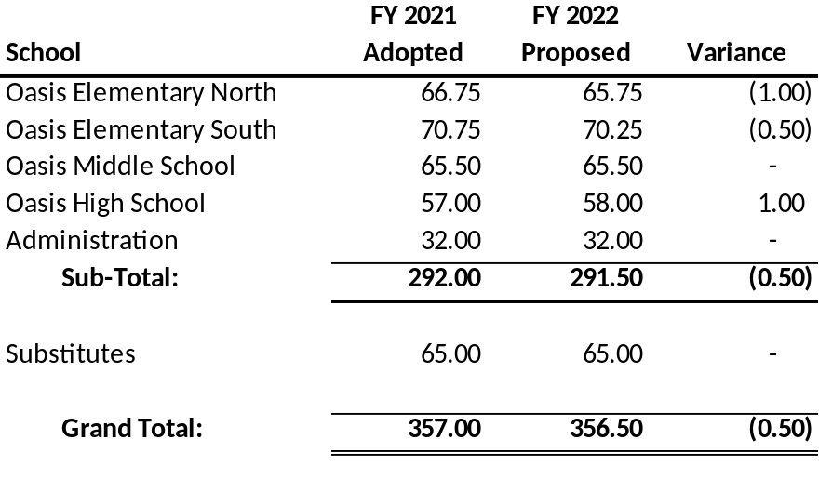
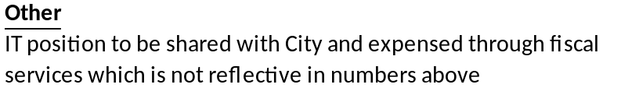
FY 2022 Staffing Changes
Notes:
Staffing levels reflect an overall decrease of .50 full time equivalent (fte).
The HR Specialist and Payroll Specialist positions have been placed on hold pending City transition meetings.

Slide 9
Personnel
Comprises of base payroll, add pays, health plans, FRS and workers’ compensation
Workers Comp rates reflect a slight decrease:
  Bus Drivers $4.81 to $4.01, Teachers .44 to .43, and Food Service/Maintenance $3.95 to $3.77
Florida Retirement System (FRS) reflects an increase from 10% to 10.30%; employees contribute 3%; announced in July
Increase to Special Pay/Add Pays at Elementary Schools for Extended Workday $116k
  Reduction in miscellaneous Add Pays of $47k
One time Pay Parity for Veteran Teachers/Support Staff $75k per school or a total of $300k
Notes:
Upcoming FRS Rates were recently announced at 10.82%
Teacher/Principal Bonuses were announced by the Governor after the Tentative Budget was developed and will be added in the Adopted Budget numbers. $1,000 each.

Slide 10
Operating
Insurance increase for Workers Comp associated with payroll increases estimated at $20k
Textbooks $483k
Technology $80k
Nutanix Server Maintenance $36k (reimbursed 60% through E-Rate)
Marketing/Advertising/Recruitment (Strategic Planning) $30k
Seal Portables Roofs $8k
Notes:
May require more than one slide

Slide 11
Capital Outlay
Purchase of 3 new buses as previously approved by CCSA Governing Board $331k
New Phone System per City IT $100k
Centegix Software (Alyssa’s Law) $65.5k and $16,375 in FY 2023-FY 2026
Notes:
All items have been previously approved by the Governing Board
Centegix will increase in the Adopted Budget to $92k in FY 22 and $10k for the four years following if approved this evening.
Rollover p.o.’s: Radiator for OMS Generator $8k, Café Oven $8k

Slide 12

Debt Service
Budgeted at $41k
  Final bus payments to be made in first quarter of FY2022
  Copier Lease

Slide 13
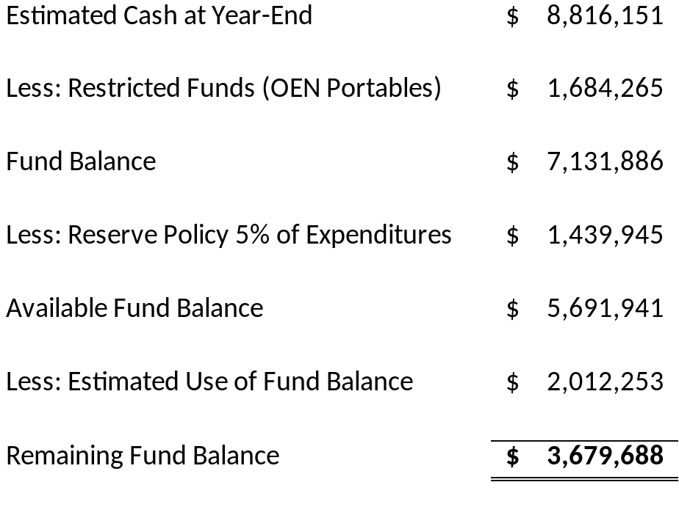
Fund Balance
City of Cape Coral Financial Policies:
“The Charter School Authority shall maintain, at minimum, an unassigned fund balance in its operating fund equal to 5% of the annual expenditures.”

Slide 14
Conclusion
In conclusion, the FY 2022 Proposed Operating Budget is presented at $35.6m which reflects an overall decrease of $1.1m or 3.07% over the FY 2021 Adopted Operating Budget
Anticipate the use of $2.0m from Reserves
Potential to offset expenditures by an estimated $600k in grant funding (Elementary & Secondary School Emergency Relief Fund (ESSER), Title IV, TAPS)
No budget update from City pertaining to reduction in debt payments/change in lease
Adopted Budget will be presented in August 2021 for approval by Charter School Authority Governing Board and incorporated into the City of Cape Coral Public Hearings for final approval in September 2021
In closing, we ask for the Governing Board’s approval of the FY 2022 Proposed Operating Budget
Questions?

Slide 15
Transportation
District
  GED or Diploma waived until Feb. 2022
  Social security card
  5 years driving experience
  Satisfactory driving record
  Continuous training
  Flexible hours
  Training Stipend after 45 working days
  6 paid holidays
  Subs hourly rate of $14.69
  Beginning hourly rate of $16.32 Market Rate
  Typical increase of 2% annually based on negotiations and funding
Charter School Authority
  GED or Diploma required
  Social security card
  5 years driving experience
  Satisfactory driving record
  Continuous training
  Flexible Hours
  3-Paid Holidays
  Subs hourly rate of $14.69
  Beginning hourly rate of $16.48

Slide 16
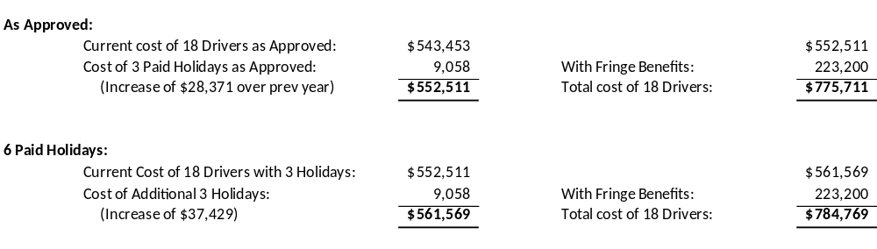
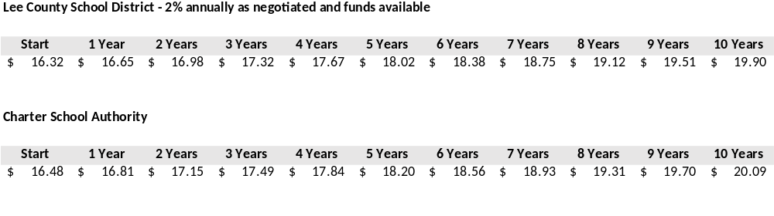
Transportation

