Slide 1

Start Here,
Go Everywhere.

Slide 2
OUR VISION
OUR MISSION
Oasis Charter Schools believes that everyone can succeed in a nurturing and secure learning environment with support from diverse and meaningful community partnerships.
Our mission is to create a K-12 system that educates students to be responsible, critical thinkers who are prepared to successfully compete in a dynamic global workforce.

Slide 3
STRATEGIC GOALS 2024-2027
01
02
03
STUDENT ACHIEVEMENT
Oasis Charter Schools will cultivate academic achievement using a rigorus and alligned curriculum that will provide all students the opportunity to master knowledge and expand their learning
CONTINUOUS IMPROVEMENT
Oasis Charter Schools will identify, recruit, and retain high caliber educators by offering a competitive salary, shared educator values, and opportunities for professional development.
COMMUNITY ENGAGEMENT
Oasis Charter Schools will nurture alliances with community partners who share the same vision and commitment to meeting the workforce needs of dynamic business leaders.

Slide 4

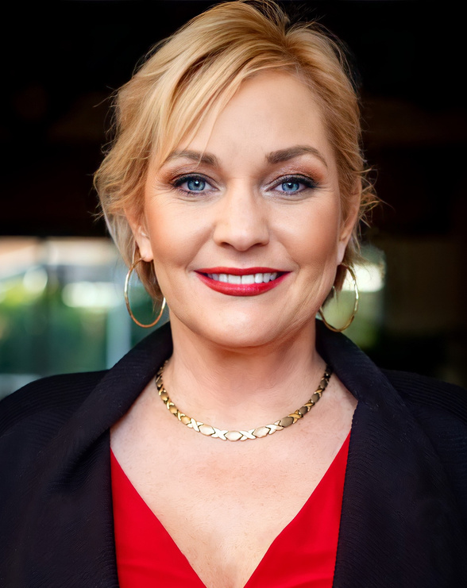
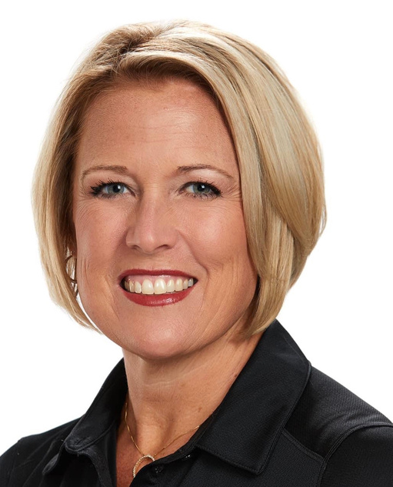
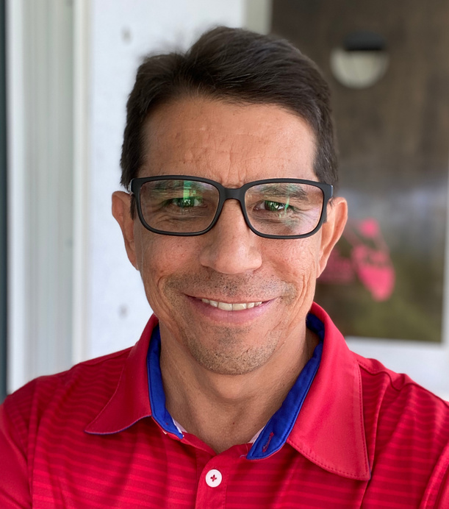
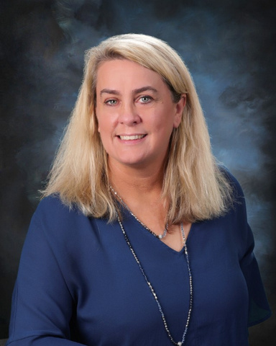
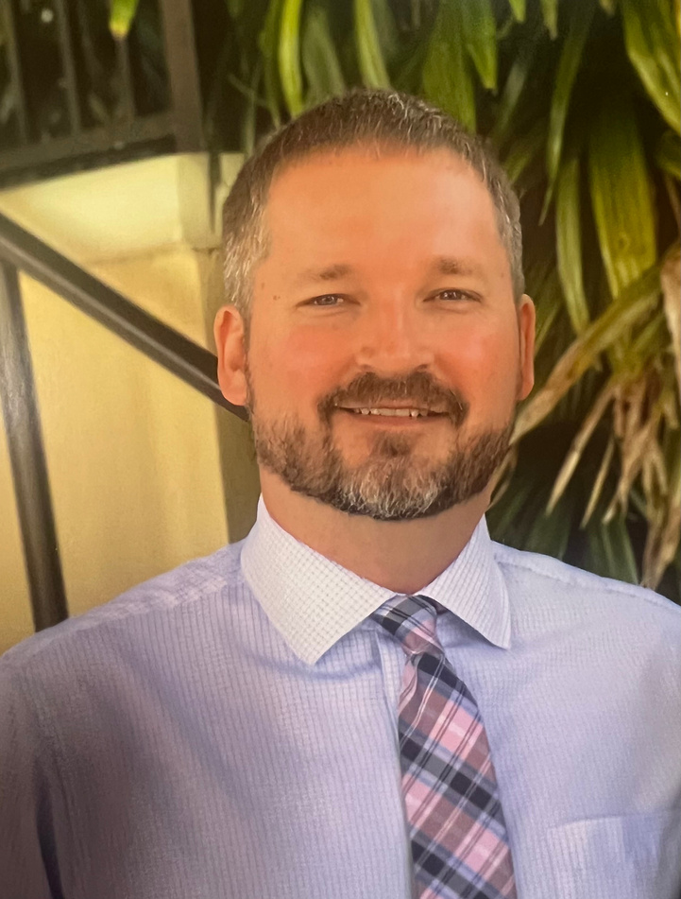

OASIS LEADERSHIP
Superintendent Jacquelin Collins
18 Years Serving Oasis
28 Years Education Services
Jackie Corey
Donnie Hopper
Marybeth Grecsek
Kevin Brown
Oasis High School
Oasis Middle School
Oasis Elementary South
Oasis Elementary North
1 year Serving Oasis
27 Years Education Services
Assistant Principals:
Cyndi Chiorello, 27 years, Tim Loughren, 23 years; Dr Brianne Romano, 23 years
7 years Serving Oasis
27 Years Education Services
Interim Assistant Principal
Amy Picciolo, 30 years
6 Years Serving Oasis
29 Years Education Services
Assistant Principal
Carrie Abes, 19 years
19 Years Serving Oasis
19 Years Education Services
Assistant Principal
Kelly Weeks, 22 years

Slide 5
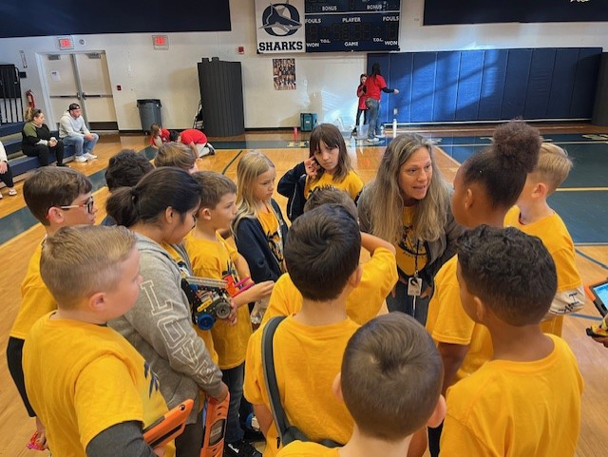

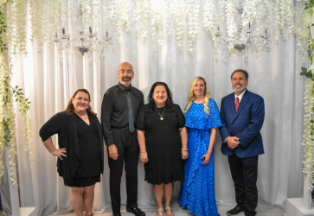
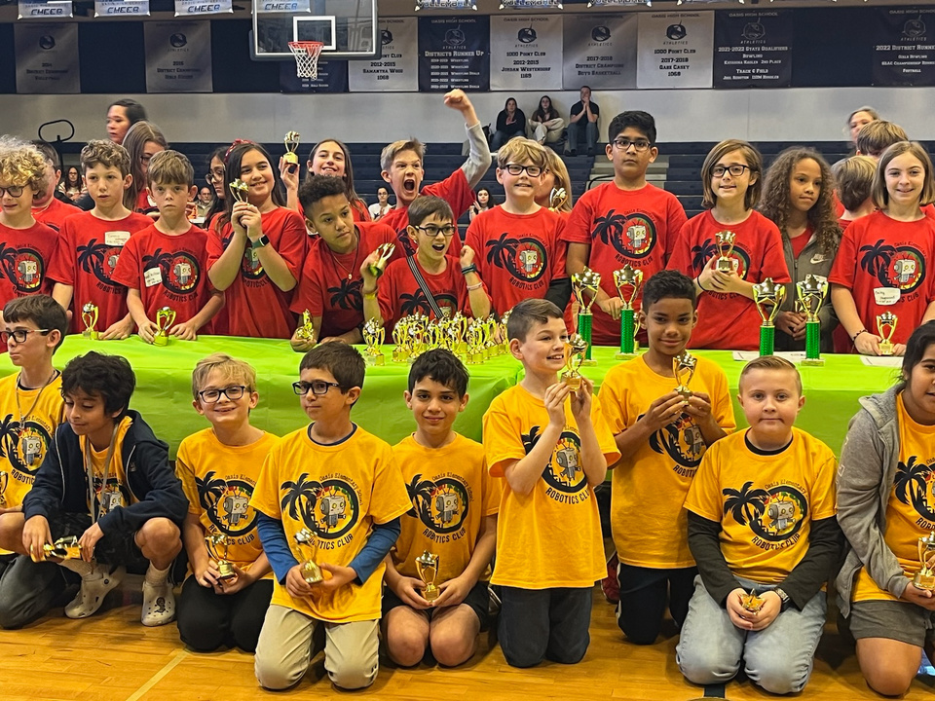
OASIS CHARTER SCHOOLS ENROLLMENT & WORKFORCE SY 23/24
TOTAL STUDENT ENROLLMENT SY23/24
3,317
637 EMPLOYEES
EDUCATORS
Including certified educators, staff, transportation and food service workers.
2 DOCTORATE EDUCATORS
2 SPECIALISTS
62 MASTERS DEGREES
216 CAUCASIAN
36 HISPANIC
3 AFRICAN AMERICAN

Slide 6
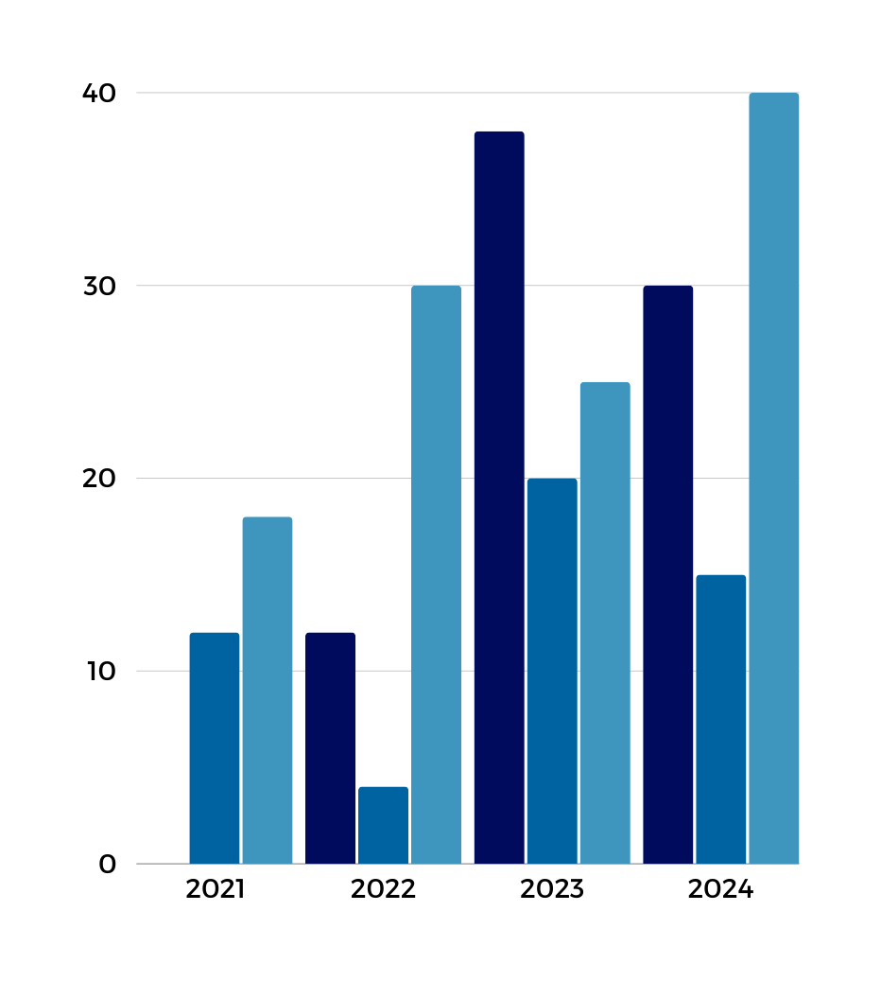
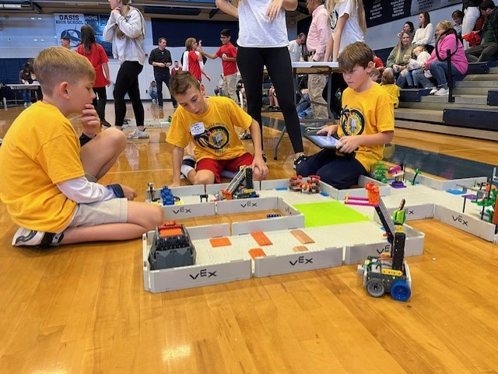
OASIS ELEMENTARY
SOUTH
STUDENT ENROLLMENT
872
SCHOOL GRADE SY23/24: “A”
Student learning Gains: Leaped 32 points
STUDENT DEMOGRAPHICS
Causian: 499; Hispanic: 260;
African American: 49; Multiracial: 36 0,;Asian-Pacific: 26 and Indian/Alaskan: 2
MILITARY FAMILIES OES SUPPORTS
24

Slide 7
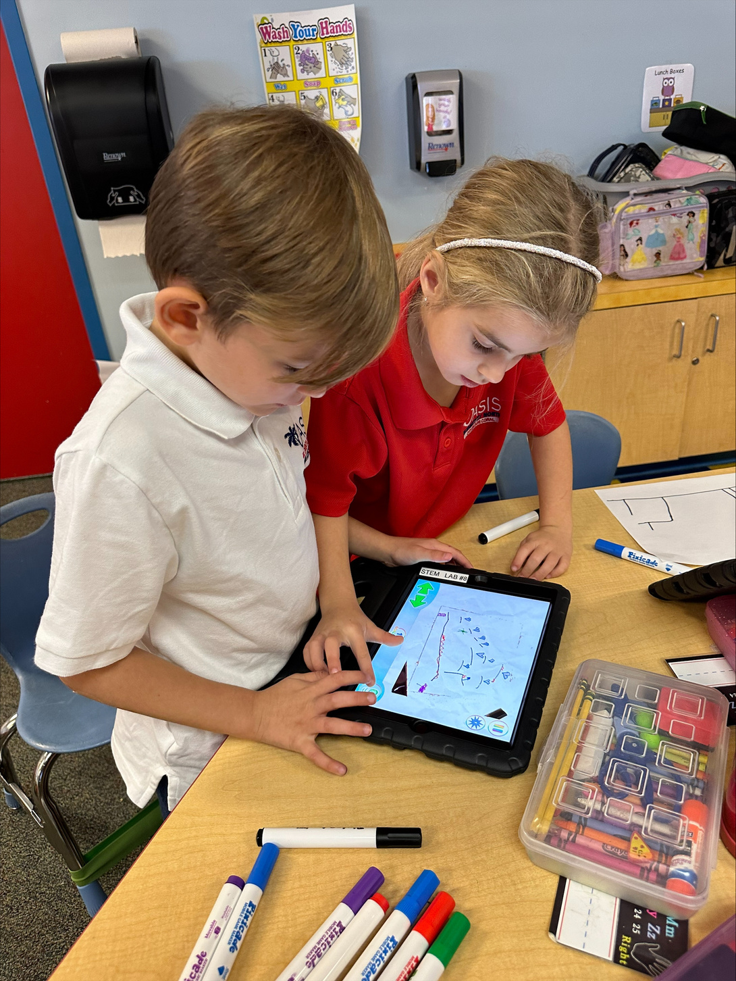
OASIS ELEMENTARY
NORTH
STUDENT ENROLLMENT
809
SCHOOL GRADE SY23/24: “A”
Student learning Gains: Rose 19 points
STUDENT DEMOGRAPHICS
Causian: 493; Hispanic: 237;
African American: 25; Multiracial: 38 ;Asian-Pacific: 15 and Indian/Alaskan: 1
MILITARY FAMILIES OEN SUPPORTS
27

Slide 8
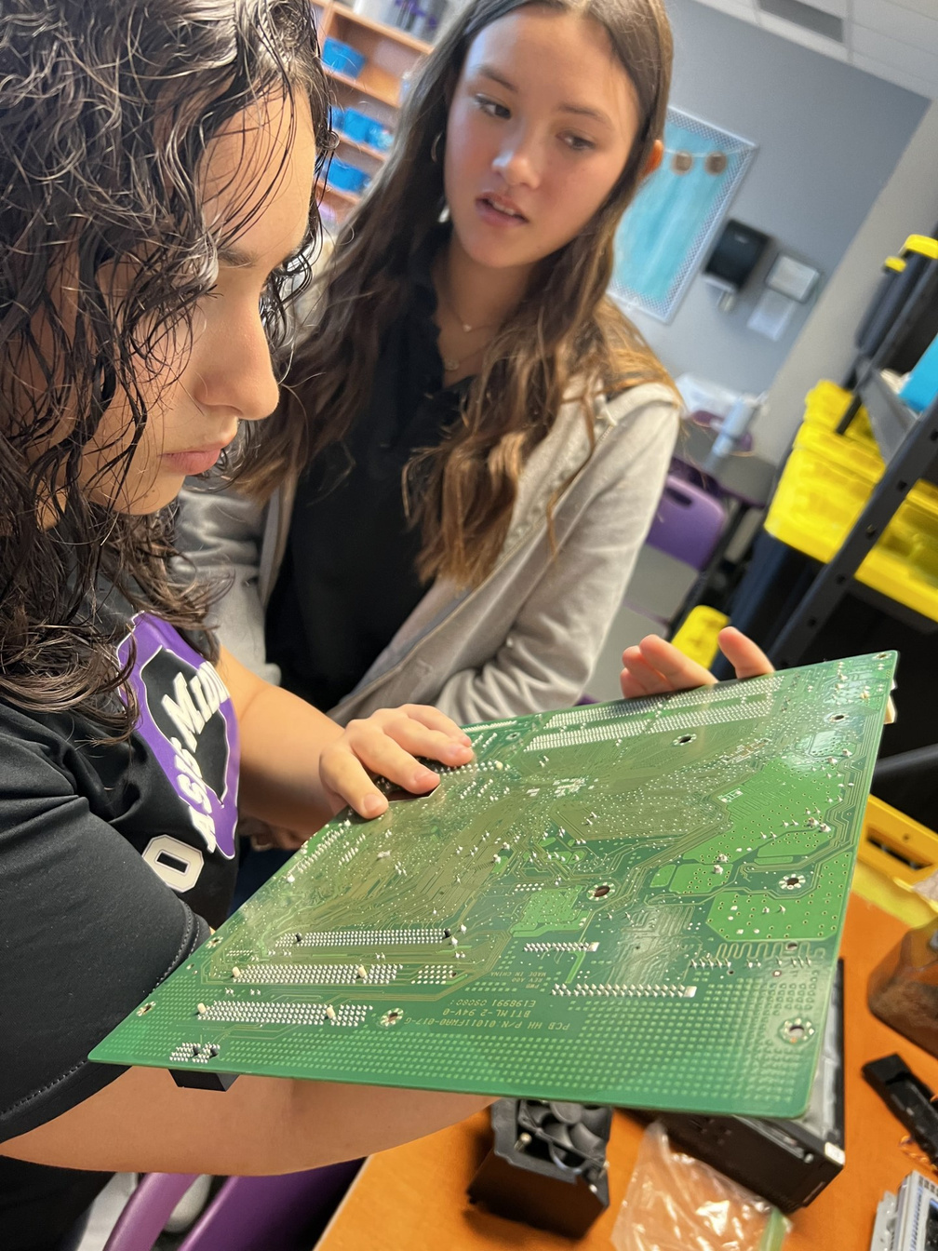
OASIS MIDDLE
SCHOOL
STUDENT ENROLLMENT
845
SCHOOL GRADE SY23/24: “A”
Student Learning Gains: Uptick 9 points
STUDENT DEMOGRAPHICS
Causian: 547; Hispanic: 216;
African American: 28,;Multiracial: 39; Asian-Pacific: 14 and Indian/Alaskan: 1
MILITARY FAMILIES OMS SUPPORTS
86

Slide 9
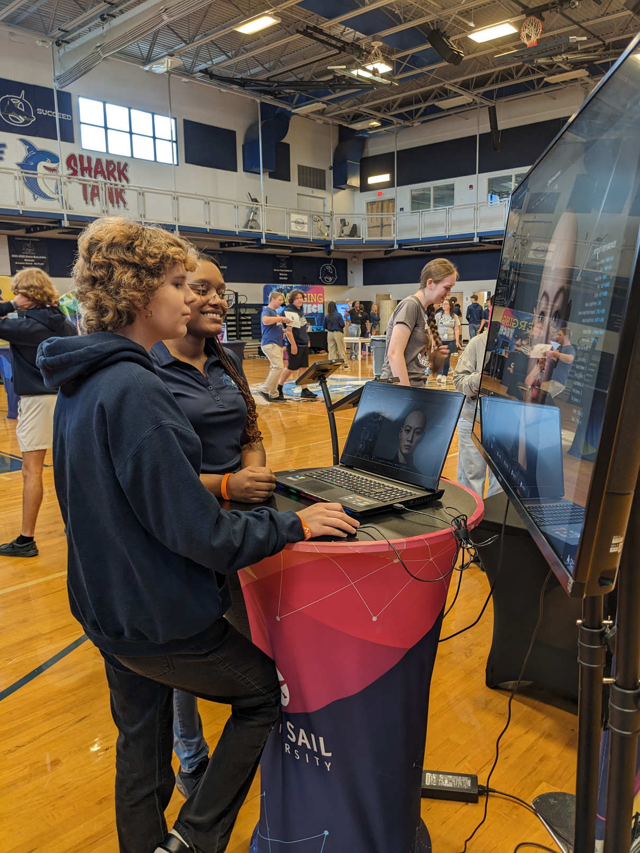
OASIS HIGH
SCHOOL
STUDENT ENROLLMENT
791
SCHOOL GRADE SY23/24: “A”
Student learning Gains: 32 points upsurge
STUDENT DEMOGRAPHICS
Causian: 507; Hispanic: 207;
African American: 23; Multiracial: 37; Asian-Pacific: 16 and Indian/Alaskan: 1
MILITARY FAMILIES OHS SUPPORTS
19

Slide 10

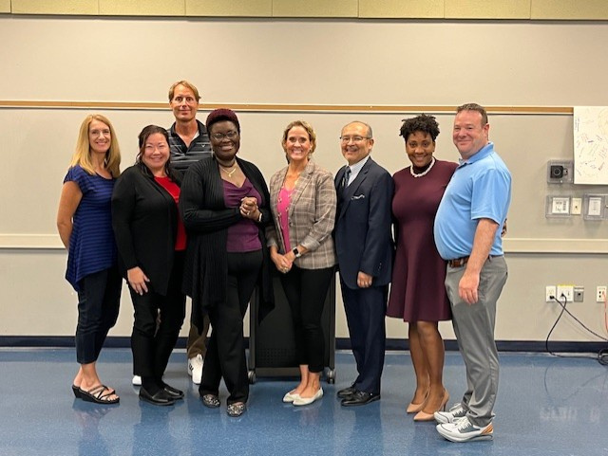

OUR GOVERNING BOARD
Board Members are certified and appointed by City Council to serve two-year terms.
CA-Community at Large; BC- Business Community; ED-Education Services; CL-City Council Liaison; PR-Parent Representative
Kristifer Jackson, Chair
CA
Mykisha Atisele
CA
Cathy Stout
CL
Keith Long, Disrict 6
PR
Jennifer Hoagland, PR/OHS
BC
Karen Michaels, Vice Chair
PR
Gregor Schade, PR/OMS
BC
PR
Jose Soto PR/OES
Dr. Guido Minaya
ED
Charles Pease
PR
Caroline Rouzeau, PR/OEN

