Slide 1

State
of the
Charter Schools
Update SY 2023/2024
Moving Forward SY 2024/2025

Slide 2
OUR VISION
OUR MISSION
Oasis Charter Schools believes that everyone can succeed in a nurturing and secure learning environment with support from diverse and meaningful community partnerships.
Our mission is to create a K-12 system that educates students to be responsible, critical thinkers who are prepared to successfully compete in a dynamic global workforce.

Slide 3
STATE OF THE SCHOOLS FY24
01
02
03
CHARTER WORKFORCE
& THE END OF ESSER
STRATEGIC GOAL#1
STUDENT ACHIEVEMENT
STUDENT TEST DATA

Slide 4
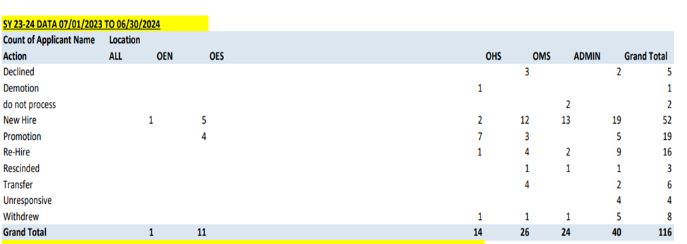
Charter Schools Workforce 23/24
Teachers Hired: 34
17.43% turnover rate

Slide 5
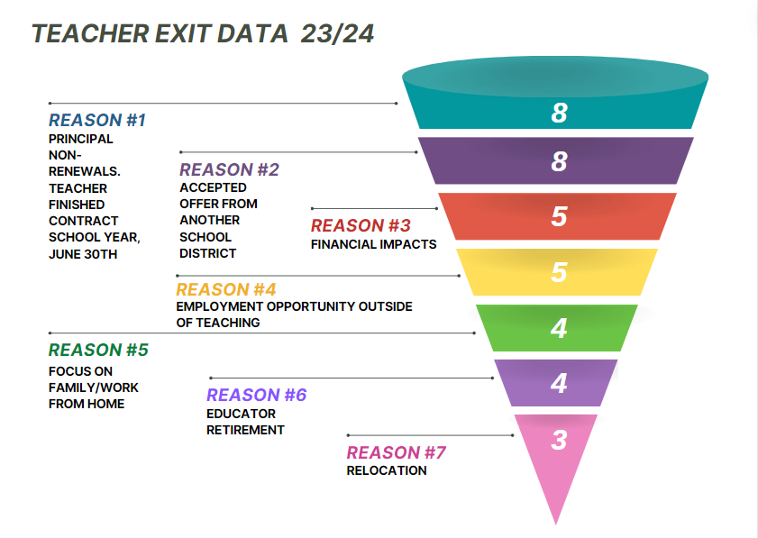

Slide 6
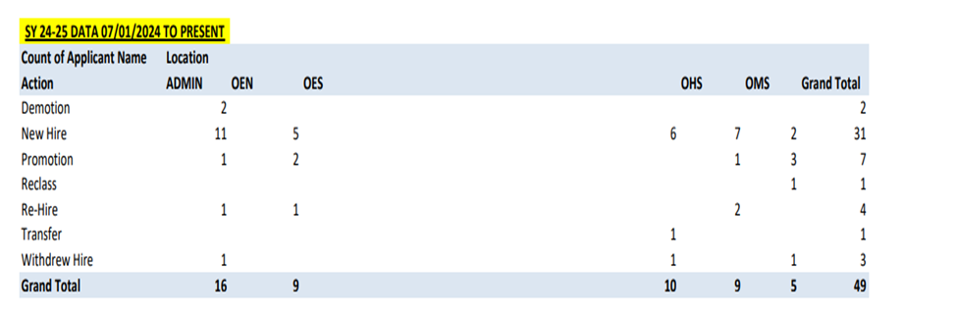
Charter Schools Workforce 24/25
Teachers Hired: ​25

Slide 7

THE END OF ESSER
TOTAL
ESSER
FUNDING OASIS CHARTER SCHOOLS RECEIVED:
$9.9m
Beginning in September 2020 federal lawmakers approved K-12 federal stimulus aid programs that would eventually total more than $191 billion in school aid.
The last and final segment of funding, ESSER III, requires school districts to spend all of their allocations by September 30, 2024. Funding is to be used to directly help students overcome learning loss due to the Coronavirus pandemic.
Consequently, education services professionals forecast major academic impacts, as well as pressure on schools to return to relying heavily on their general funds and other supplementary resources.

Slide 8










TOTAL ESSER FUNDING BY SCHOOL
$2.11m
$2.59m
$2.77m
$2.43m
OASIS HIGH
OASIS MIDDLE
OASIS ELEMENTARY
SOUTH
OASIS ELEMENTARY NORTH

Slide 9
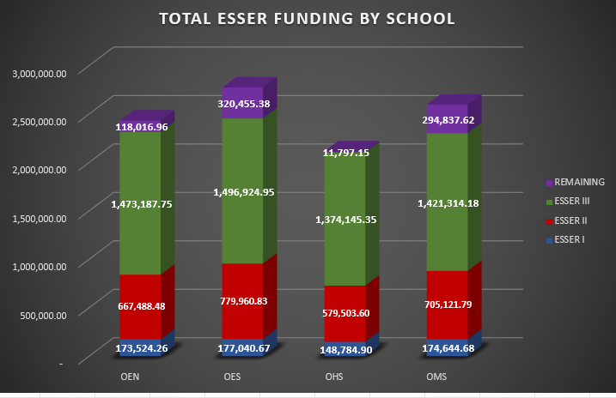

Slide 10




ESSER EXPENDITURES
$1.84m
$1.86m
$948,167
$330,627
$3.96m
$222,335
ITS
Computer equipment, chromebooks, prometheans, computer upgrades
CURR
Textbooks, classoom supplies, classroom peridodicals, digital platforms
CAPITAL ASSETS
Capital and furniture, cafe tables, sound systems, replacement AV equipment, student furniture
HEALTH & SAFETY
Clinic tracking software, medical supplies, equipment, cleaning & labor, professional counseling
LABOR
FTE positions, special pay (CP/tutoring), summer schools, COVID leave pay, stabilization pay/bonuses
PRO DEV
Professional Development conference training and travel, on-site training, professional development materials

Slide 11
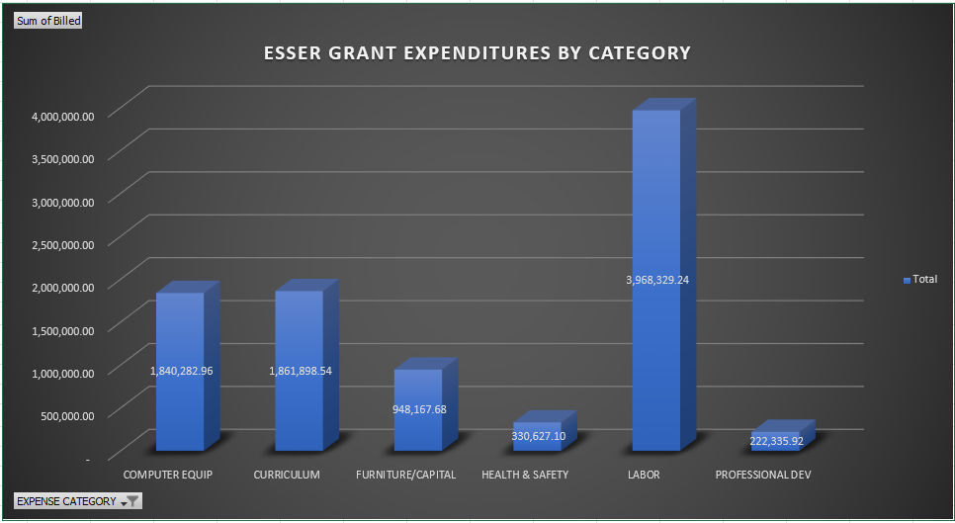

Slide 12

Employee Compensation
Bonus Dollars paid to staff in FY 24:
$1,546,677.36
(ESSER and Reserves)

Slide 13
STRATEGIC GOAL #1
STUDENT TEST DATA
Proficiency and Gains

Slide 14
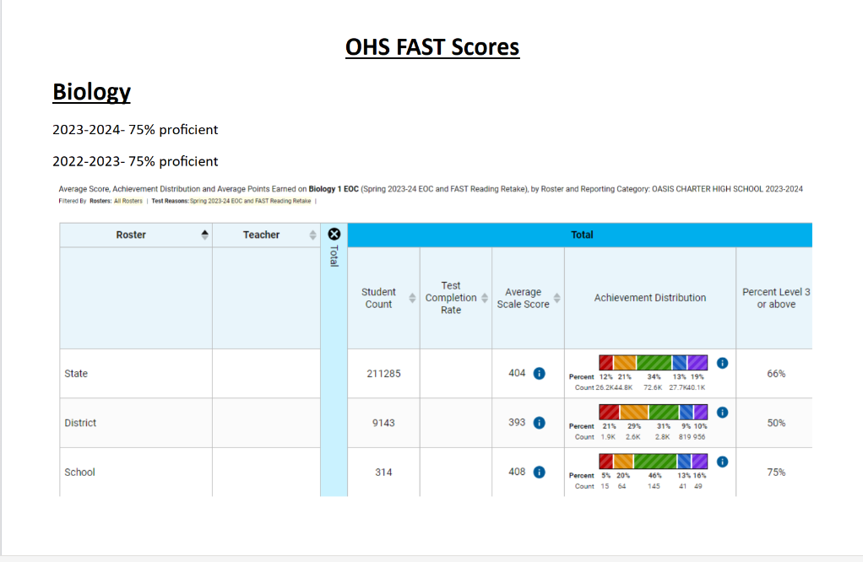

Slide 15
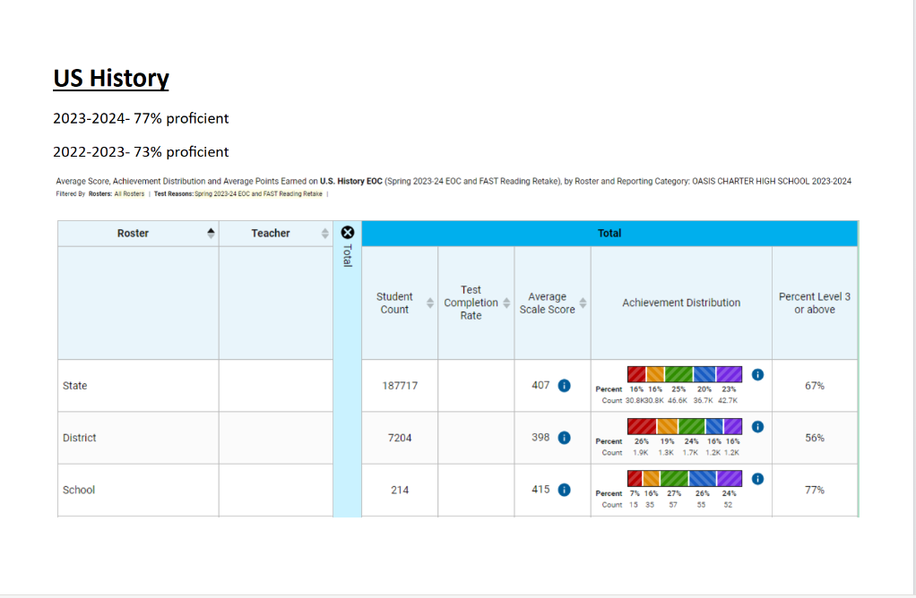
Oasis High School

Slide 16
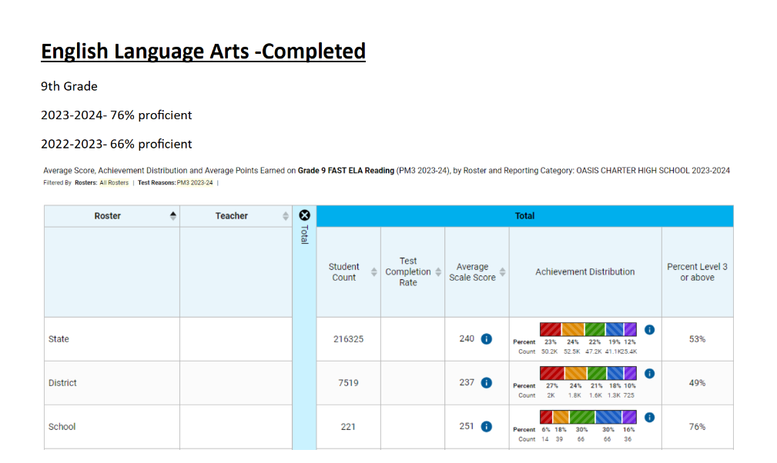
Oasis High School

Slide 17
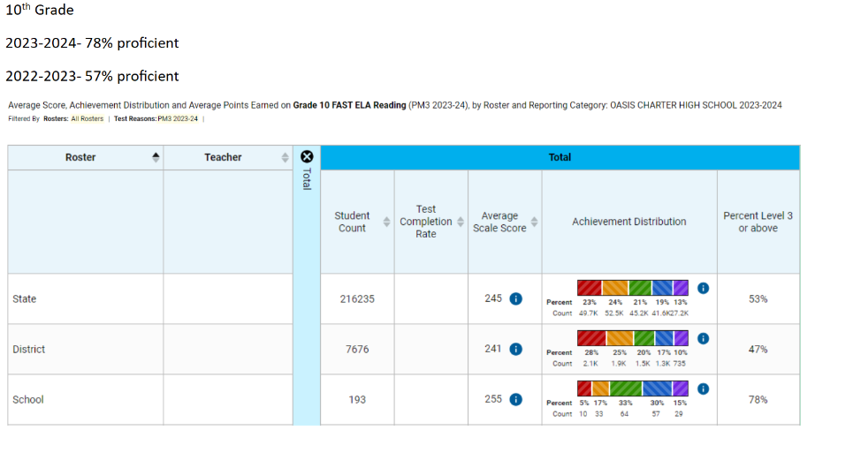
Oasis High School

Slide 18
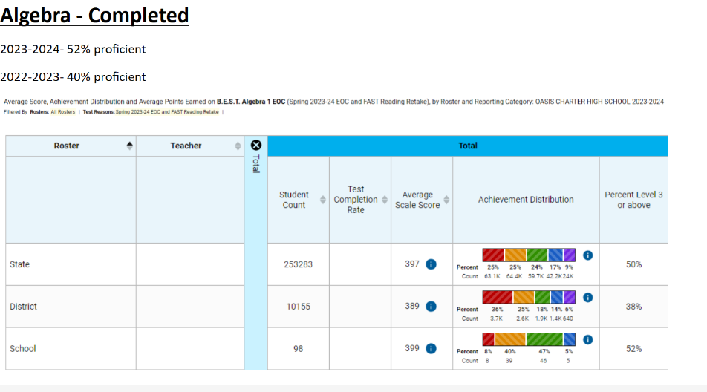
Oasis High School

Slide 19
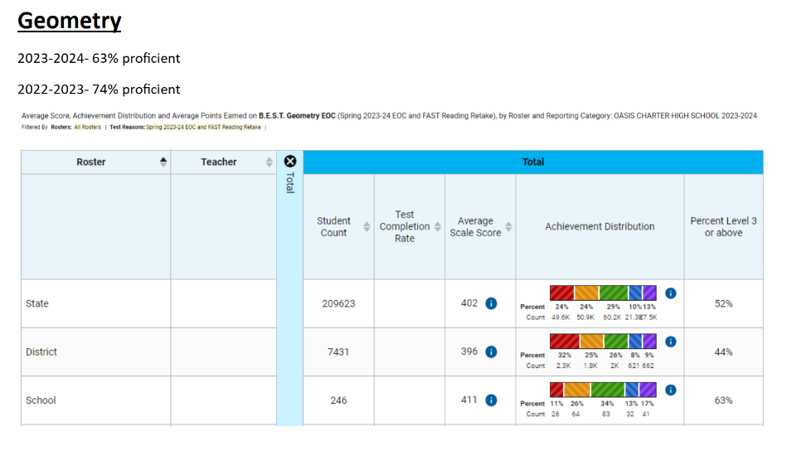
Oasis High School

Slide 20
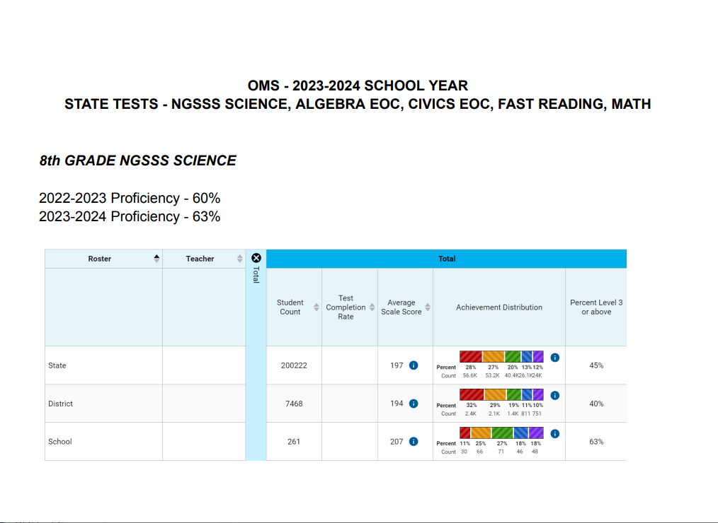

Slide 21
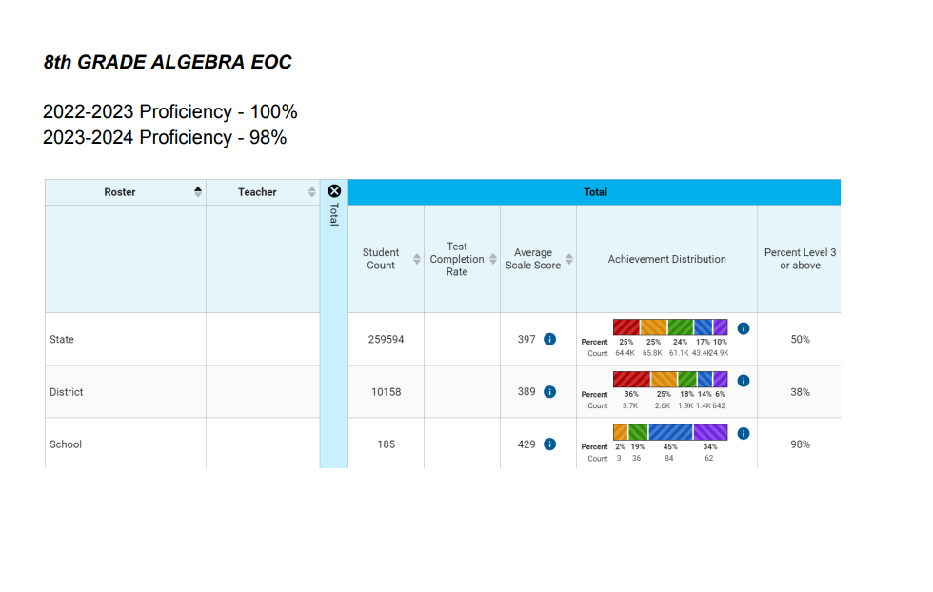
Oasis Middle School

Slide 22
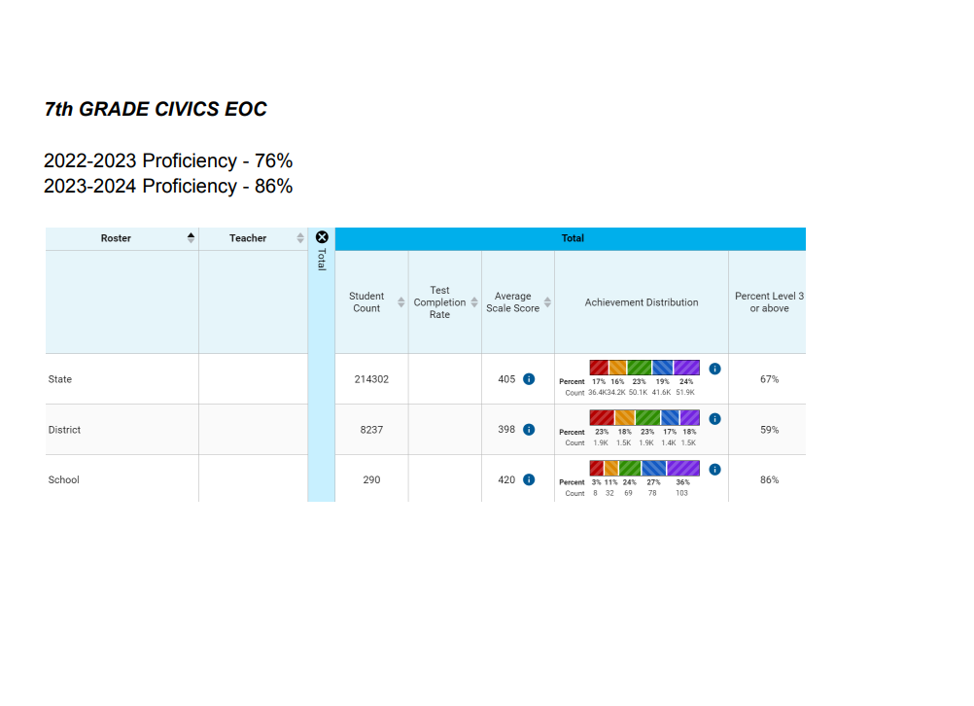
Oasis Middle School

Slide 23
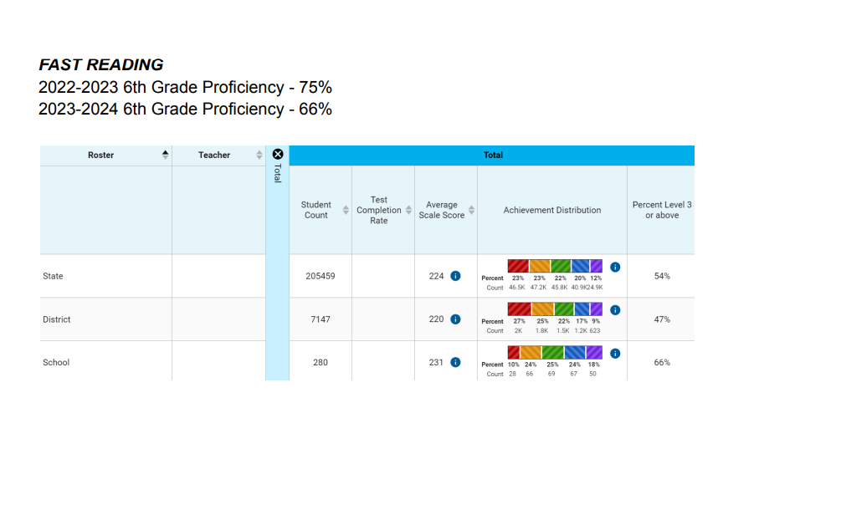
Oasis Middle School

Slide 24
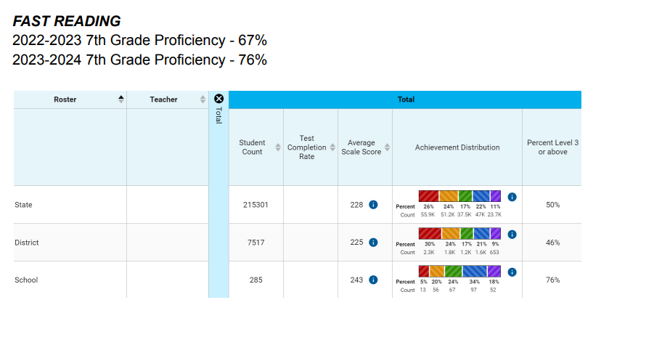
Oasis Middle School

Slide 25
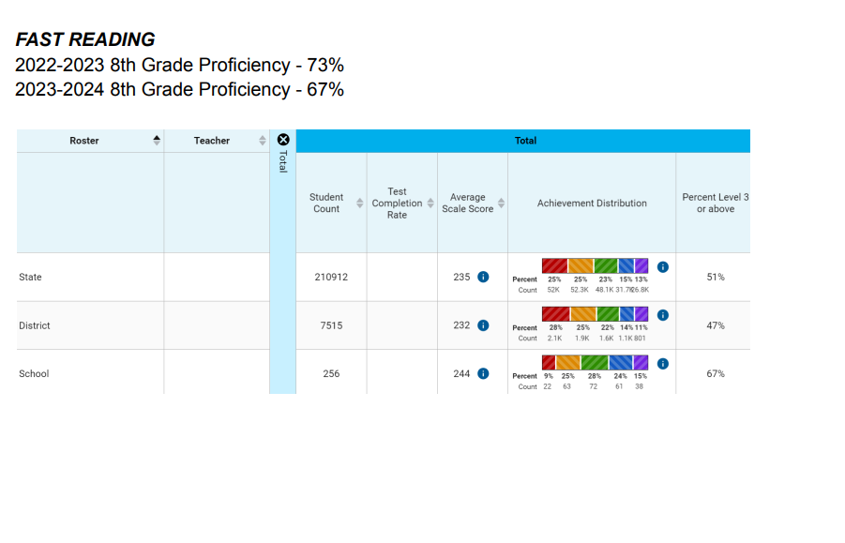
Oasis Middle School

Slide 26
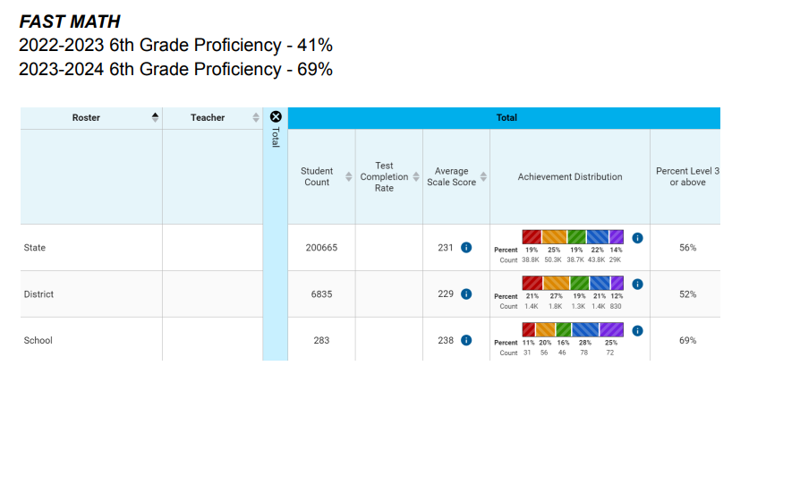
Oasis Middle School

Slide 27
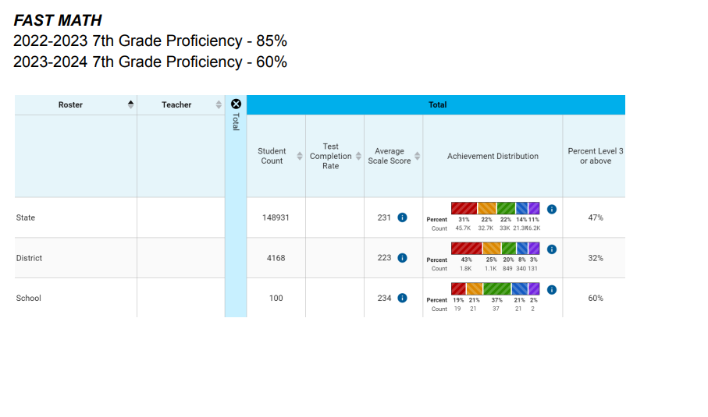
Oasis Middle School

Slide 28
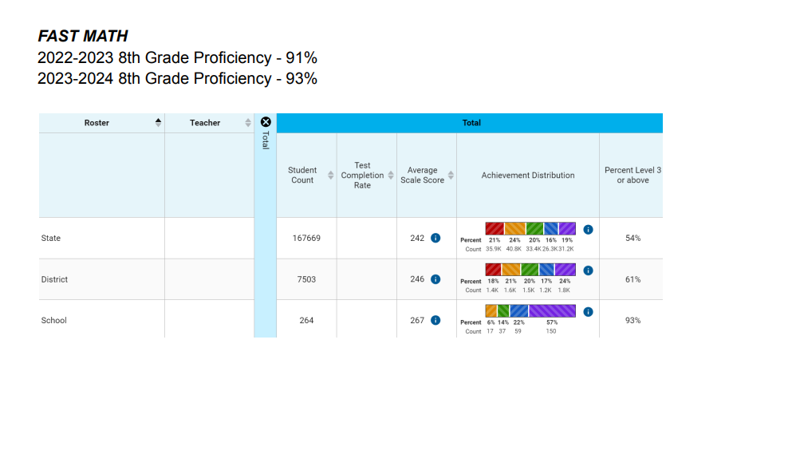
Oasis Middle School

Slide 29
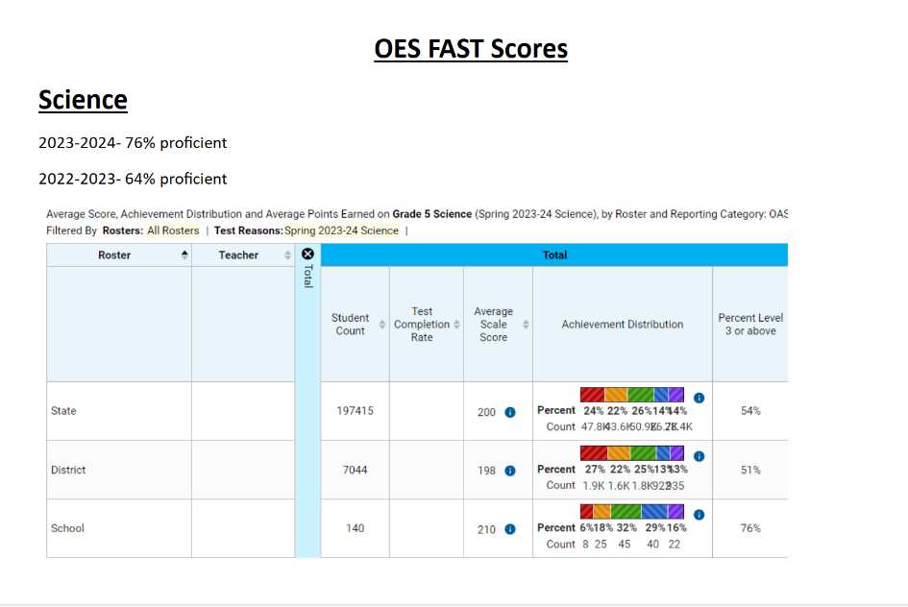

Slide 30
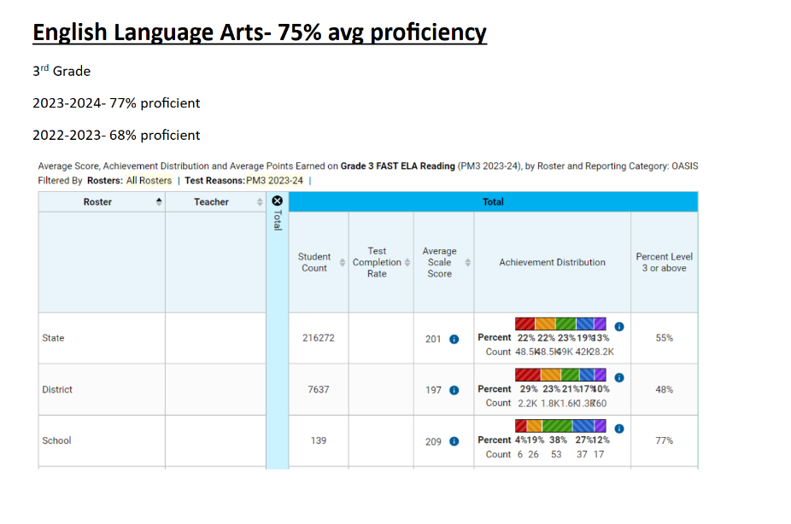

Slide 31
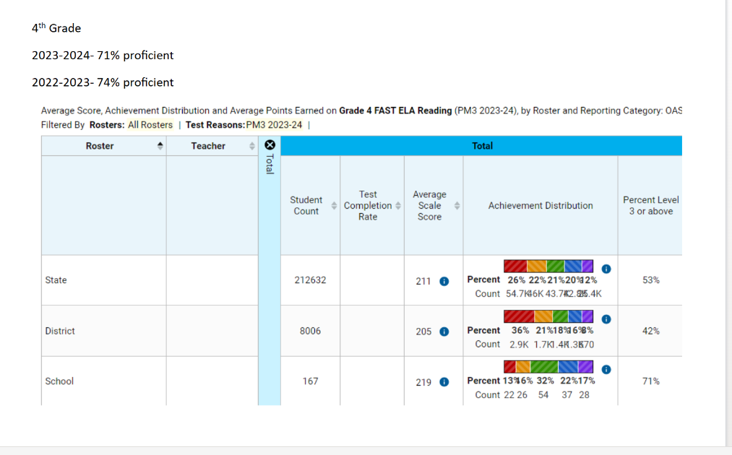
Oasis Elementary South

Slide 32
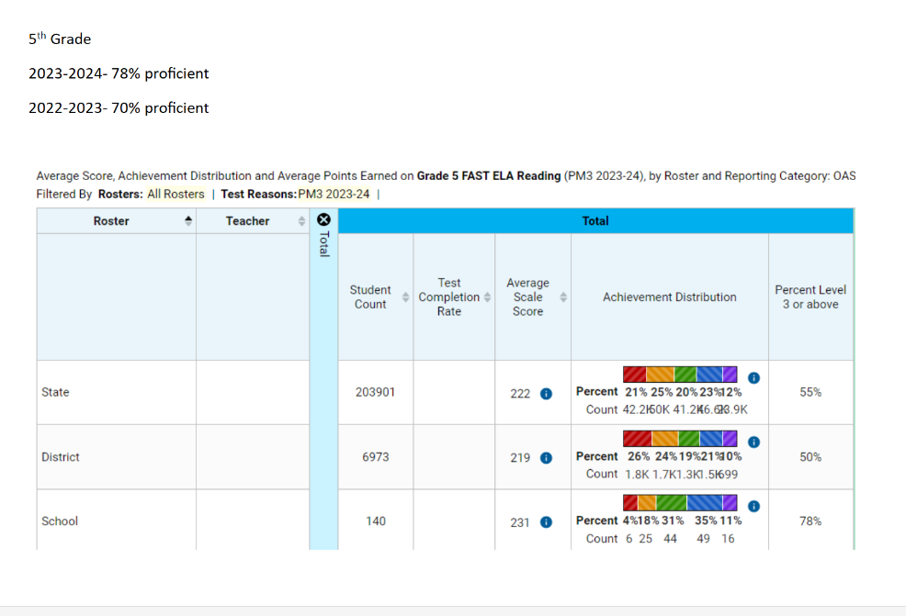
Oasis Elementary South

Slide 33
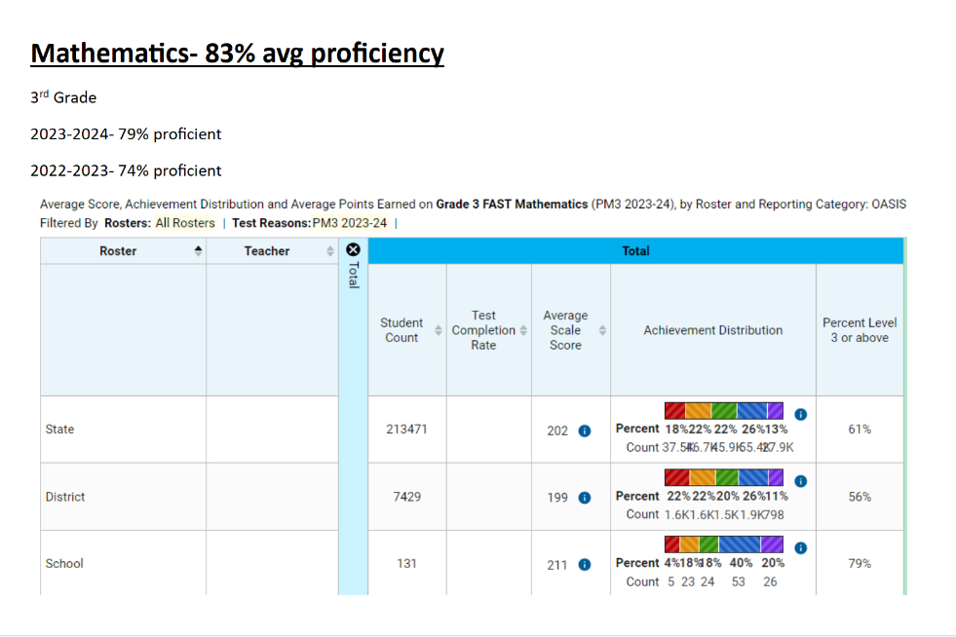
Oasis Elementary South

Slide 34
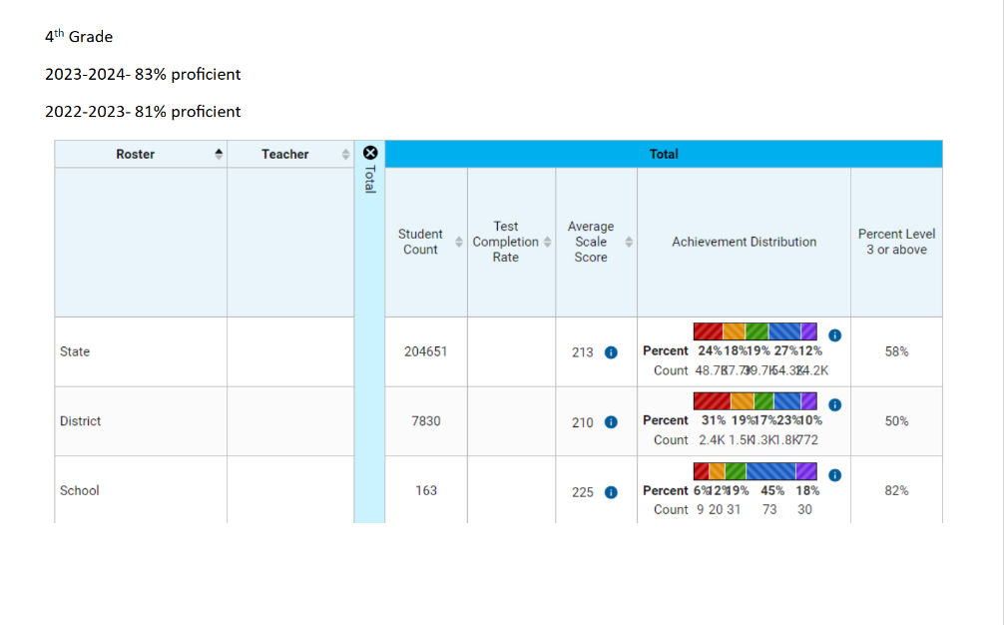
Oasis Elementary South

Slide 35
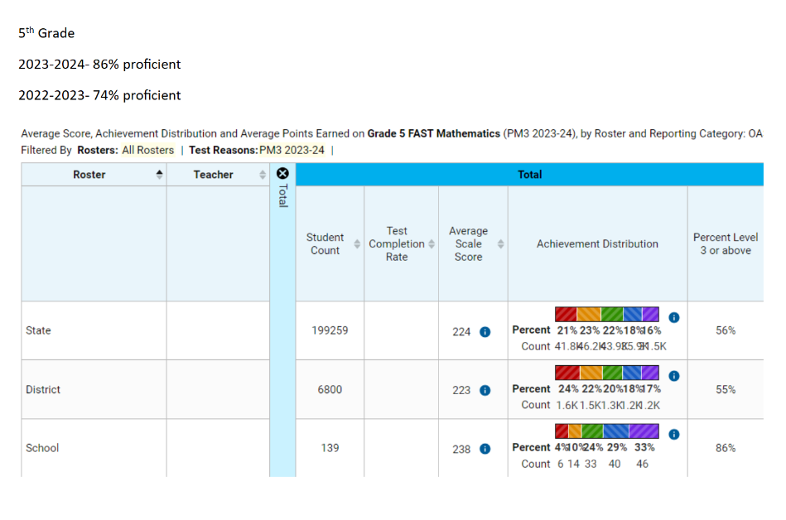
Oasis Elementary South

Slide 36
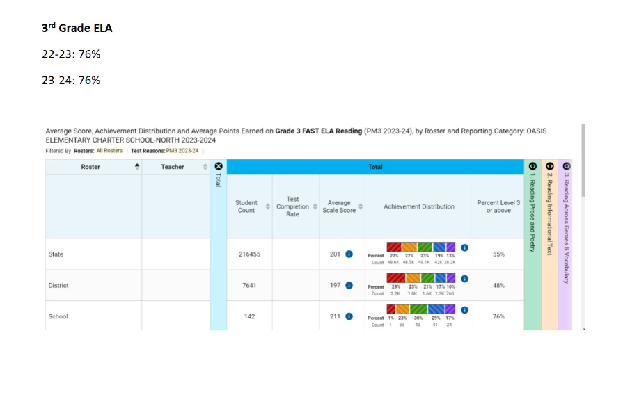

Slide 37
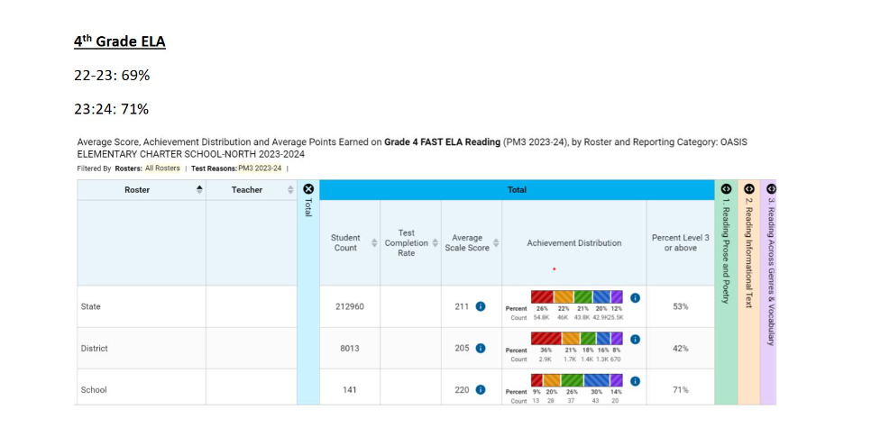
Oasis Elementary North

Slide 38
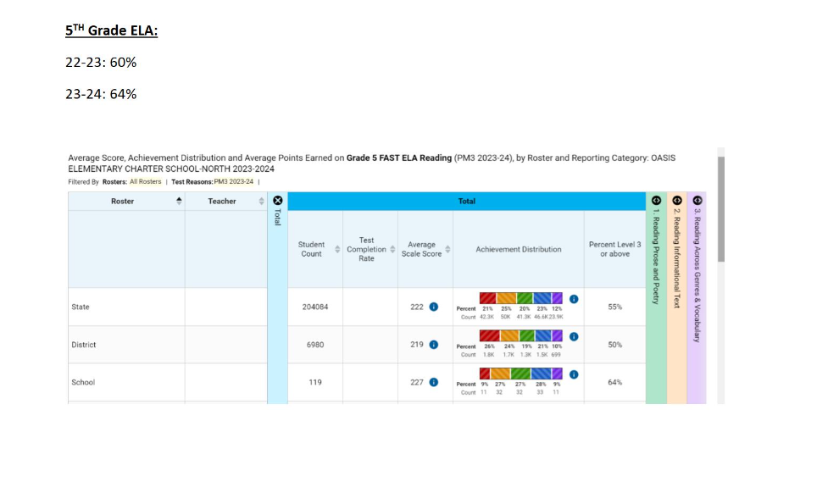
Oasis Elementary North

Slide 39
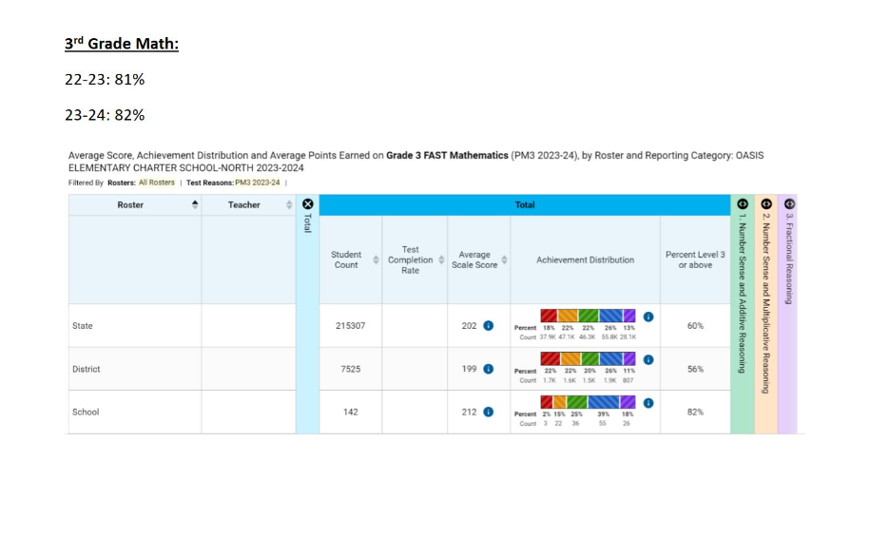
Oasis Elementary North

Slide 40
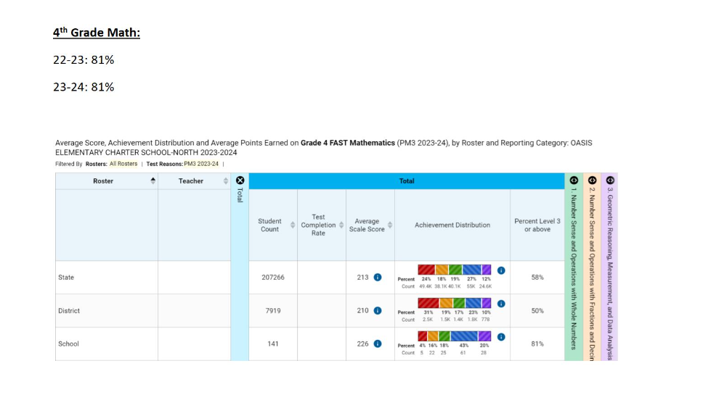
Oasis Elementary North

Slide 41
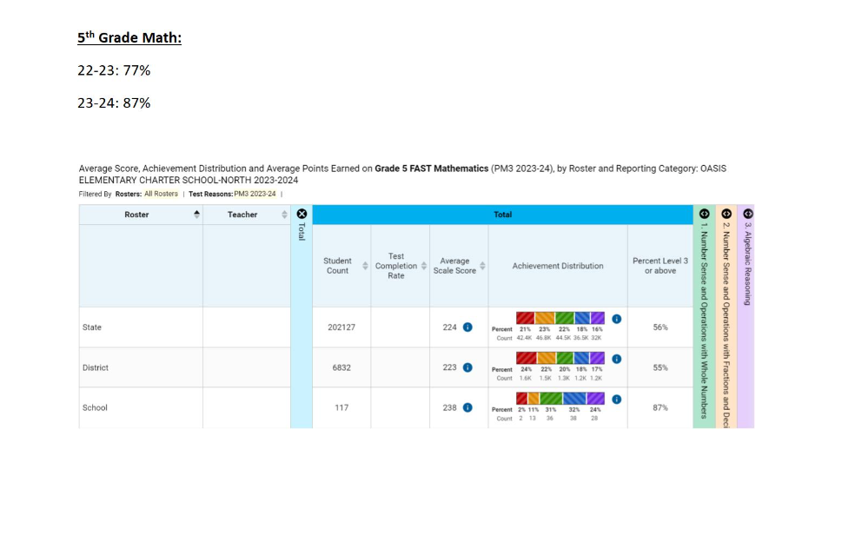
Oasis Elementary North

Slide 42
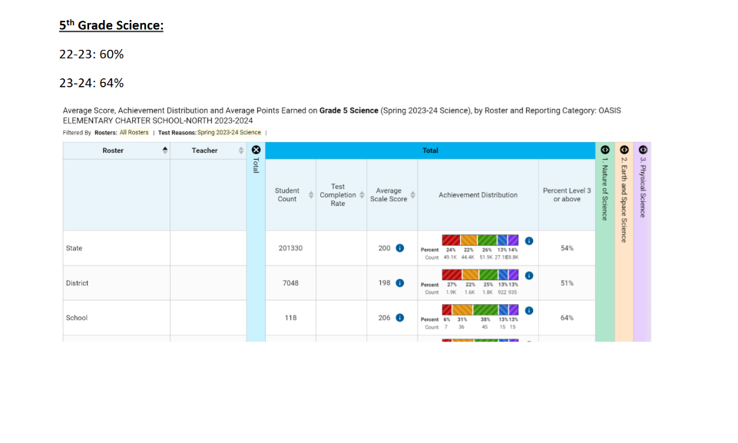
Oasis Elementary North

Slide 43
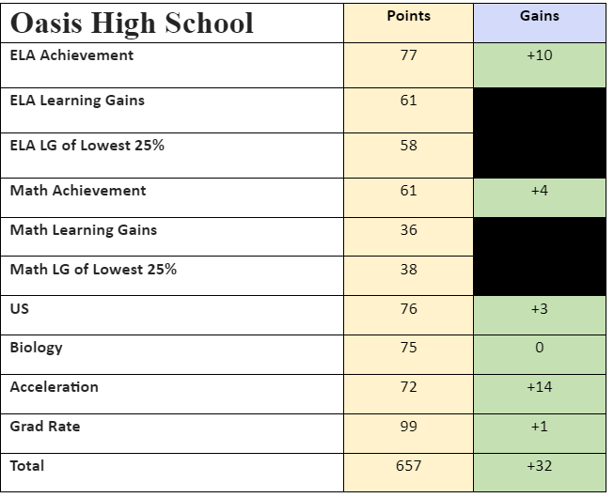
GOAL#1: Student Achievement
OASIS HIGH IS ONE OF ONLY TWO LEE COUNTY CHARTER HIGH SCHOOLS TO RECEIVE AN “A.”
GAIN: 32pts

Slide 44
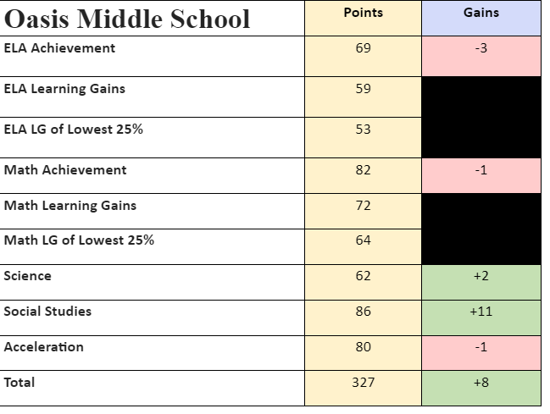
GOAL#1: Student Achievement
11th YEAR OASIS MIDDLE MADE
THE TOP GRADE
GAIN: 8pts

Slide 45
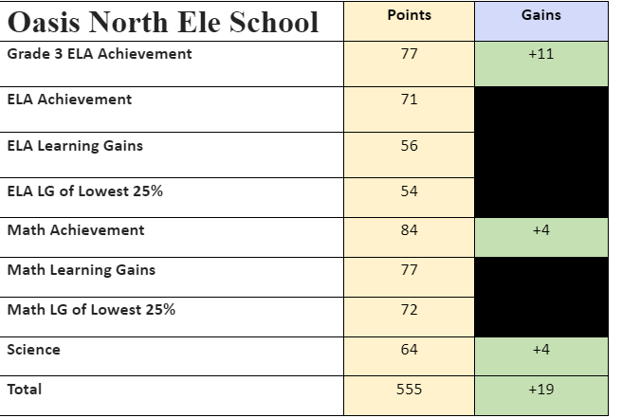
GOAL#1: Student Achievement
SCHOOL OF EXCELLENCE
GAIN: 19pts

Slide 46
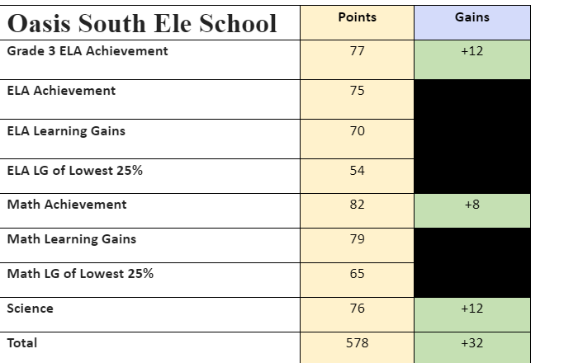
GOAL#1: Student Achievement
SCHOOL OF EXCELLENCE
GAIN: 32pts

Slide 47
STRATEGIC GOAL #1
STUDENT ACHIEVEMENT
Oasis Charter Schools will cultivate academic achievement using a rigorous and aligned curriculum that will provide all students the opportunity to master knowledge and
expand their learning

Slide 48
Academically what did we identify as needs
when developing our Strategic Plan?​
  Need for vertical alignment
  Desire to function academically as a system​
  Increased opportunities for College and Career exposure and skills
  Strategies for Increased Rigor​
  Integrate resiliency into basic curricular and instructional principals

Slide 49

WHAT IS
AVID?
A national program of professional educator strategies designed to support and assist all students to succeed in a college preparatory path and/or become workforce ready
Advancement Via Individual Determination
AVID LEARNING BENEFITS

Slide 50
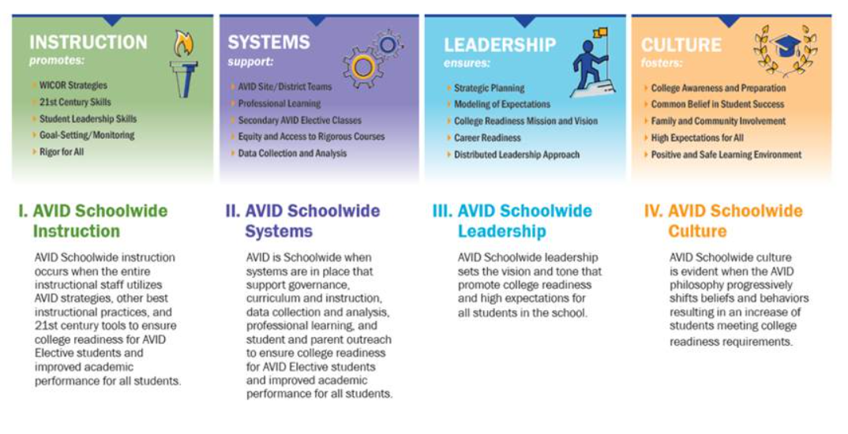
How do we go from “Good to GREAT” academically?
  Universal approach to teaching and learning as a system​
  Strategic focus on professional development​
  Commitment of minimum 3-5 years in staff development & implementation​
  Lazer Focus on Instruction, Systems, Leadership and Culture

Slide 51
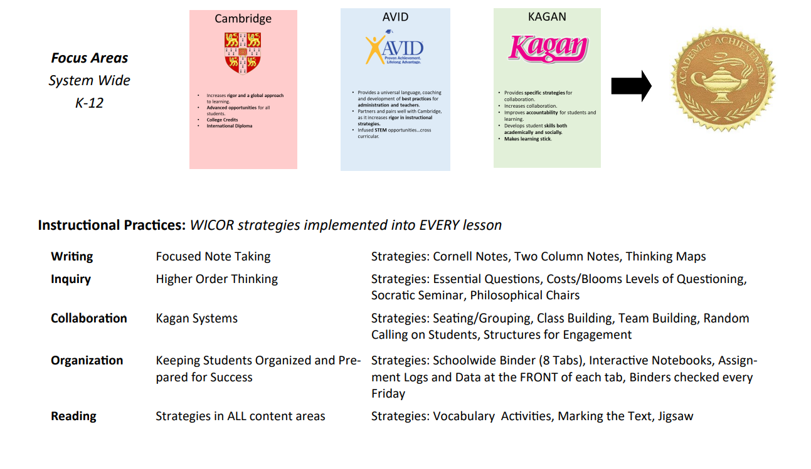

Slide 52
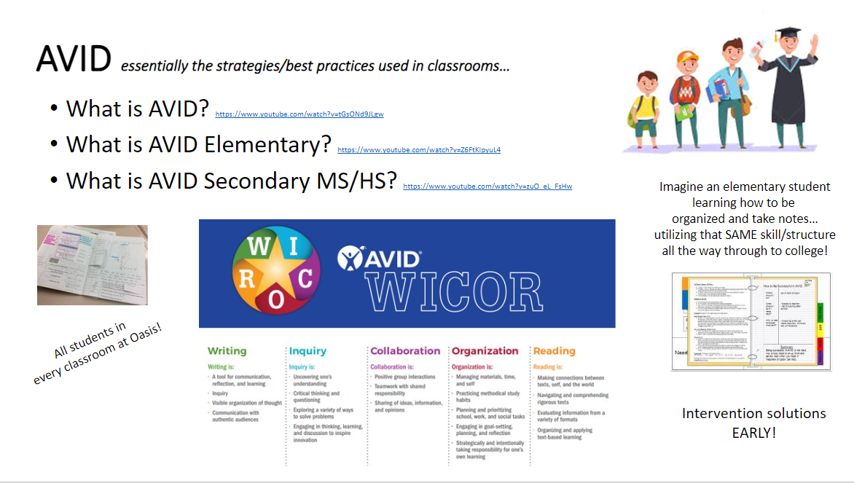

Slide 53
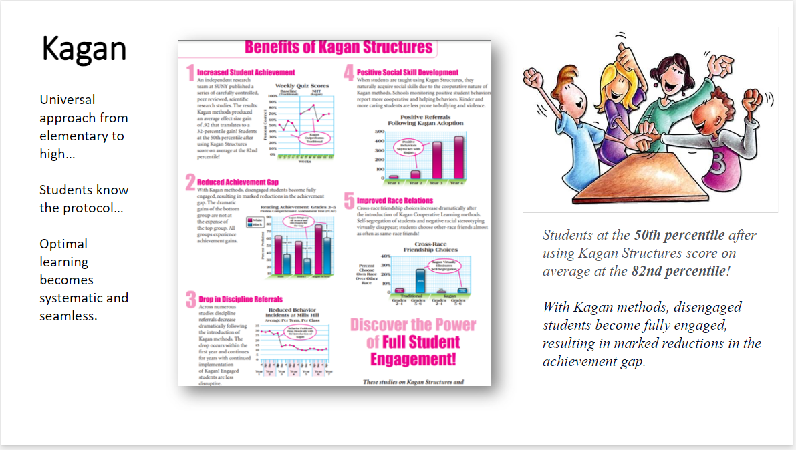

Slide 54
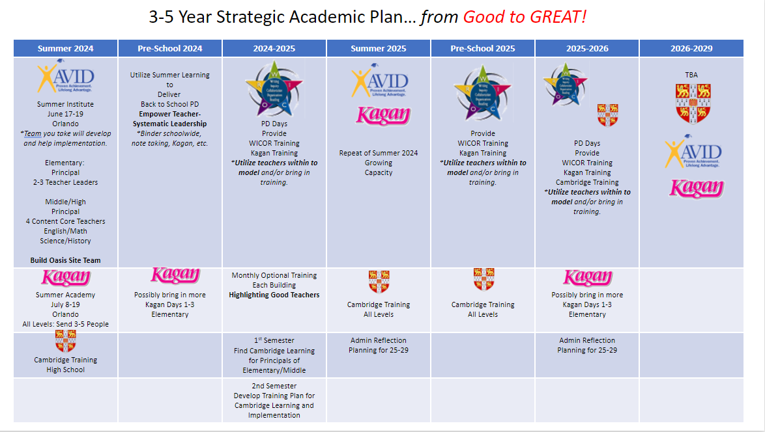

Slide 55

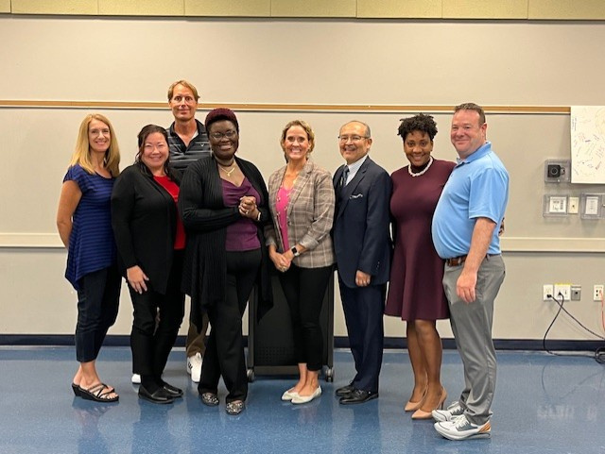

OUR GOVERNING BOARD
Board Members are appointed by City Council and serve two-year terms.
They are certified by Florida Charter School Governance Training.
Kristifer Jackson, Chair
CA
Mykisha Atisele
CA
Cathy Stout
CL
Keith Long, Disrict 6
PR
Jennifer Hoagland, PR/OHS
BC
Karen Michaels, Vice Chair
PR
Gregor Schade, PR/OMS
BC
PR
Jose Soto PR/OES
Dr. Guido Minaya
ED
Charles Pease
PR
Caroline Rouzeau, PR/OEN

Slide 56
Thank You!

