Slide 1

State
of the
Charter Schools
2025-2026

Slide 2

OUR VISION
OUR MISSION
Oasis Charter Schools believes that everyone can succeed in a nurturing and secure learning environment with support from diverse and meaningful community partnerships.
Our mission is to create a K-12 system that educates students to be responsible, critical thinkers who are prepared to successfully compete in a dynamic global workforce.

Slide 3
STATE OF THE SCHOOLS STRATEGIC GOALS FY25
01
02
03
STUDENT ACHIEVEMENT
COMMUNITY ENGAGEMENT
CONTINUOUS IMPROVEMENT

Slide 4
STRATEGIC GOAL #1
STUDENT ACHIEVEMENT
Oasis Charter Schools will cultivate academic achievement using a rigorous and aligned curriculum that will provide all students the opportunity to master knowledge and
expand their learning

Slide 5
STRATEGIC GOAL #1
STUDENT TEST DATA: Proficiency, Gains, Trends

Slide 6

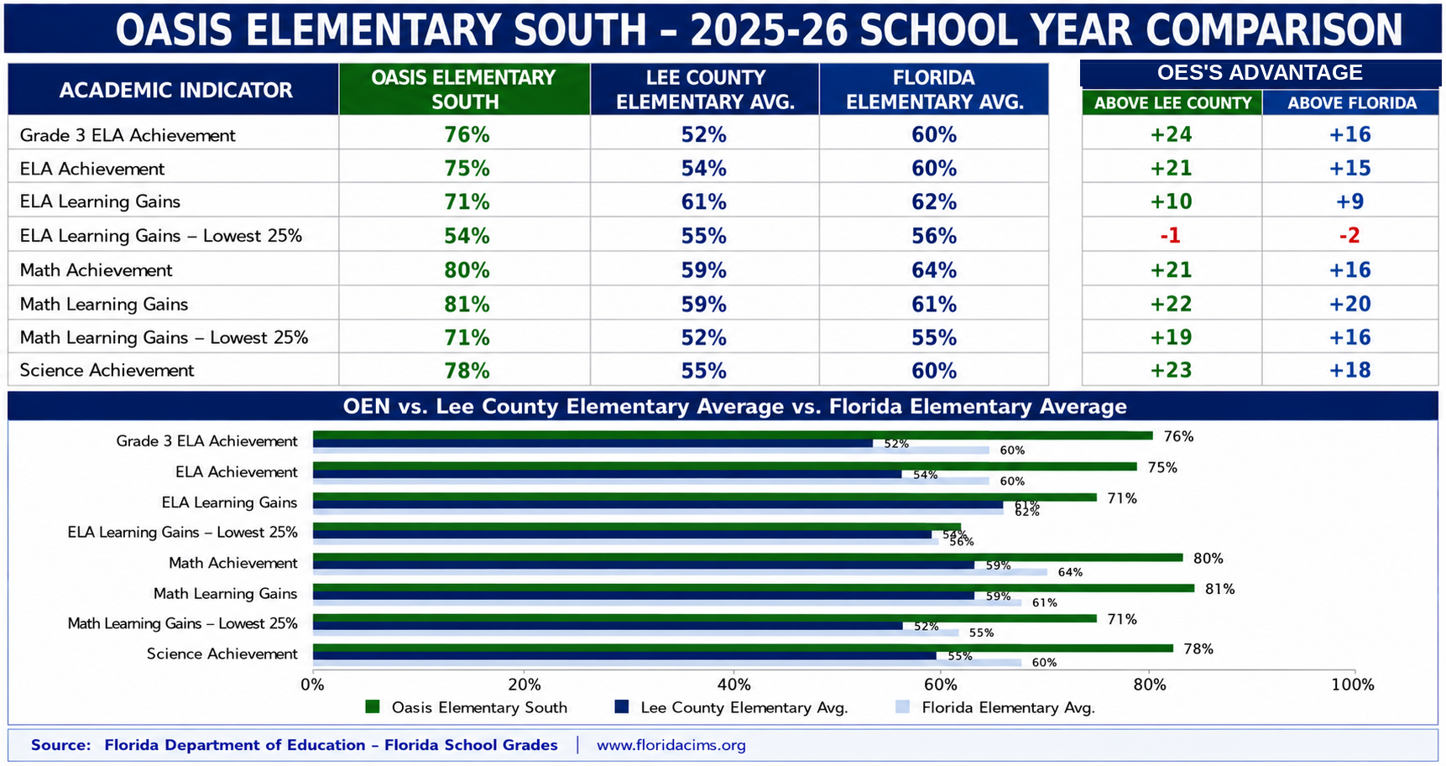
ELA/Math/Science Scores 2025 - 2026

Slide 7
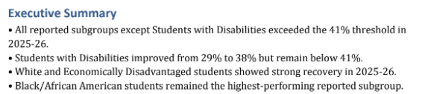
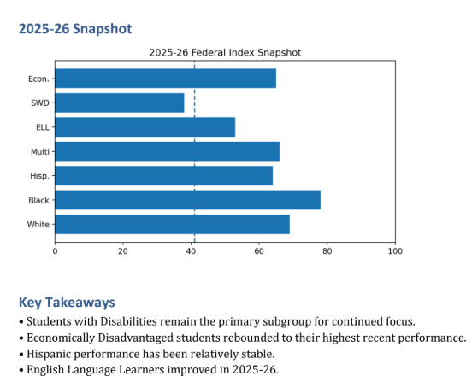
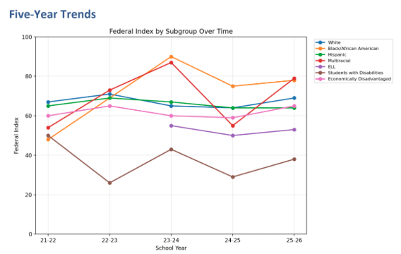
ESSA Subgroup Analysis FY22 – FY26

Slide 8

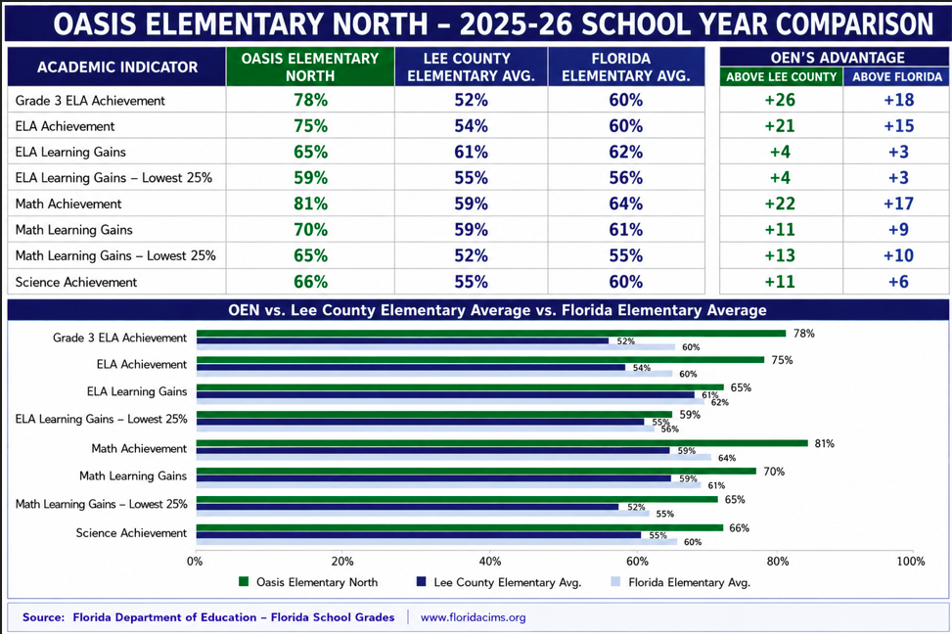
ELA/Math/Science Scores 2025 - 2026

Slide 9
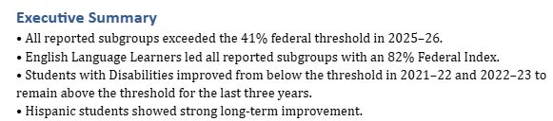
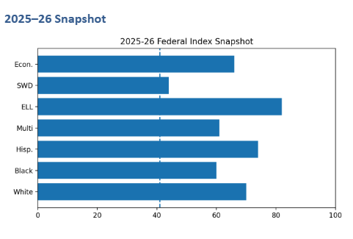
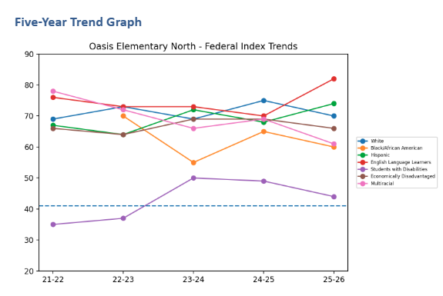
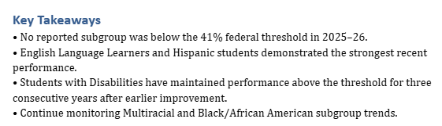
ESSA Subgroup Analysis FY22 – FY26

Slide 10

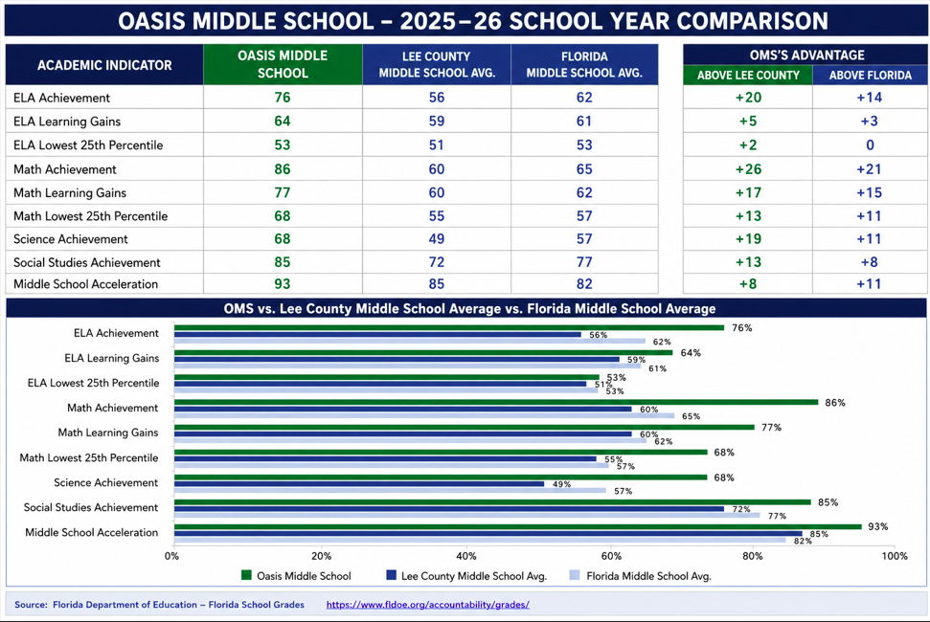
ELA/Math/Science/Social Studies
Scores 2025 - 2026

Slide 11
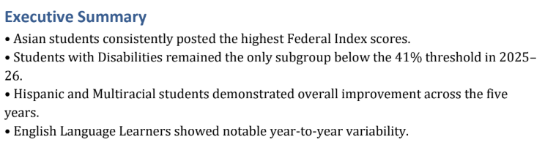
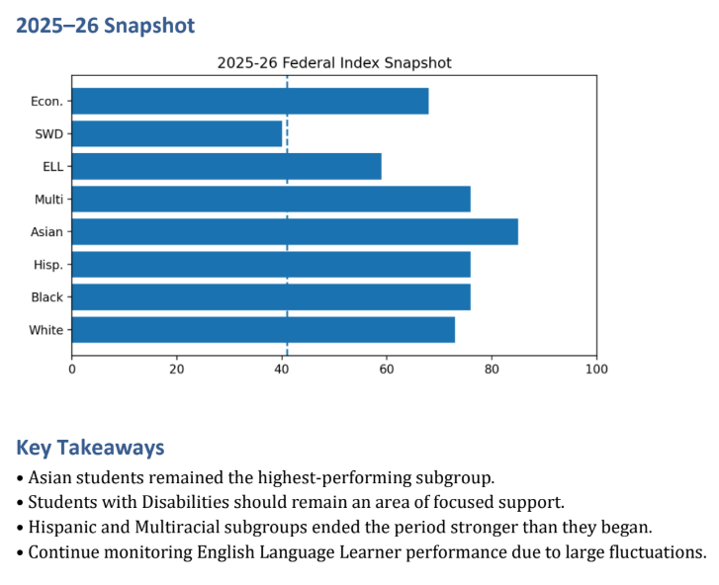
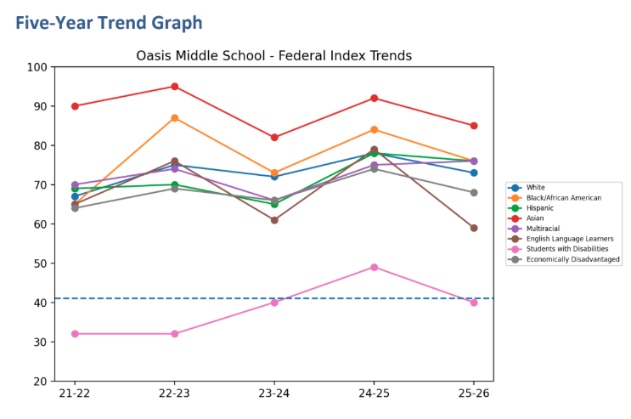
ESSA Subgroup Analysis FY22 – FY26

Slide 12

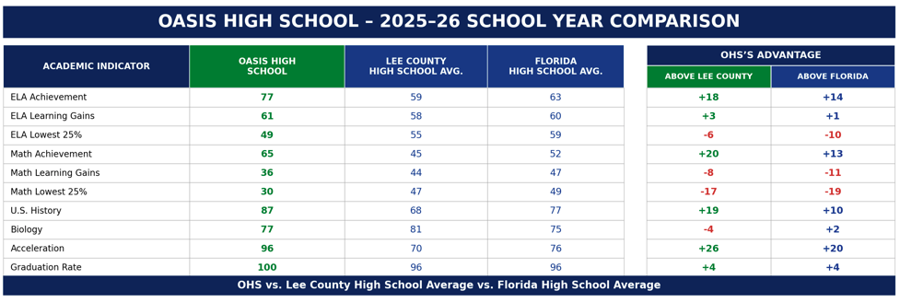
ELA/Math/History/Biology Scores 2025 - 2026

Slide 13
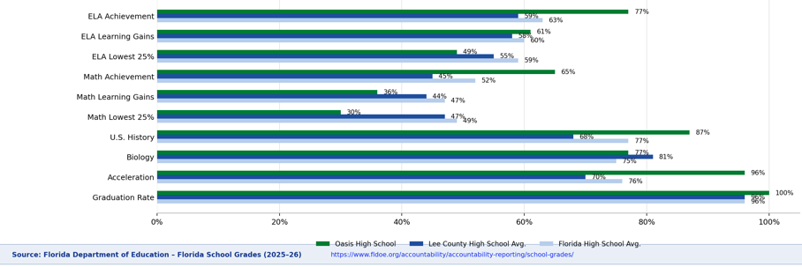
ELA/Math/History/Biology Scores 2025 - 2026

Slide 14
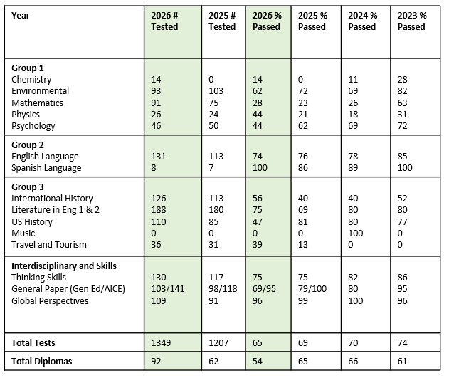
Cambridge Testing Highlights 2025 - 2026

Slide 15

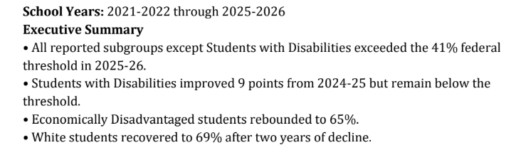
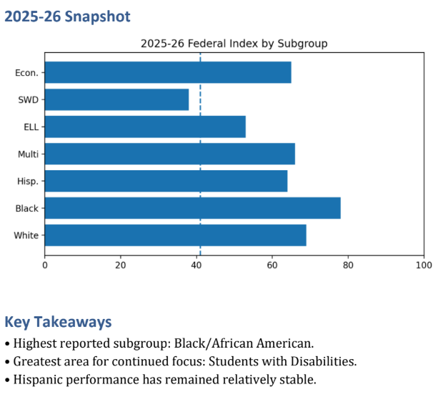
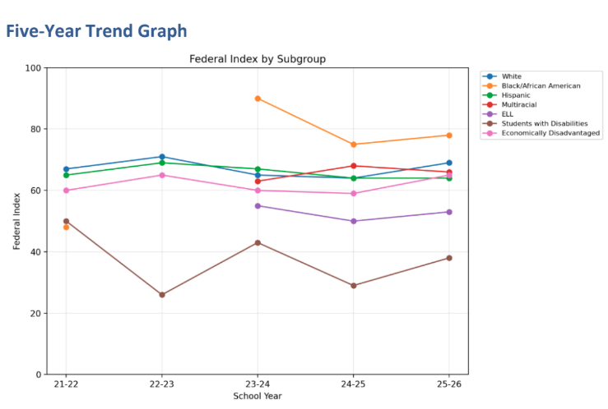
Subgroup Analysis 2025 - 2026

Slide 16
STRATEGIC GOAL #1
1.1 Align K-12 Measurable Curriculum
1.2 Provide Innovative Curriculum to promote high academic performance
1.3 Integrate Resilience learning
1.4 Develop Professional Teaching Corps

Slide 17
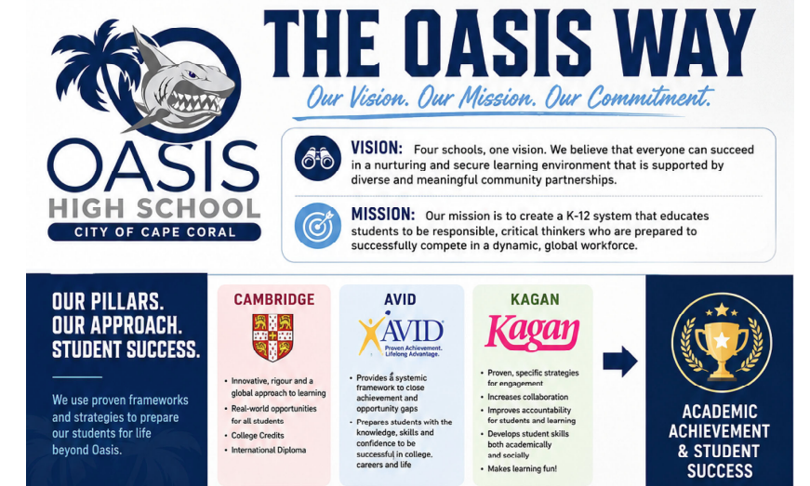

Slide 18
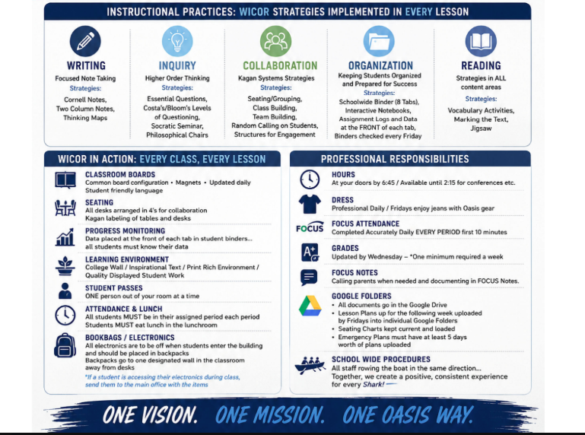

Slide 19
Danielson Evaluation Model
Danielson Evaluation model focuses on exceptional teaching beginning with intentional planning, purposeful instruction meaningful assessment and strong relationships. This framework recognizes that strong teacher-student relationships are foundational to effective instruction and student achievement.
Domains 2 and 3 Focus On Building Strong Relationships:
Domain 2a – Creating an Environment of Respect and Rapport
Domain 2d – Managing Student Behavior
Domain 3a – Communicating with Students
Domain 3b – Using Questioning and Discussion Techniques
Current research shows that positive teacher-student relationships are associated with improved academic achievement, stronger student engagement, better attendance, and fewer behavioral issues.
AVID/WICOR strategies are integrated into these domains.

Slide 20
STRATEGIC GOAL #2
CONTINUOUS IMPROVEMENT
Oasis Charter Schools will identify, recruit and retain high caliber educators by offering a competitive salary, shared educator values and opportunities for professional development

Slide 21
STRATEGIC GOAL #2
2.1 Recruit and Retain Qualified Staff
2.2 Educator Development

Slide 22
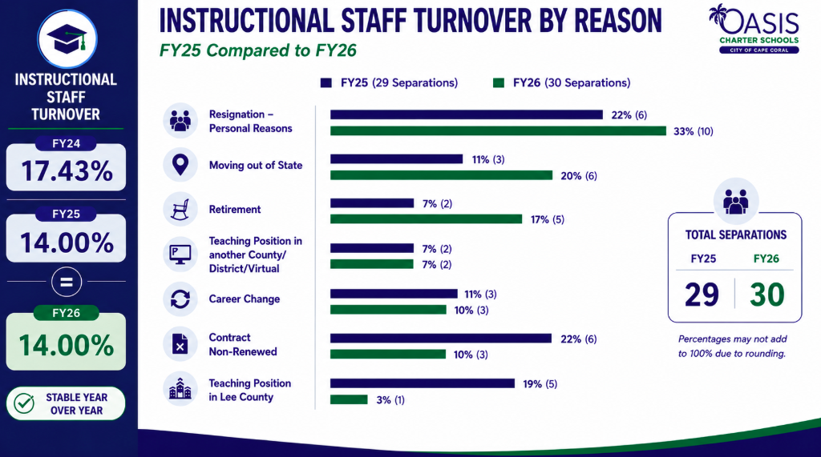

Slide 23
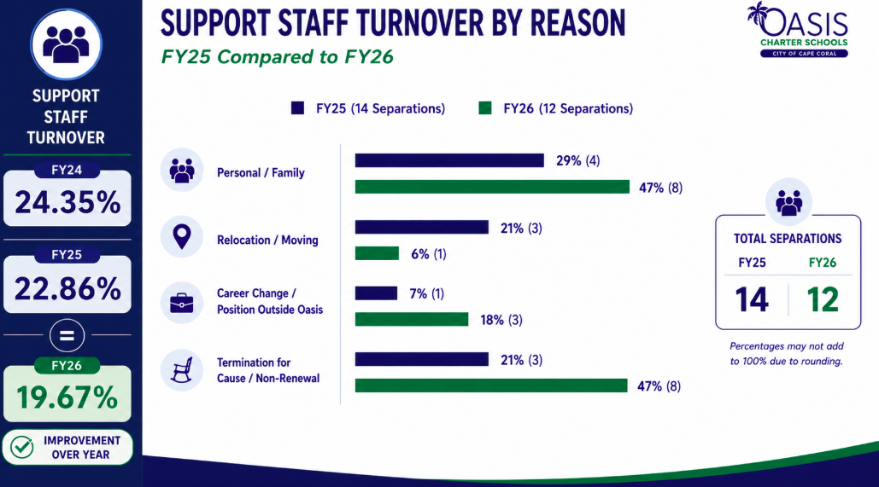

Slide 24
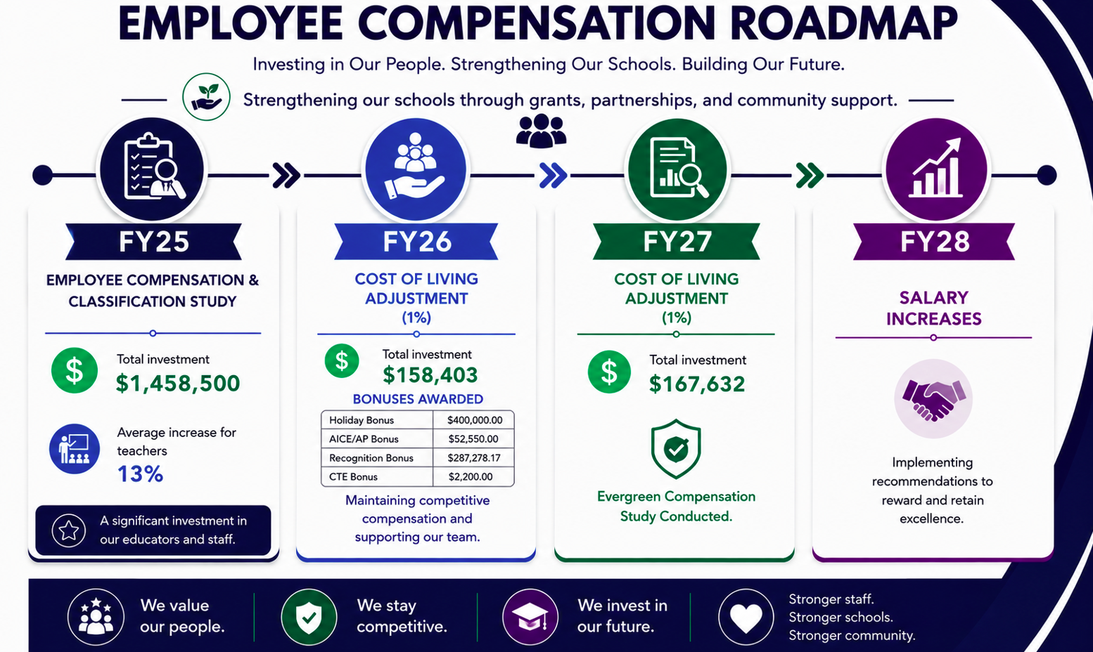

Slide 25
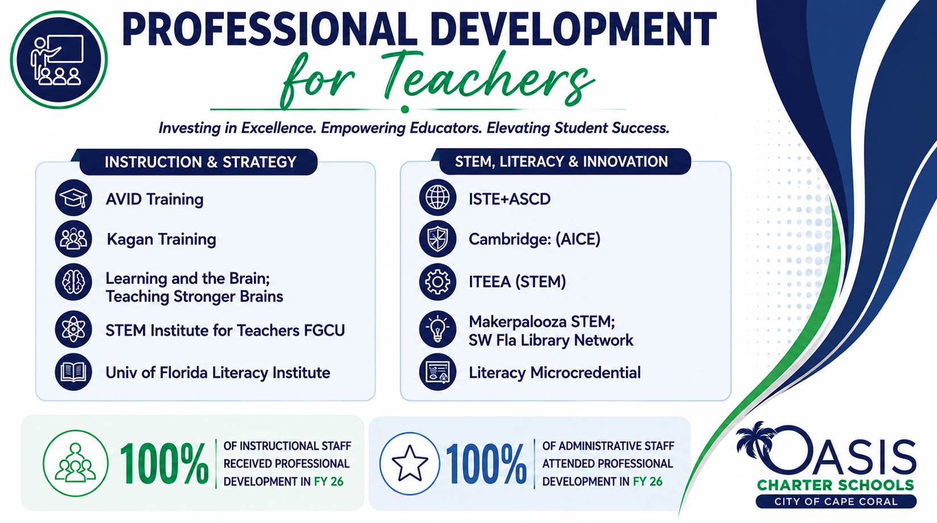

Slide 26
STRATEGIC GOAL #2
2.3 Refine Educator Evaluation Process
2.4 Develop Workforce Pathways

Slide 27
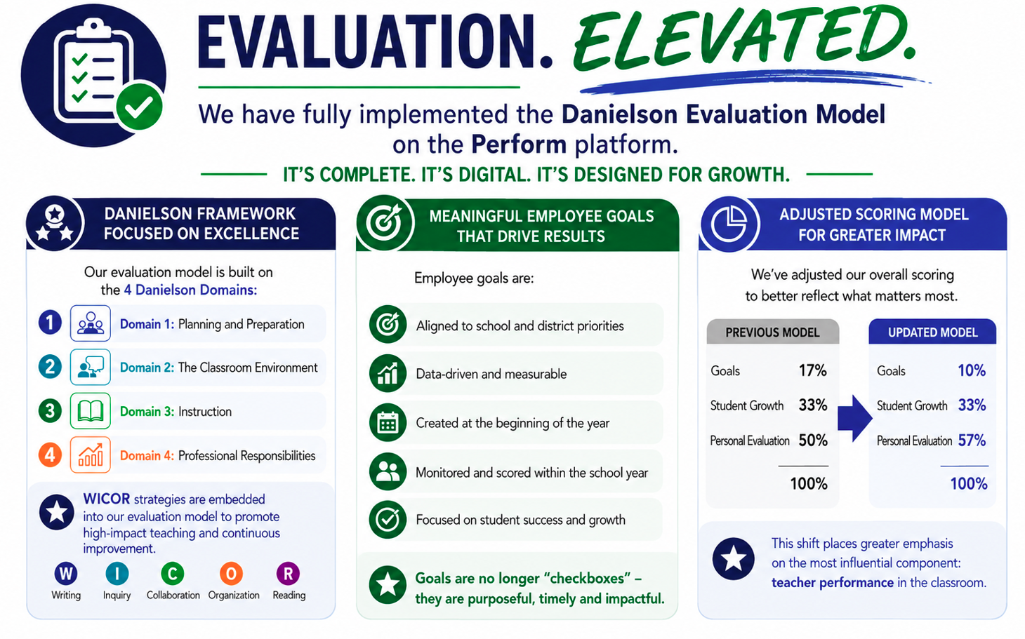

Slide 28
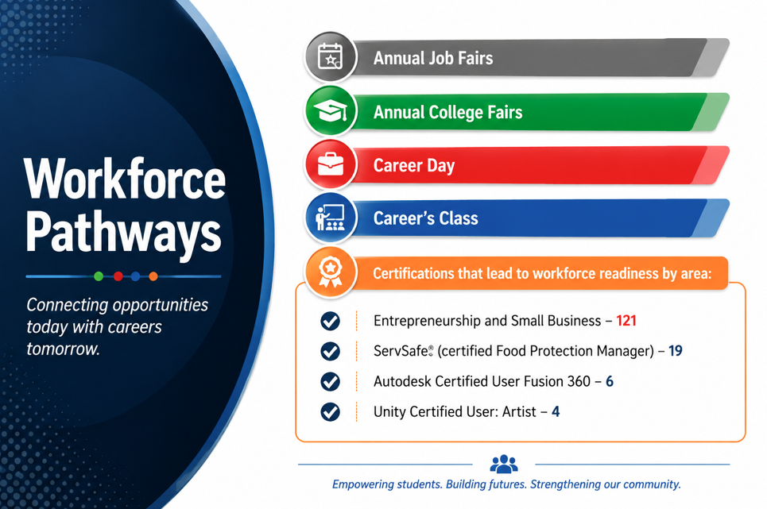

Slide 29
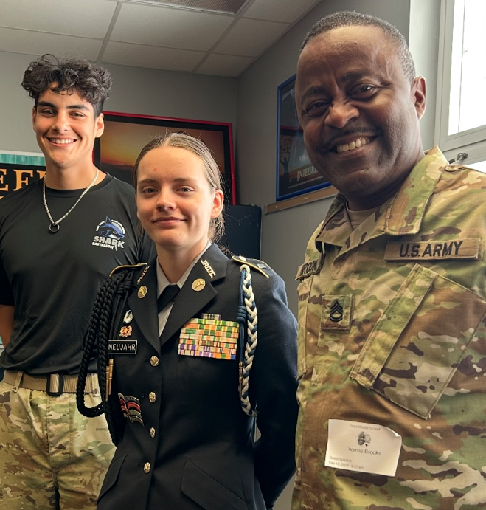
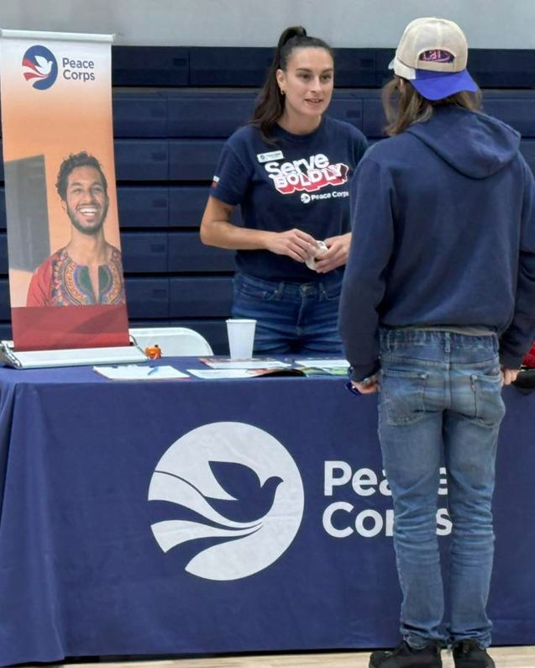
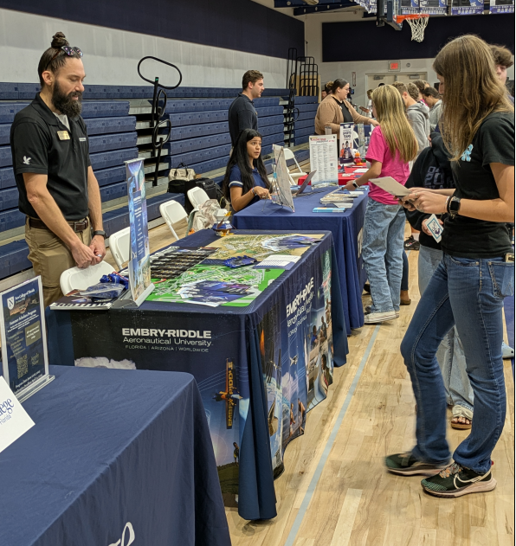
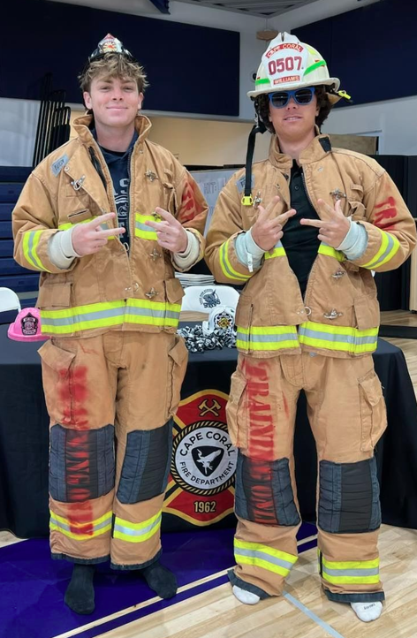
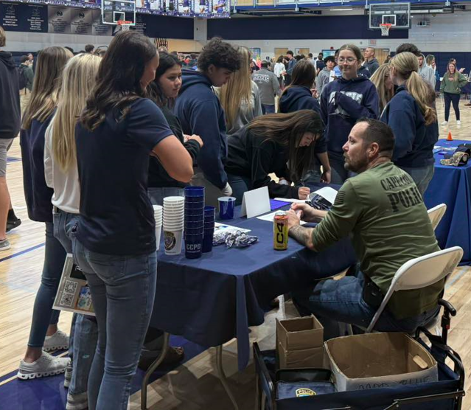
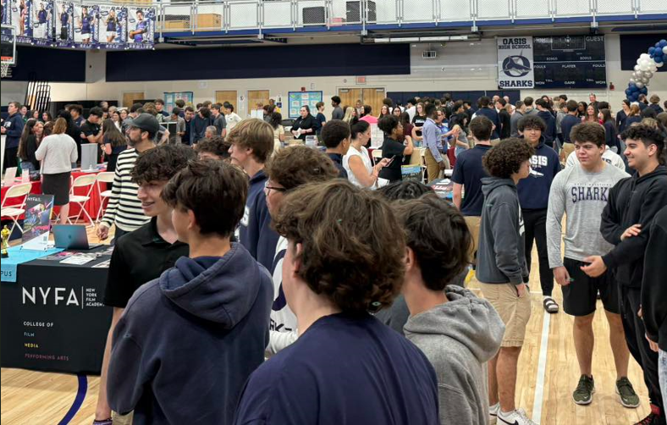
Work force pathways

Slide 30
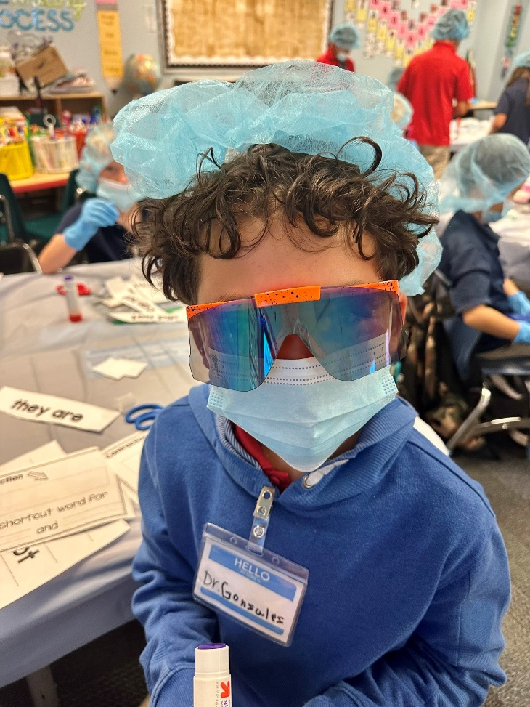
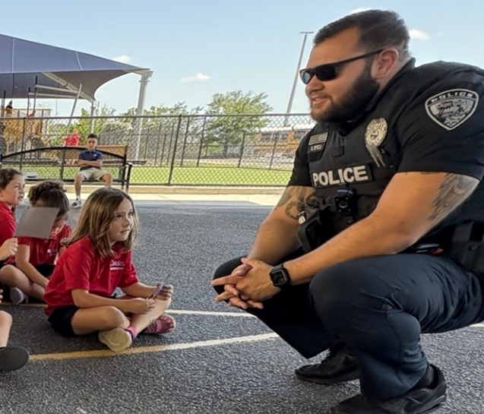
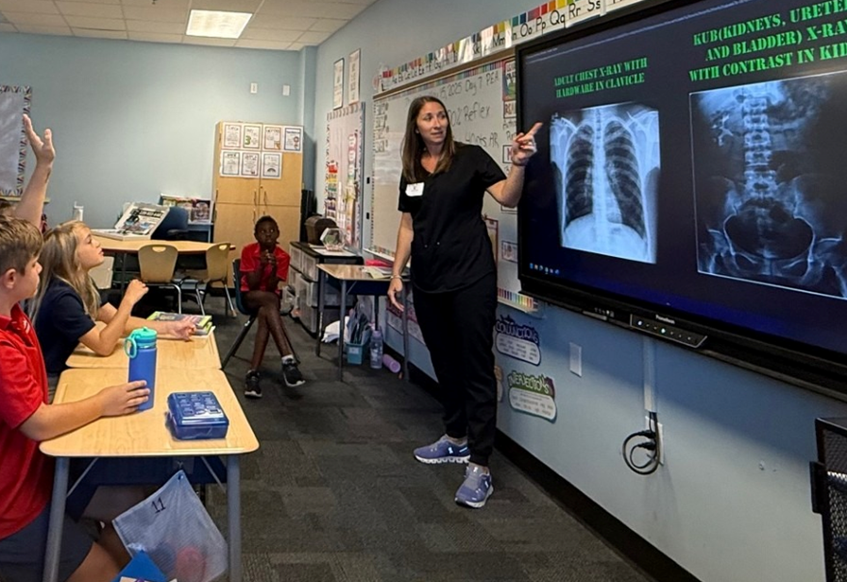
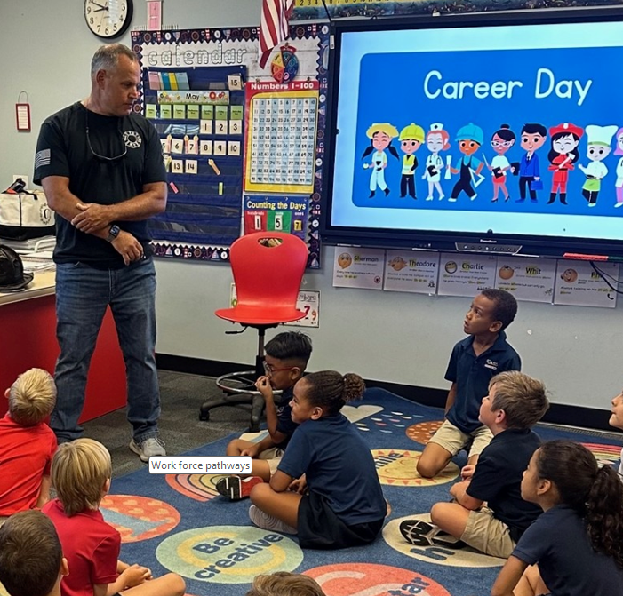
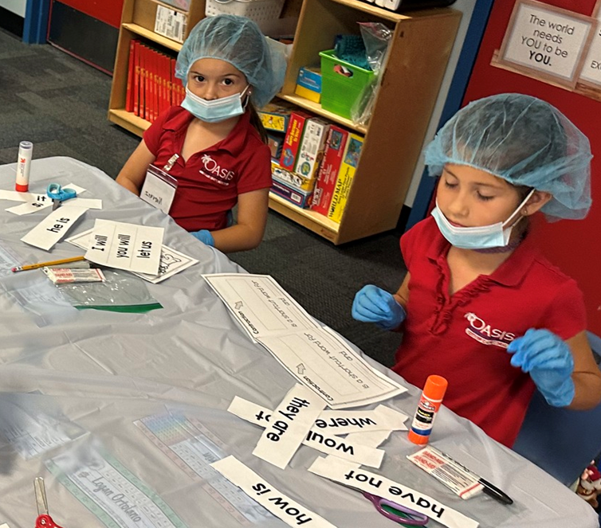
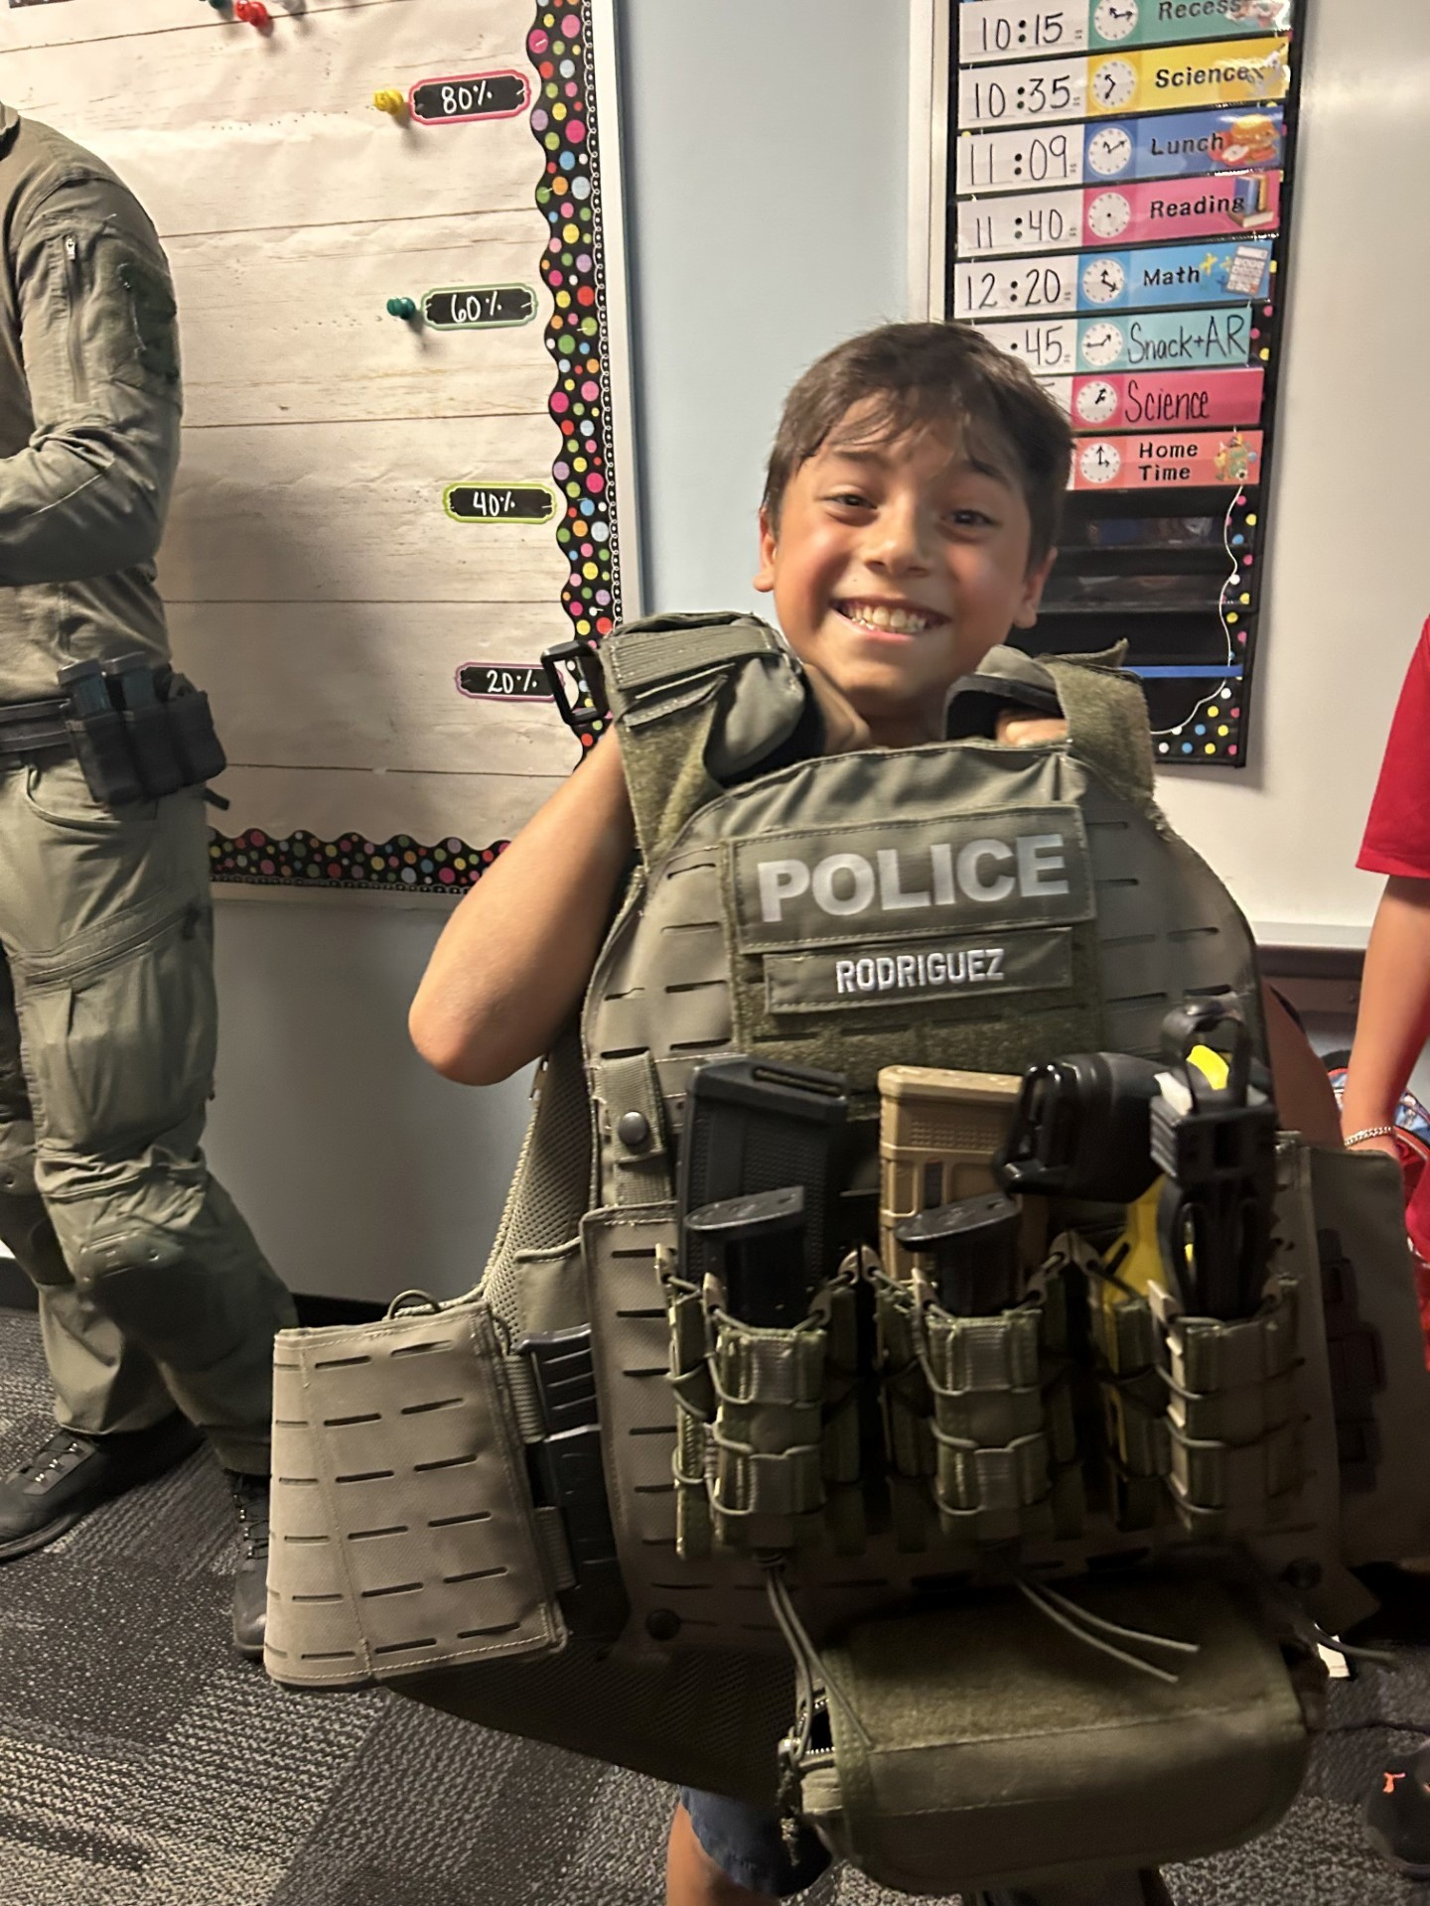
Work force pathways

Slide 31
STRATEGIC GOAL #3
COMMUNITY ENGAGEMENT
Oasis Charter Schools will nurture alliances with community partners who share the same vision, mission and commitment to the community at large.

Slide 32
STRATEGIC GOAL #3
3.1 Brand Expansion
3.2 Cultivate Economic Allies
3.3 Increase Parent Involvement Support
3.4 Develop Funding Support

Slide 33
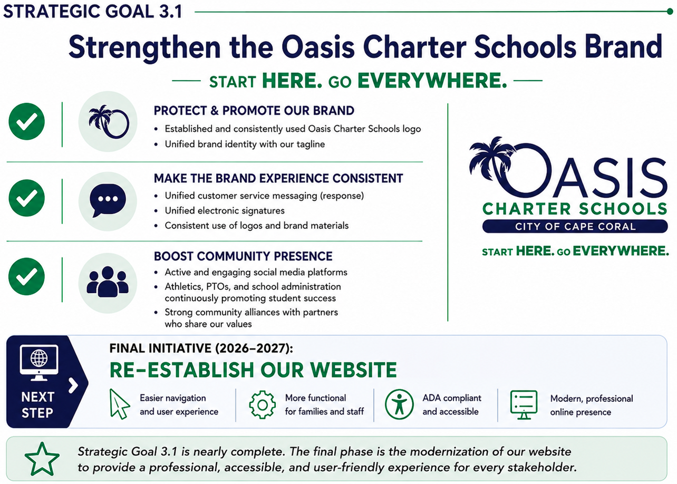

Slide 34
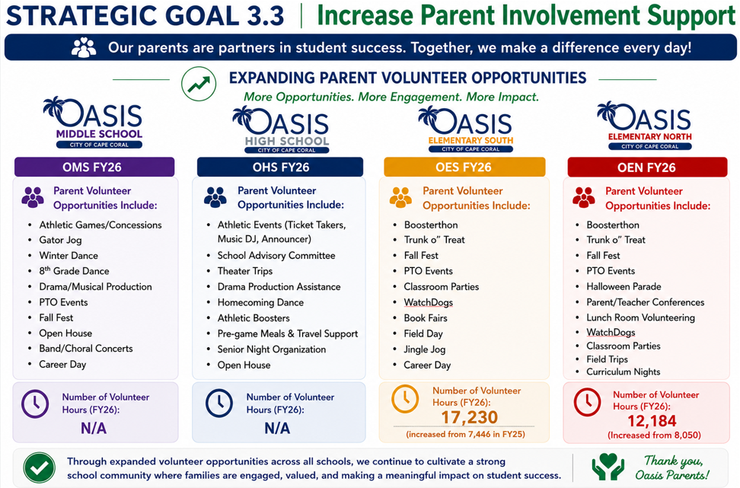

Slide 35
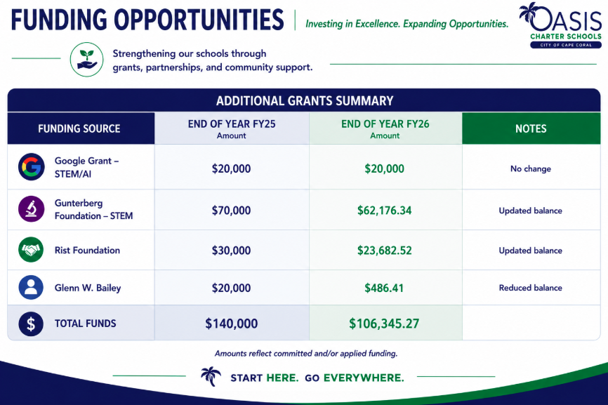

Slide 36
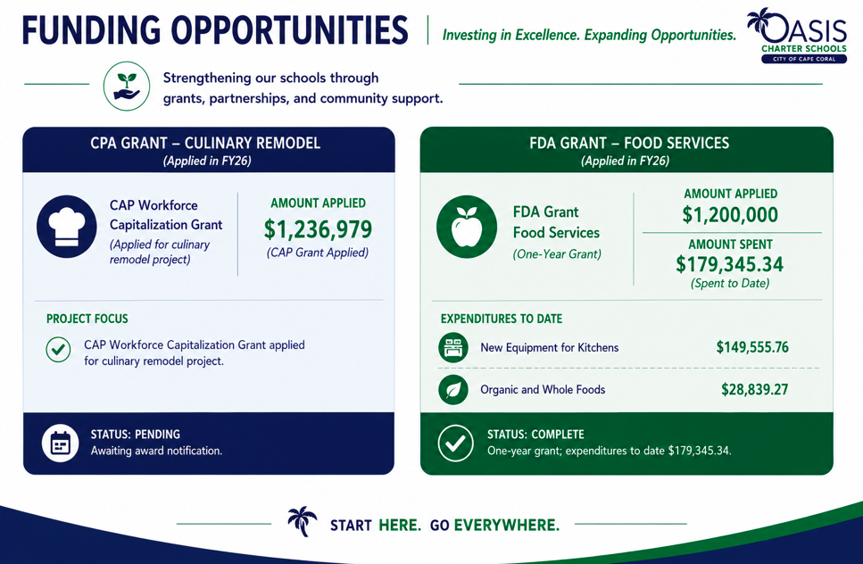

Slide 37
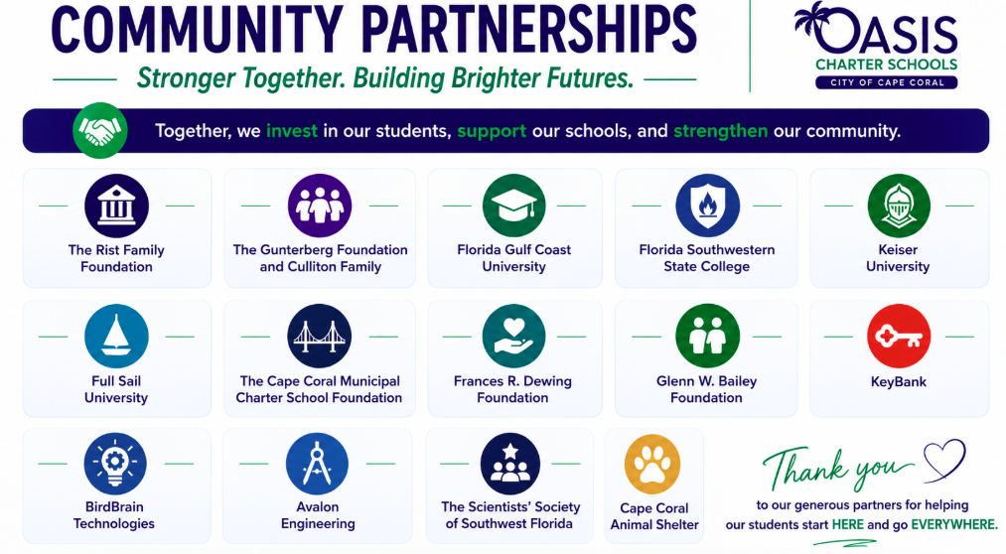

Slide 38

OUR GOVERNING BOARD
Board Members are appointed by City Council and serve two-year terms.
They are certified by Florida Charter School Governance Training.
Kristifer Jackson, Chair
CA
Mykisha Atisele
CA
Jay Santos
CL
Joseph Kilrane, District 5
PR
Micela Hueglin PR/OHS
BC
Karen Michaels, Vice Chair
PR
Gregor Schade, PR/OMS
BC
PR
Brittiny Gibson PR/OES
TBD
ED
Sara Katine
PR
Caroline Rouzeau, PR/OEN

Slide 39
Thank You!

