Slide 1
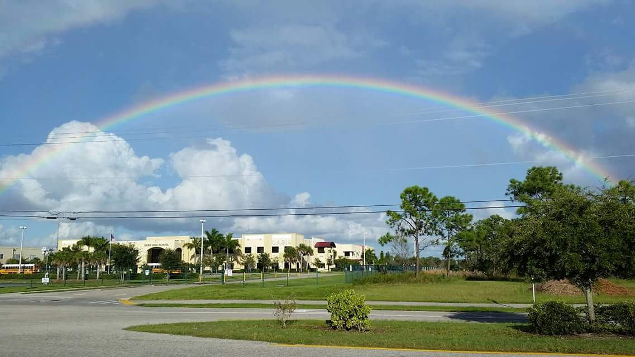

Budget Workshop No. 1
May 9, 2023

Slide 2
Agenda
Overview of Budget Process
Enrollment Projections
Budget Overview
Summary By School
Revenues
Staffing Changes
Expenditures
Open Discussion/ Conclusion

Slide 3

Budget Process
December
Budget Kick-Off
Budget Guidelines and Capital Asset Plans
Released to Schools
June
Tentative Budget Presented
For Governing Board Approval
July
Additional Adjustments
Are Made as Actual Results
Are Recieved
August
Final tentative Budget Is
Presented for Governing Board
Approval and Incorporated Into the City of Cape Coral Budgets for Public Hearings and Final Adoption in September
January- February
Capital Asset Plans Due
Budget Projections are
Released to
Schools
March
Operating Projections Close
Submissions are Reviewed by Budget
Meetings are Held With
Superintendent
May
Budget Workshop No. 1 Held
With Governing Board
May
Adjustments Made
Budget Workshop No. 2 Held
September/October
Annual Strategic Planning Session
Start

Slide 4
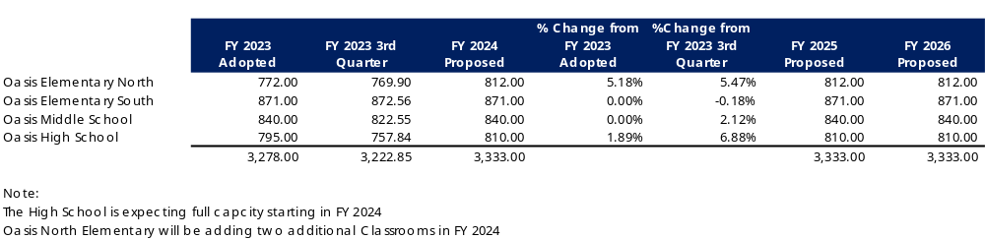
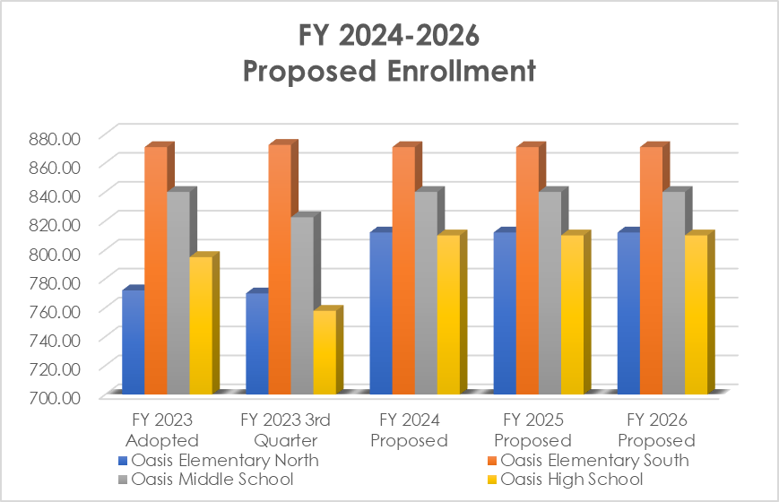
Enrollment Forecast
Notes:
May require more than one slide

Slide 5
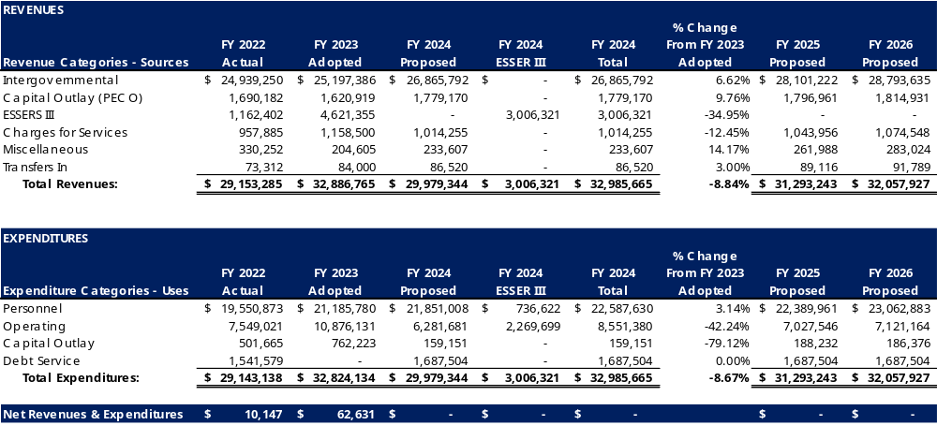
Budget Overview
Notes:
May require more than one slide

Slide 6
Budget Overview by School
FY 2024
Revenues | Oasis South Elementary | Oasis North Elementary | Oasis Middle | Oasis High | Total
Intergovernmental | $ 7,077,154 | $ 6,634,578 | $ 6,479,904 | $ 6,674,156 | $ 26,865,792
Capital Outlay (PECO) | 480,919 | 424,398 | 461,766 | 412,087 | 1,779,170
ESSERS III | 988,455 | 769,160 | 630,973 | 617,733 | 3,006,321
Charges for Services | 255,420 | 210,870 | 281,160 | 266,805 | 1,014,255
Miscellaneous | 66,972 | 74,648 | 52,969 | 39,018 | 233,607
Transfers In | 41,200 | 14,420 | 20,600 | 10,300 | 86,520
Total Revenues | $ 8,910,120 | $ 8,128,074 | $ 7,927,372 | $ 8,020,099 | $ 32,985,665
Expenditures
Personnel Services | $ 5,875,626 | $ 5,783,973 | $ 5,487,785 | $ 5,440,246 | $ 22,587,630
Operating | 2,115,259 | 1,955,731 | 2,130,771 | 2,349,619 | 8,551,380
Capital Outlay | 44,869 | 38,094 | 38,094 | 38,094 | 159,151
Debt Service | 400,276 | 390,076 | 417,226 | 479,926 | 1,687,504
Total Expenditures | $ 8,436,030 | $ 8,167,874 | $ 8,073,876 | $ 8,307,885 | $ 32,985,665
Notes:
May require more than one slide

Slide 7
Revenues
Budgeted at 99%
Adjusted based on the Legislative Session that concluded on May 5, 2023
Florida Education Finance Program (FEFP) projections will increase $405 on average per student to $8,648. Highest amount of per-student funding in Florida history. Note that the funding per school varies.
Capital Outlay (Public Education Capital Outlay – PECO) level funded
Grants – not budgeted
  Title IV, Title II & TAPS
Other
  E-Rate Award of $345,000 to be spent over the next 3 years. Working with City IT to identify needs.
  Teacher Salary Allocation – still unknown; potential for $800 million. Proposed $200 million increase in FY 2023-2024 to continue raising for the fourth year in a row.

Slide 8

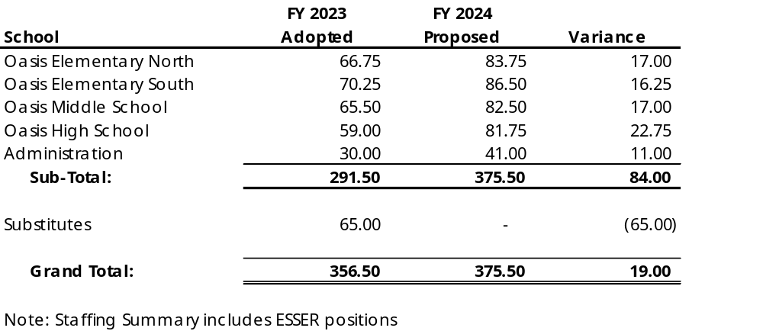
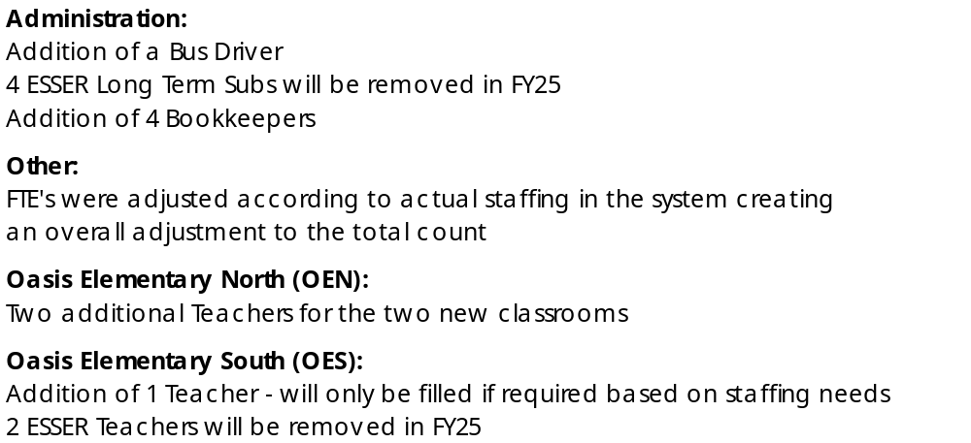
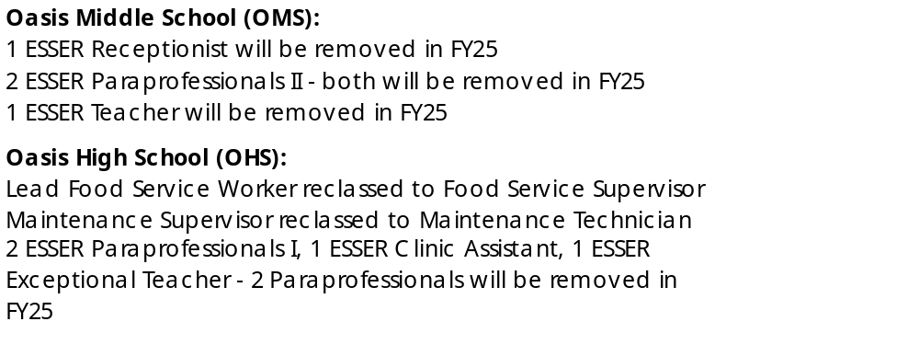
Staffing Changes
Notes:
May require more than one slide

Slide 9
Personnel
Comprises of base payroll, add pays, health plans, FRS and workers’ compensation
Health plans budgeted at current rates; increased by 10%
Workers Comp rates at current rates
Florida Retirement System (FRS) from 10.19% to 10.86%
Includes a 1% increase for staff and compression for the paraprofessionals/assistant principals
Includes the addition of 4 bookkeeper positions
$50,000 per school for employee recognition bonus
Notes:
May require more than one slide

Slide 10
Operating
Textbooks $593,801
Technology $280,466
Licenses for Miraki wireless access points - $30,000, Nutanix -$30,000 and Firewall maintenance -$30,000 (50% covered by erate)
Marketing/Advertising/Recruitment (Strategic Planning per Charter School) $13,750
Training & Seminars - $142,729
Notes:
May require more than one slide

Slide 11
Capital Outlay
Two door freezer for OES - $6,775
Camera System Upgrade - $130,000
Centegix equipment - $16,376
Synology - $6,000

Slide 12
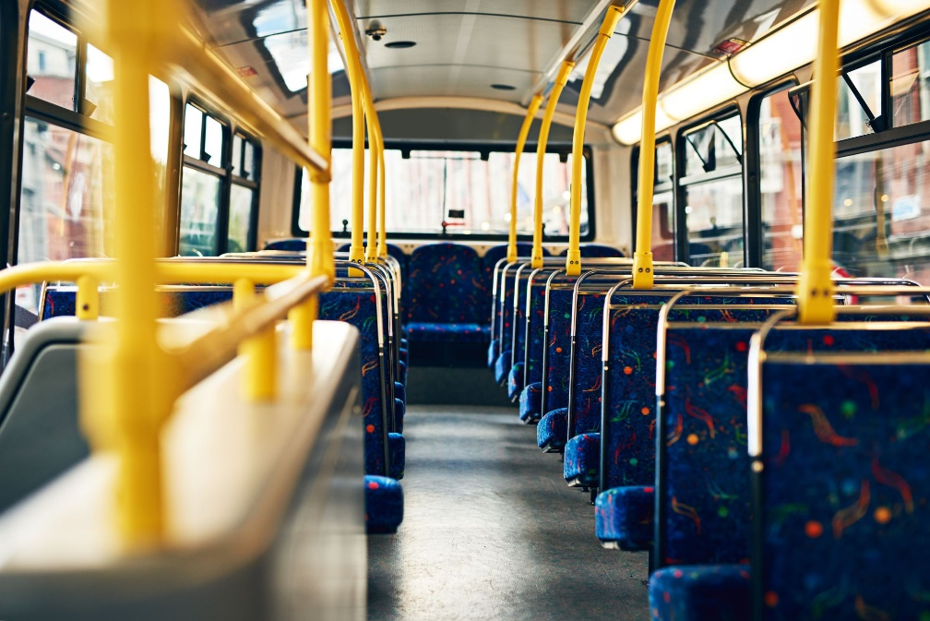
Leases
Budgeted at $1,687,504
  Bus Leases - $187,504 per year
  Building Lease - $1,500,000 per year

Slide 13
Conclusion
In conclusion, the FY 2024 Proposed Operating budget is presented at $32,985,665 which reflects an increase of 0.30% over the FY 2023 Adopted Operating Budget of $32,886,765.
The Final tentative budget will be presented in August 2023 for approval by the Charter School Authority Governing Board and incorporated into the City of Cape Coral Public Hearings for final approval in September 2023.
Questions???

